Slide 1
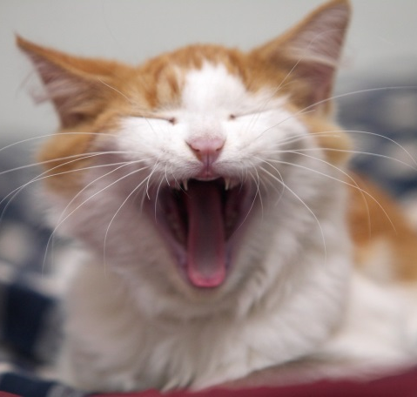
What’s all the fuss about CAFAS?
Child and Adolescent Functioning Assessment Scale
Natalie McCluggage, MA, LPAT, LPA

Slide 2

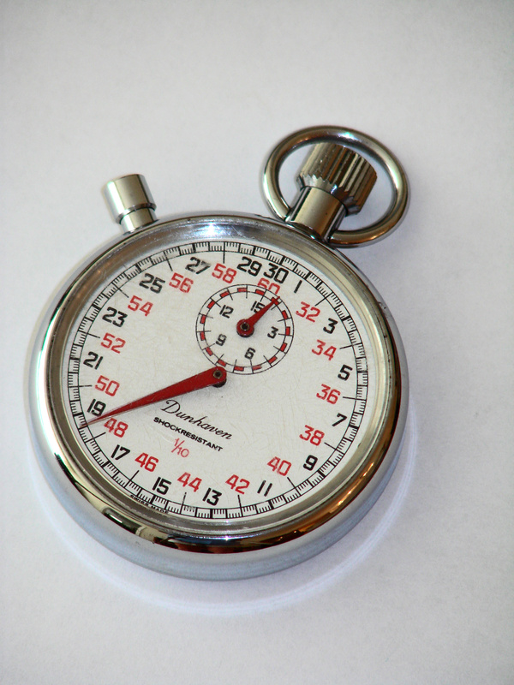


Where do you stand?
Notes:
Who has used assessment scales in their work?

Slide 3
Annoying?
Notes:
How many people think that using assessment scales and gathering data is annoying? (monster)

Slide 4

Fun!!
Notes:
Anyone out there think that using assessments are fun? (giggle girl)

Slide 5
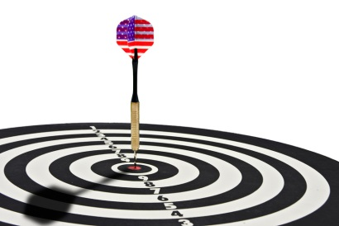
Training Objective
Introduce the Child and Adolescents Functioning Assessment Scale (CAFAS)
Explain what it is and demonstrate it with a case example.
Discuss how this tool may add to therapy and outcome measurement.
Notes:
Hopefully this training will appeal to you whether you like assessments or not and will leave you with a better understanding of how we can use it to enhance our treatment with our clients

Slide 6

Who Says?
MCOs
Quality Assurance
Track what works
Notes:
Who says we have to have objective data and measure treatment outcomes? (who says book)

Slide 7
What is it?
The CAFAS is a comprehensive, objective measure of children and adolescents’ functioning levels:
School
Self-harmful
Home
Substance Use
Community
Thinking
Behavior- Others
Material Needs
Moods/Emotions
Family/Social
Notes:
School/Work- ability to function in a group educational setting
Home- extent that the youth follows rules and does age-appropriate tasks
Community- respect for rights of others and conforming to law
Behavior Towards Others- appropriateness of youth’s behavior towards others
Moods/Emotions- modulation of the youth’s emotional life
Self-Harmful Behavior- ability of youth to cope without using self-harm behavior or verbalizations
Substance Use- substance use and extent
Thinking- ability of youth to use rational thought process
Material Needs- extent to which caregiver provides for the youth’s material needs
Family/Social- extent to which the caregiver provides a home setting that is free of known risk factors or in providing for youth’s developmental needs
Child and Adolescent Functional Assessment Scale (CAFAS)
is widely used to assess the needs of youth who require services across systems of care, and evaluate outcomes for programs, Evidence-based treatments and Evidence Informed Practices.
Over twenty years of research and 80 published articles provide evidence of reliability and validity of the measure.
CAFAS scores have been found to:
• Correlate with actual intensity of treatment, involvement with juvenile justice, school related problems and child and family risk factors.
• Predict restrictiveness of care, total cost of all services received, number of bed days and number of days of service six and twelve months post-intake.
• Predict future contact with the law and poor school attendance.

Slide 8
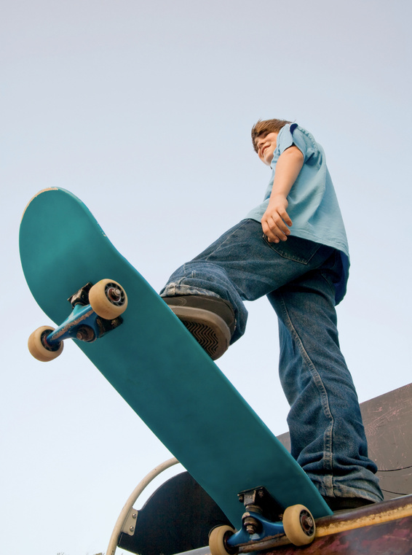
Target Population
Developed for SED children and adolescents who require interventions across multiple domains/systems.
Age range: 5 -19

Slide 9
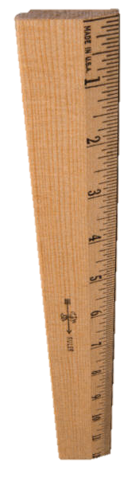
Score!!!
Overall Functioning Level score
Subscale Functioning scores
CAFAS Levels of Impairment
Severe Impairment (30): Severe disruption or incapacitation
Moderate Impairment (20): Major or persistent disruption
Mild Impairment (10): Significant problems or distress
Minimal/No Impairment (0): No disruption in functioning

Slide 10
Level of Care
CAFAS Total Level of Care
0-30 Likely referred to qualified health professional (non- SED)
40-70 Likely receives outpatient services
80-100 Likely receives outpatient care with additional intensive/supportive services
110-130 Likely receives intensive, community-based services, some may require acute residential
>= 140 Very intensive services: residential/in-patient

Slide 11


Scores, strengths, goals, oh my...
The functioning scores correspond with:
  Level of care
  Treatment goals
  Clients’ strengths.
Allows matching care with functioning level and client strengths.
Can measure
before, during, and
after treatment to
track progress.

Slide 12

Administration
Practitioners rate clients on each subscale by marking the behavioral descriptions that match the client’s functioning level, based on biopsychosocial/history.
Each provider will be given a login to access an online data base to complete the assessment and track progress.

Slide 13

Why we like it
Notes:
Before we get into how we do it, could you tell me some benefits of using an assessment that measures functioning in multiple domains?

Slide 14
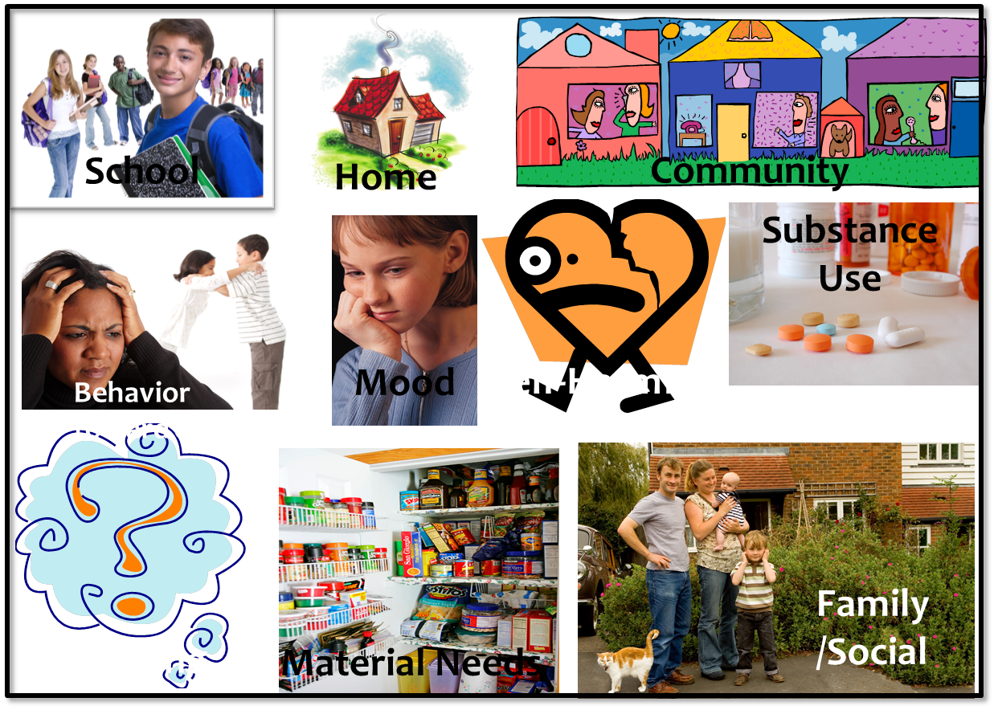
Whole picture

Slide 15


Meets our clients’ needs
  -assessing multiple domains,
  -applies to different diagnoses
Meets our providers’ needs
  - spans across theoretical approaches
Notes:
Applies to our clients by assessing all areas of functioning
It spans across theoretical approaches
Can match treatment goals with functioning levels and strengths
Provides Before and After-treatment information
Enables monitoring treatment progress
Organizes the data

Slide 16
Can match treatment goals with functioning levels and strengths
What is the benefit of being able to give the assessment before, during, and after treatment?
Functioning Level
Strengths
Goals
Notes:
Produce treatment plan directly from the assessment.
(3d)

Slide 17
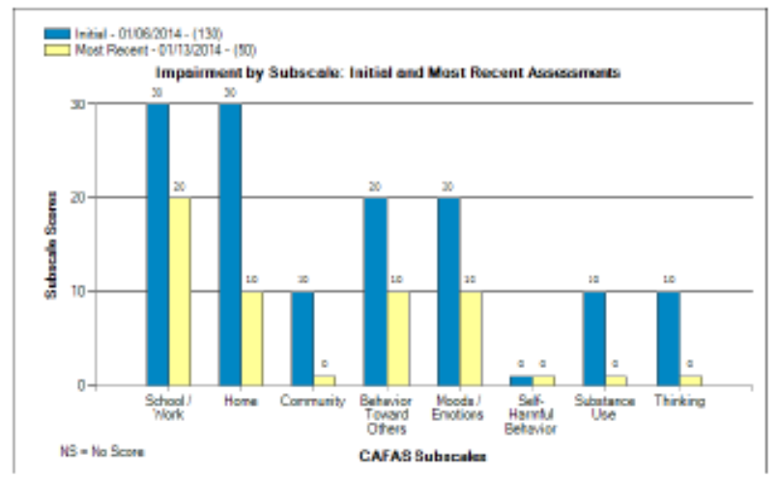
Provides Before and After-treatment information
Enables monitoring treatment progress
Organizes data

Slide 18
HOW?
8 Youth Scales
2 Caregiver Scales
Notes:
Group provide a total score (scale), what level of care, and treatment goals might provide (matching)
Review computer display
https://app2.fasoutcomes.com/Login.aspx
What does the pre/post chart tell you? (lolly)

Slide 19
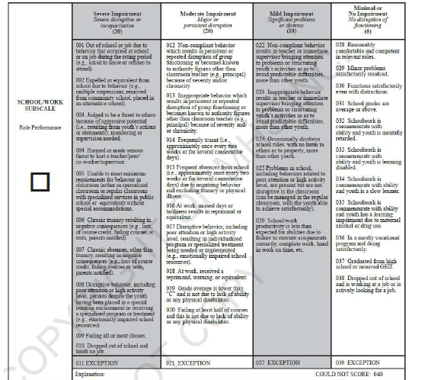
School

Slide 20
1. Thirteen year old is reported to truancy officer because of truancy.
30
2. 14-year-old was placed in EBD classroom 6 months ago. His behavior initially improved, but now he frequently walks out of class, screams at peers, knocks over desks, and does not listen to the teacher.
30
3. Teacher placed child’s desk next to her desk to discourage his disruptive behavior.
10

Slide 21
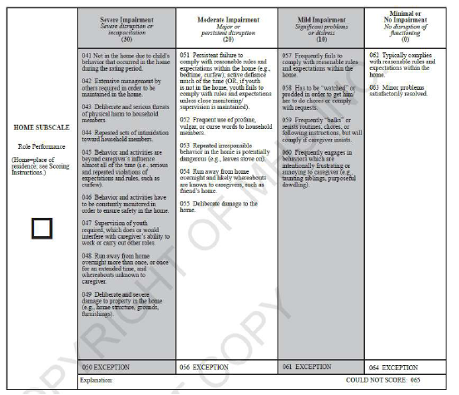
Home

Slide 22
1. Child makes a point of not doing what his parents want him to do most of the time in front of company at their home- the parents are often embarrassed.
20
2. 16-year-old in the last 3 months has been missing curfew, had an auto accident in which the car was wrecked, and came home smelling of alcohol despite drinking being strictly forbidden by his parents.
30
3. 8-year-old girl “gives attitude” and complains when asked to complete her chores. She will do them only if her mother insists.
10

Slide 23
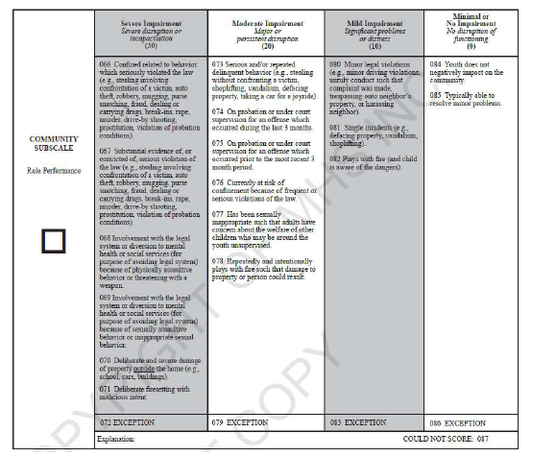
Community

Slide 24
1. Client got into a fight at school. During the fight, picked up a bottle to hit the other youth. Broken up by school authorities who reported the incident to the police.
30
2. 14-year-old on probation for stealing a car, last incident 4 months ago.
20
3. A 10-year-old boy’s mother reported that her son shoplifted once from Walmart.
10

Slide 25
Behavior

Slide 26
1. A 9-year-old male grimaces and growls at peers, almost all of the time. His parents find the behavior bizarre.
30
2. Other children ignore and refuse to play with client.
10
3. Threatens and emotionally abuses brother frequently.
20

Slide 27
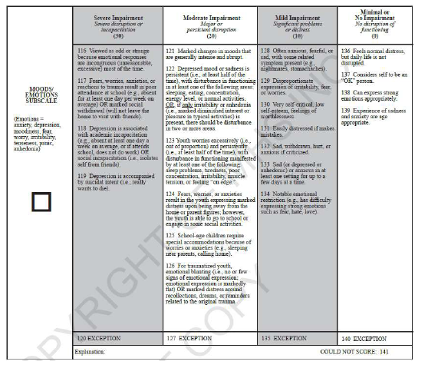
Mood

Slide 28
1. 9-year-old worries constantly and has to sleep with mother.
20
2. Often sad and complains about nightmares.
10
3. Constant worries and avoids going to school, misses at least one day per week. Avoids social interaction.
30

Slide 29
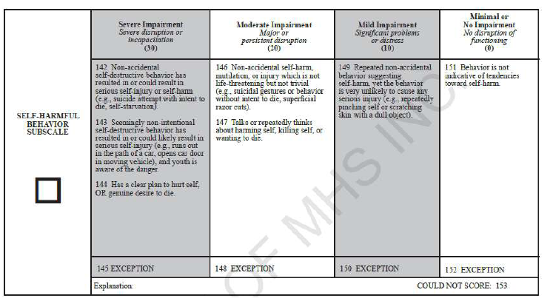
Self-Harmful

Slide 30
1. Says cut arms and legs with paperclip wire last year.
0
2. Running out in the street in front of cars when angry.
30
3. Talks about harming self but says does not want to die.
20

Slide 31
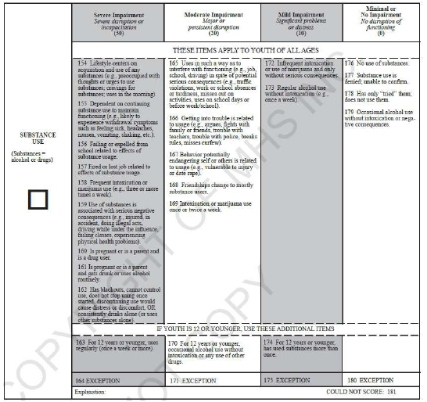
Substance
Use

Slide 32
1. Admits to trying pot once.
0
2. 12-year-old has been caught drinking alcohol several times but does not appear to get drunk.
20
3. Teen becomes intoxicated/high more than twice a week.
30

Slide 33
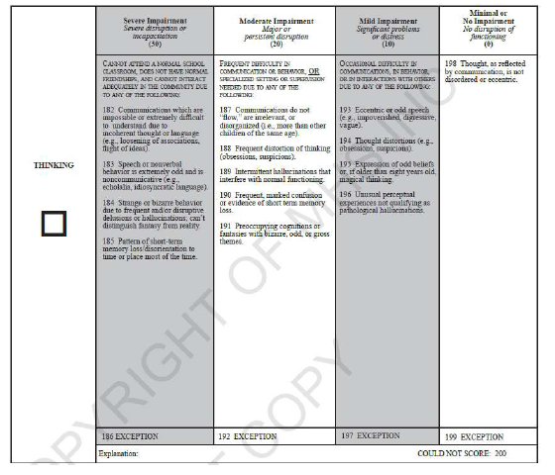
Thinking

Slide 34
1. Obsesses about rubber bands, has to have them arranged in a particular order and screams if anyone messes with them, but aside from this issue, does well in school and has friends.
10
2. Is in a self-contained class, displays echolalia, says things that do not make sense.
30
3. Makes grandiose statements that causes peers to reject him.
20

Slide 35
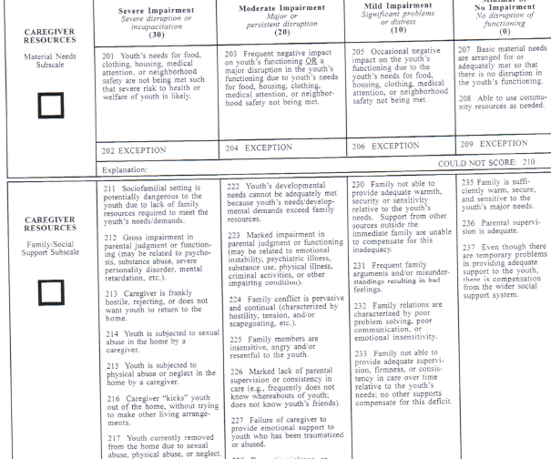
Family

Slide 36
Case Example!

Slide 37
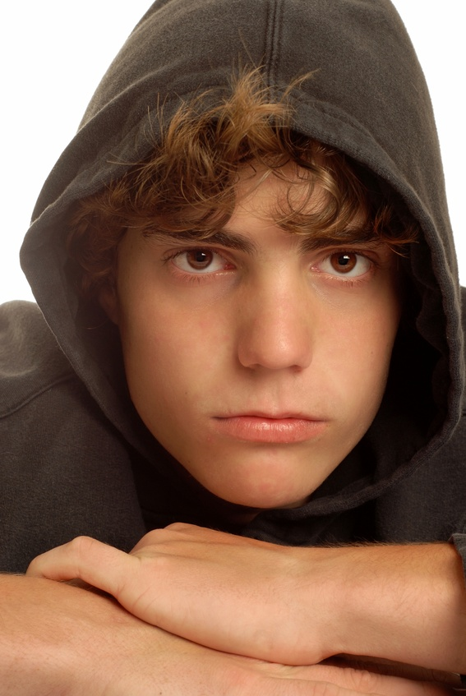
Stuart Smalley
Age 14
9th grade, failing
Lives with mother who never married his father, has a history of domestic violence relationships. She blames Stuart’s behavior for family conflict. He has two younger siblings whom he threatens and intimidates. He cusses out mother, destroys property, sleeps with a knife. Refuses to comply with house rules, curfew.
Increased involvement with negative peer group, admits to trying marijuana.
He attends school regularly, but he refuses to do work, sleeps in class, and talks back to teachers.
He fights with peers at school and in the neighborhood. He thinks that people are always judging him.
He avoids home, but he likes spending time with his uncle and family.
No legal charges, but is at risk because of destroying community property.

Slide 38
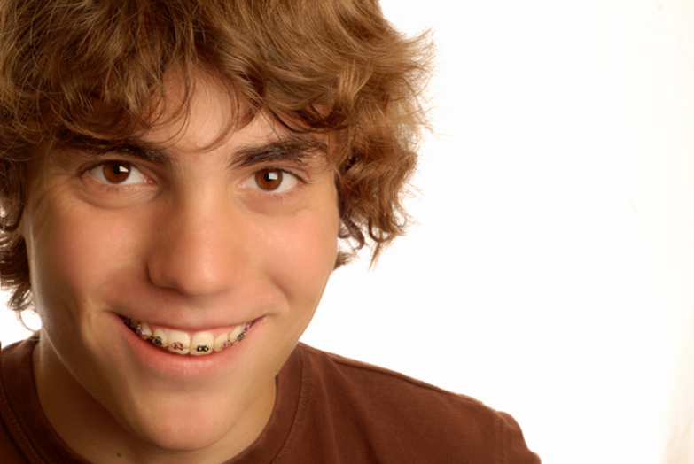
Results
Total score
Level of care
Treatment goals
Demonstration of 3-month follow-up

Slide 39
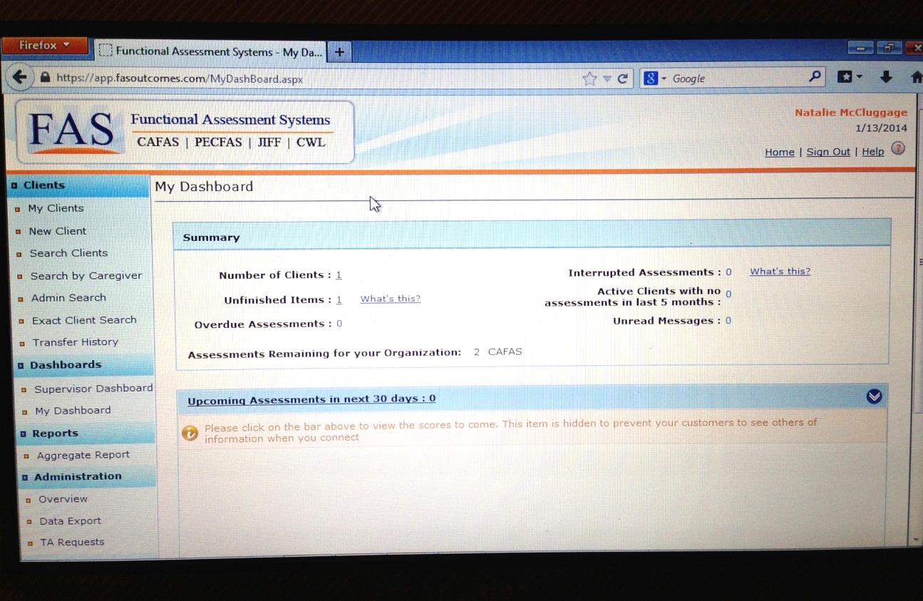
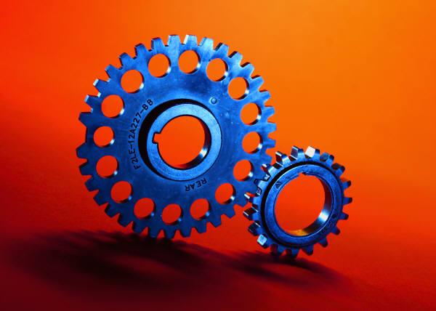
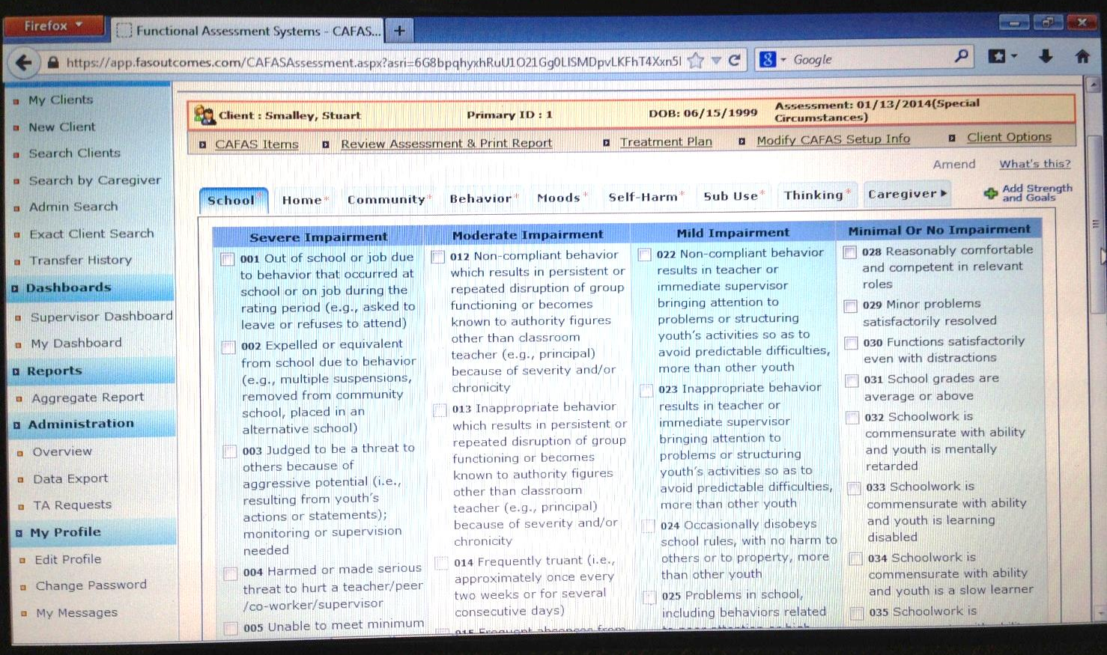
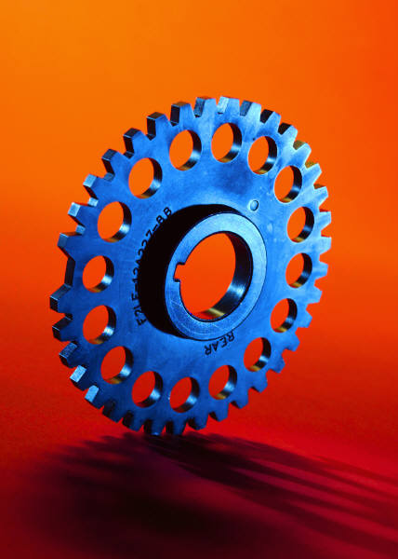

Slide 41

How will you use this tool to help your clients transform?
Notes:
transformer

Slide 42

WHEN?
Now!
You will receive an email directing you to an online self-training to ensure that we all score clients the same way.
  http://www.youtube.com/playlist?list=PLRDR6vne4ABNlnX_3m64QYHYvZLxYpXJx
Complete the self-training and take the quiz http://www.proprofs.com/quiz-school/story.php?title=cafas-online-reliability-training-quiz
Email a copy of your certificate and you will receive an email from FASoutcomes with your user name and temporary password to begin using the assessment with clients.

Slide 43
nmccluggage@transformationsllc.net
Notes:
Ask me

