Slide 1
Collateral Therapy
CPT Code 90887

Slide 2
Information for this training has been obtained from the IMPACT Plus Manual and a Medicaid training provided by Medicaid Specialist, Mary Thornton.

Slide 3
The collateral service involves face to face
behavioral health consultation with a parent or legal guardian, school personnel, or
other individual with custodial control or supervision of the client.
Impact Plus Manual

Slide 4
Common examples of Collateral
Therapy include the attendance of a Behavioral Health Professional or Behavioral
Health Professional under clinical supervision at a
Service team meeting,
School Annual Review Committee meetings
Conferences with teachers,
Face-to-face meetings with other service professionals involved in the child’s treatment, and
Therapy sessions with caregivers and family members.
IMPACT Plus Provider Manual
Notes:
Explain the food chain

Slide 5
A session with a client and siblings or a client and a boyfriend, can NOT be billed as a 90887.
Notes:
No guardian is present

Slide 6
Teaching a client how to organize and manage responsibilities regarding school work cannot be billed as a 90887.
This service should be billed as a H2021 code (Therapeutic Child Support)
The intervention should be documented as “skill building”.
Notes:
The billing code is about the service and not the provider’s identity

Slide 7
Helping a client find a tutor cannot be billed as a 90887.
This is the work of a targeted case manager.

Slide 8
Medicaid believes that “consultation with family members can be a necessary part of planning and providing care to clients. But they believe that consultation can devolve to a point where it becomes a means of treating other family members rather than, or in addition to the identified client. Medicaid will not reimburse for services provided to ineligible family member for treatment of their problems not related to the treatment of the Medicaid beneficiary” Mary Thornton

Slide 9
All treatment must be solely for the emotional and behavioral recovery of the identified client.

Slide 10
Despite it all, Medicaid expects to see us working with the family.

Slide 11
“Medicaid expects to see interventions utilized during the family sessions that effect a change or modify the structure, dynamics and interactions that act on the client’s emotions and behaviors.”
From Mary Thornton
Notes:
The intervention has to be directed to the client’s behavior

Slide 12
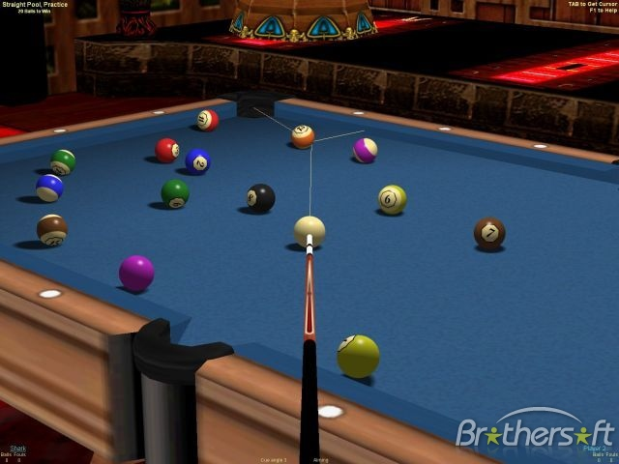
Collateral therapy is like playing a game of billiards.

Slide 13
Collateral therapy is like playing a game of billiards.
First you state your intended goal:
I want to put the 12 ball in the corner pocket.

Slide 14
Collateral therapy is like playing a game of billiards.
First you state your intended goal:
I want to put the 12 ball in the corner pocket.
You utilize a structural intervention:
Tap the cue ball with the stick.

Slide 15
Collateral therapy is like playing a game of billiards.
First you state your intended goal:
I want to put the 12 ball in the corner pocket.
You utilize a structural intervention:
Tap the cue ball with the stick.
You assess the response:
Where is the 12 ball now?

Slide 16
Collateral therapy is like playing a game of billiards.
First you state your intended goal:
I want to put the 12 ball in the corner pocket.
You utilize a structural intervention:
Tap the cue ball with the stick.
You assess the response:
Where is the 12 ball now?
Then plan your next move.

Slide 17
G- You state your intended goal:
I want to put the 12 ball in the corner pocket.
I -You utilize a structural intervention :
Tap the cue ball with the stick
R- You assess the response:
Where is the 12 ball now?
P- Then plan your next move:

