Slide 1

WellCare of Kentucky’s
Quest for Quality
Impact Plus Provider Orientation

Slide 2








Why the Quest for Quality?
It’s the RIGHT thing to do for the patient/member
Helps you reach targeted goals (clinical and financial)
Stresses evidenced-based approaches to care, which improve outcomes and reduce costs
1

Slide 3
How Do We Work Together to Achieve Our Goals?
Our approach to Quality is four-pronged. It is built on fostering partnerships and working collaboratively with providers, members, the community and State to improve health outcomes.
Improved Health Outcomes
Providers
Members
Community
State
Manage members’ care
Provide tools to assist providers
Assist in coordinating members’ care
Educate members
Assist in coordinating care and removing barriers to care
Bring community advocates together to serve members needs
Identify member social resources
Find solutions for State-wide issues and barriers to care
2

Slide 4
HEDIS
Follow-Up After Hospitalization for Mental Illness: Percentage of discharges for members 6 years of age and older who were hospitalized for treatment of selected mental health disorders and who had an outpatient visit, an intensive outpatient encounter or partial hospitalization with a mental health practitioner.
ICD9-CM Diagnosis | 295-299, 300.3, 300.4, 301, 308, 309, 311-314

Slide 5
Case Management
8

Slide 6
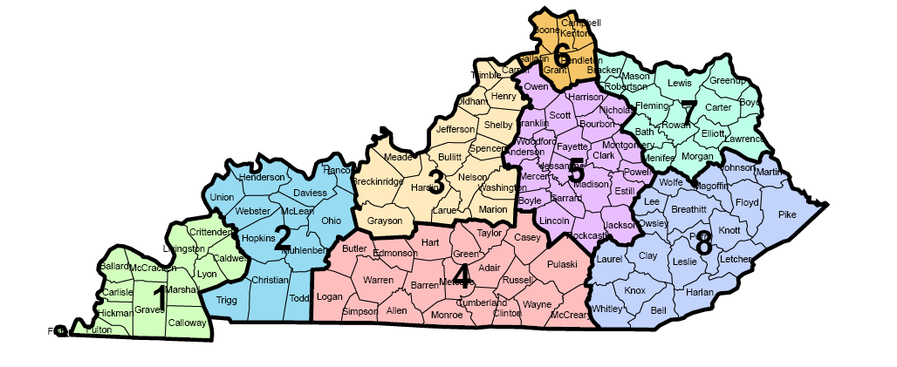
Regional Offices
Regional offices perform the following functions:
Complex Case and Disease Management
Provider Relations
Contract Processing
Behavioral Health
Lexington Office
859-264-5100
Ashland Office
606-327-6200
Louisville Office
502-253-5100
Owensboro Office
270-688-7000
Hazard Office
606-436-1500
Bowling Green Office
270-793-7300
9

Slide 7
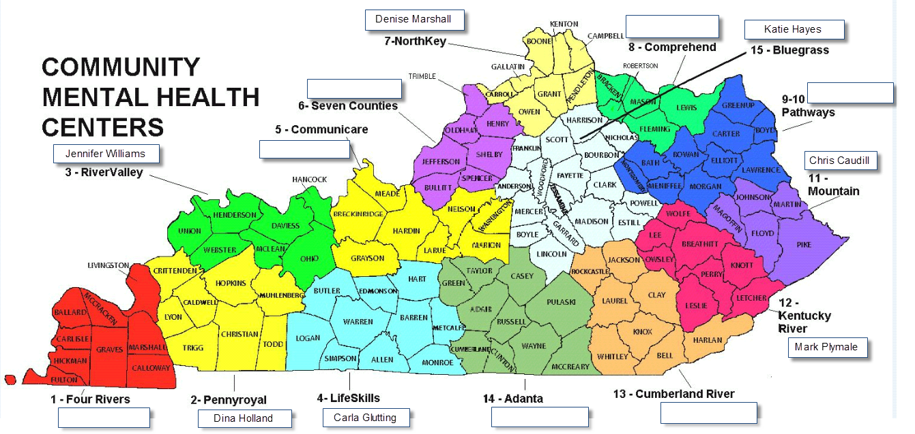
Behavioral Health Case Management

Slide 8
The Mission and Purpose
The mission of Case Management is to:
Coordinate timely, cost effective, integrated services for individual, physical, and behavioral health needs of members to promote positive clinical outcomes.
The purpose of Case Management is to:
Decrease fragmentation of healthcare service delivery
Facilitate appropriate utilization of available resources
Optimize member outcomes through education, care coordination, and advocacy services for the medically compromised populations served.
11

Slide 9
Goals of Case Management
Enhance member safety, productivity, satisfaction and quality of life
Coordinate care services utilizing evidence based guidelines
Identify and eliminate barriers to care and wellness
Ensure and facilitate access to quality healthcare
Offer education and information on available resources, clinical topics and access to services
Empower informed members to be independent advocates for self management of care needs.
Provide members with ongoing access to qualified healthcare professionals
Maintain ongoing documentation and reporting of goal achievement
Maintain cost effectiveness in the provision of health services
12

Slide 10
How Members are Identified for Case Management
Providers may request case management services for any WellCare member
Members can self-refer
Family members can refer members
Hospital discharges may trigger a referral
Findings from the Health Risk Assessment (HRA)
Review of utilization data
Members identified for Behavioral Health Case Management services include:
Members who require coordination of services following discharge from State or private facilities
Adults with severe and persistent mental illness
Children and adolescents with serious emotional disturbance
      Defined mental disorder
      Level of functioning that requires two or more coordinated behavioral health services
      Imminent risk of out-of-home behavioral health treatment placement
  Members with special health care needs
13

Slide 11
The Model
Member-Centered Case and Disease Management
Member and caregiver-centered model
Service Coordination
  Proactive and collaborative face-to-face outreach and assessment
  Discharge Planning
  Matching members needs with most appropriate provider and/or setting.
  Driving Interdisciplinary Care Teams
  Integrating care for members
Holistic Management
  Home & Community-Based
  Behavioral Health
  Pharmacy
  Medicare and Medicaid
Culturally Competent
  Services in multiple languages
  Understanding and sensitivity to subcultural norms and preferences
Primary Care Physician
Community / Advocate
Specialist and HCBS Providers
Member
Family Supports
Whole Person Orientation
Provider Relations
Service Coordination
14

Slide 12
Case Management Contact Information
Case Management
Will Coltharp, RN, Director Field Service Coordination
Joyce Buxton, RN, Manager Field Service Coordination – Regions 1 & 2
Trudy Smyth, RN, Manager Field Service Coordination – Regions 4 & 5
Paula Wade, RN, Manager Field Service Coordination – Regions 6 & 7
Shannon Jones, RN, Manager Field Service Coordination – Region 8
Behavioral Health Case Management
Paul Kensicki, MD, Behavioral Health Medical Director
Lori Gordon, LCSW, Director Behavioral Health Clinical Operations
Jennifer Byrd, RN, Manager Behavioral Health
Behavioral Health On-Site Reviewers at:
Rivendell
Our Lady of Peace
Bluegrass CMHC
Lifeskills CMHC
KY River CMHC
Pennyroyal CMHC
NorthKey CMHC
Additional reviewers will be hired so that each CMHC has a designated person
16

Slide 13
Disease Management
17

Slide 14
Disease Management Programs
Chronic Obstructive Pulmonary Disease (COPD)
Diabetes
Coronary Artery Disease (CAD)
Asthma
Hypertension
18

Slide 15
The Mission and Purpose
The mission of Disease Management is to:
Identify members with selected chronic diseases and provide education and health coaching to the members and/or their caregivers to empower them to make behavior changes and improve health outcomes.
The purpose of Disease Management is to:
Increase member and caregiver knowledge of their chronic condition
Empower members and caregivers to self-manage their condition
Improve adherence and compliance to the provider’s treatment plan
19

Slide 16
How Members are Identified for Disease Management
Providers may request disease management services for any WellCare member
Members can self-refer
Family members can refer members
Referred from case managers and/or transitional care management
Findings from the Health Risk Assessment (HRA)
Review of utilization data
20

Slide 17
Utilization Management
8

Slide 18
Utilization management
Prior authorization is required for any IMPACT Plus services
Prior authorization is required for Inpatient Hospital Services, Residential Treatment Services, Partial Hospital Services and Intensive Outpatient Services
WellCare does not require prior authorization for most outpatient services provided at a CMHC. Prior authorization is required for psychological testing and ECT

Slide 19
Impact Plus Clinical Information
ALL Impact Plus Services MUST be prior authorized
The OTR is the 7 page eligibility application the Impact Plus Providers are
required to use. See HANDOUT for full information
We are using the SAME forms and the SAME processes and the SAME criteria
that the state was using prior to November 1, 2011
The FAX numbers for Impact Plus Providers to submit their forms is:
Outpatient Authorization Request Submissions Fax (877) 544-2007
Impact Plus providers can contact our BH Intake staff at:
Urgent authorizations and Provider Services (855) 620-1861
(note: regular BH Outpatient services don’t require auth but impact plus
Services do- there is a separate OTR for regular BH for psych testing
but it is not to be used by Impact Plus Providers- they must always use the
State forms)

Slide 20
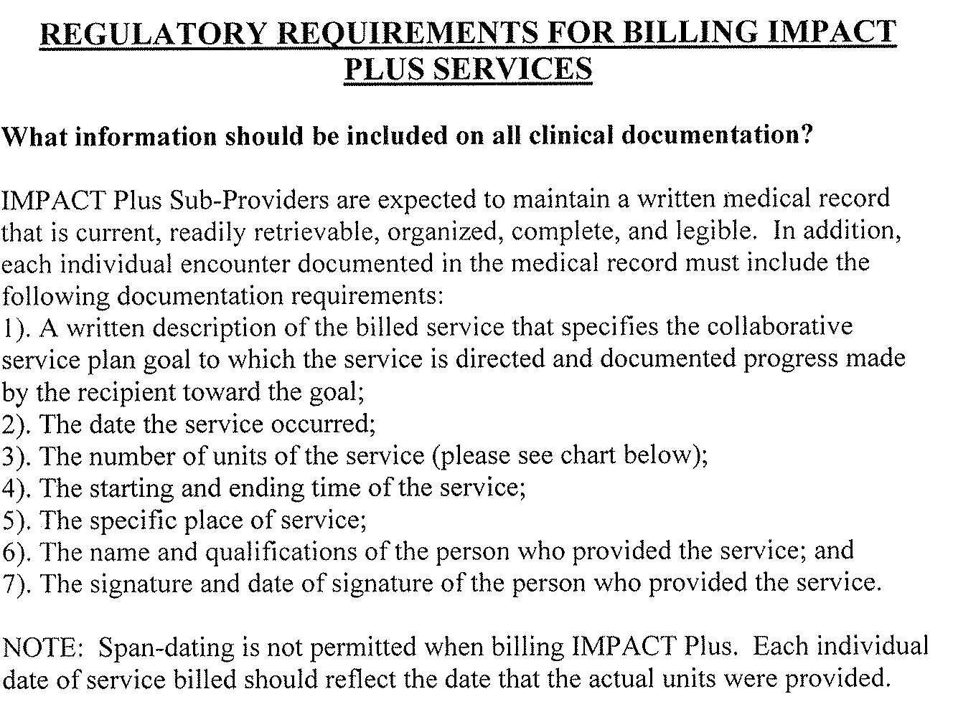

Slide 22

Common Provider Themes
Request for Service and Clinical Documentation Tips
Include the DSM-IV R Diagnostic code and Diagnostic Title on all Axis I and Axis II. Ensure Axis I thru V is complete
Completely fill out all forms and please use spell check if you are typing your documents
Clearly indicate what services you are requesting. Clearly indicate what services you are providing
When psychiatric services are provided please include the provider’s rolling feedback regarding the child’s response/progress/lack of to pharmacology interventions
Include the names of all responsible parties supporting the child/youth’s service plan
Offer specific goals on the Collaborative Service Plan (treatment plan/treatment plan reviews) *What are the chief issues bringing the child into treatment? What behaviors/symptoms are you targeting?

Slide 23
Common Provider Themes ~ Continued
Request for Service and Clinical Documentation Tips
On CSP what are the Target signs, symptom’s, behavior’s that you want to decrease or increase *In the clinical information section on the Impact Plus Care Plans they are often clearly described
Ex: “Defiant behavior has increased in frequency and intensity for the
past 6 months. It is now occurring on a daily basis”
Ex: “Child is verbally aggressive evidenced by screaming, yelling,
threatening physical harm/safety of others”
Tie/marry the clinical information/history/presenting problem to the CSP. They support each other. Presenting problem’s in the assessment should be addressed/incorporate on the CSP. Progress or lack of progress documented in the member’s progress report should be reflected in the CSP
Describe the symptom’s/behavior’s. If the child is Defiant/Breaking rules, being disruptive at home/in school; what behavior’s are associated with the defiance? Are they using profanity, throwing things at the teacher/peers while in class? Are these major or minor rules being broken? Are these family/or society social norms/rules?
Identify how progress is being measured. Use AEB: As evidenced by…
Ex: Are you using an outcomes instrument, token system, stars,
red, yellow, green light system, daily calendar with stickers?
Progress notes: describe progress or lack of in measurable terms. Current practice offers qualitative descriptions. Progress needs to be shown quantitatively. It is difficult to measure progress or lack of progress without measurable data.
Discharge plans: are essentially trying to resolve all the presenting problem’s/behavior’s by discharge. This is an intensive 6 month program. We want to target the behavior’s that are causing the most disruption/quality of life/instability issues. When developing their discharge plans keep in mind how are we going to transition this child to a lower level of care. What will be the ongoing issues that will need continued therapy to help with reinforcing the skills learned and change made during the Impact Plus program

Slide 24
Measurable Plans
Benefits of Measurable Plans
Clear ‘road’ map for the treating provider(s), child, family, support system
Progress or lack of progress clearly defined. Will help validate the hard work the child, family is doing to meet their goals. Gives everyone the opportunity to celebrate treatment ‘wins’ no matter how big or small the step to recovery is
Will help you, the provider hold the child, family, system accountable when progress is not being made
Helps demonstrate good outcomes and member care
Allows the WellCare clinical review team to clearly identify medical necessity. Affords ease of the concurrent authorization review process
When lack of progress is clearly defined, the family’s treatment team can course correct. This affords the opportunity to review if this child is in the right level of care for their treatment needs
Notes:
Text
Text
Text
Text

Slide 25
WellCare clinical teams follow the State’s Impact Plus Manual and Guidelines when determining
Eligibility and medical necessity criteria, the Impact Plus Provider Manual and all forms can be found
On the KY DBHDID website:
http://dbhdid.ky.gov/dbh/impactpluscmforms.asp?sub70
WellCare Health Services intranet site also houses all of the behavioral health forms and
Provides links to the KY website.
http://wellcarelink.wellcare.com/C6/C7/Behavioral%20Health%20Department/default.aspx

Slide 26
Prior authorization Process for Impact Plus providers:
Prior auth team receives fax from the LEAD Impact Plus Provider
The eligibility request form (OTR) should contain all services needed by all providers
Prior auth team reviews and responds within 2 business days
One authorization number is generated for the entire array of services requested
The one number is good for ALL providers on the treatment plan
The LEAD Impact Plus Provider (agency) gets notification via fax from us which contains
the authorization number and the services authorized.
The LEAD Impact Plus Provider is suppose to inform all service providers of the auth
The one authorization number is good for all claims submitted by all providers on
the member as the claims system has a member“flag” that identifies members who
have been approved as eligible for Impact Plus

Slide 27
Utilization Management
WellCare Utilization Management Telephone Numbers:
Urgent authorizations and Provider Services (855) 620-1861
Inpatient Hospitalization Clinical Submissions Fax (877) 338-3686
Outpatient Authorization Request Submissions Fax (877) 544-2007
For real-time authorization responses, submit your secure request online. Please submit your request for more services at least two weeks prior to the completion of the current authorized services (s).
For other WellCare Phone Numbers see Well Care Quick Reference Guide in handout
Notes:
See page 15 for DSM Codes
CAFAS Examples at end of module

Slide 28
Appeals
8

Slide 29
What is an appeal?
Request for review by WellCare of a WellCare action. An action can include:
• the denial or limited authorization of a requested service, including the type or level of service;
• the reduction, suspension, or termination of a previously authorized service;
• the denial, in whole or in part, of payment for a service;
• the failure of WellCare to provide services in a timely manner, as defined by the Department or its designee; or
• the failure of WellCare to complete the authorization request in a timely manner as defined in 42 CFR 438.408.
• for a resident of a rural area with only one plan provider, the denial of a Member’s request to exercise his or her right under 42 CFR

Slide 30
Methods of filing an appeal
For all pre-service appeals, it is assumed the member has given consent with the paperwork they completed when they first saw the provider (this would be the form they signed upon seeing their physician); therefore no other written consent is needed. For all post-service appeals, written consent is needed from the member; this would be in the form of appointment of representation which requires signature by the Provider and the Member. (Non-Medicare Member Appointment of Representative Statement is attached)
The provider requesting an appeal on the behalf of a member may do the following:
1.) Verbal appeal: (written consent of member is required) Phone: 1-877-389-9457
2.) In writing: (written consent of member is required) PO BOX 436000 Louisville, KY 40253
or Via fax 1-866-201-0657
3.) In person: (written consent of member is required) 13551 Triton Park suite 1800 Louisville, KY 40223
*If an appeal request is made by the member orally (pre-service or post-service) then a written request must follow, via fax or mail.
*If an appeal request is made by the member’s provider/prescribing physician and it is a pre-service (expedited or not), then a written request is not needed.

Slide 31
Appeals Timeframes
The maximum time allowed to file an appeal request is 30 days from the date of the notice of action; WellCare must receive the request within 30 days.
Within the first (3) business days of the notice of action, provider/member may request a reconsideration. The provider may request a peer to peer review through the reconsideration process.

Slide 32
Types of Appeal Request
Standard – Processed within (30) calendar days of the received appeal request.
Expedited- Processed within (72) hours of the received appeal request. An expedited review is warranted when the provider determines that allowing time for a standard resolution could seriously jeopardize the member’s health or ability to attain, maintain, or regain maximum function.
*A reconsideration request does not necessarily replace the option to file an appeal request, if the member/provider is not satisfied with the outcome of the reconsideration appeal rights can be exercised.

Slide 33
Appeal Extensions
WellCare may extend the (72) hour (expedited) and/or (30) day (standard) timeframe by (14) calendar days if the Member/Provider requests the extension, or WellCare determines that there is need for additional information, and the extension is in the Member’s interest; the extension request will be made to the Member/Provider in writing indicating the resolution date.

Slide 34
Emergency Services
8

Slide 35
Emergency Services
  WellCare is required by contract to provide our members with a 24/7 crisis line. The member ID card will contain that emergency number: 855 661-6973
  Blue Grass Regional MHMR will be answering crisis calls on behalf of Wellcare from 6 pm to 8 am M-Th and 6 pm Friday through 8 am Monday, and holiday’s
  WellCare Staff will be answering the crisis line M-F 8 am to 6 pm
  We will be directing members in crisis to the local/community crisis system as needed and will pay for any services requested through our normal claims process

Slide 36
Resources
8

Slide 37
WellCare Website Content
The WellCare Web site information:
http://kentucky.wellcare.com/
http://kentucky.wellcare.com/provider/resources

Slide 38
WellCare Website content
The resources on this page will assist you in working with WellCare of Kentucky. Click on the names of the materials listed to access more information. These materials may change over time so please check back to make sure you have the most up-to-date version.
WellCare of Kentucky Provider Manual
An extension of the Participation Agreement and a resource that provides guidelines on health plan coverage procedures, policies and other information related to the provision of health care services to our members. This document should be used simultaneously with the Provider Quick Reference Guide and other reference resources.
WellCare of Kentucky Provider Quick Reference Guide
Provides WellCare contact information and authorization guidelines.
WellCare of Kentucky Provider How-to-Guide
Resource documents and instructions on how to perform daily tasks with WellCare of Kentucky.
Claims EDI
RelayHealth, a division of McKesson, manages all claims electronic data interchange (EDI) between WellCare and our providers. If you need assistance in making a connection with RelayHealth, or if you have any questions, contact RelayHealth at 1-888-499-5465, or your vendor may call 1-888-743-8735. For more information, refer to your WellCare of Kentucky Provider Resource Guide and/or Provider How-To Guide .

Slide 39
Wellcare Website content
WellCare of Kentucky Medicaid Provider Comprehensive Preferred Drug List
This document contains information about the drugs we cover in this plan. Please note that the WellCare of Kentucky Medicaid Preferred Drug List is updated quarterly.
WellCare of Kentucky Medicaid Provider Cough and Cold Drug List
This document contains information about the drugs WellCare of Kentucky covers for coughs and colds in this plan. Please note that this list is updated quarterly.
WellCare of Kentucky Medicaid Provider Forms and Documents
Template forms and documents for appeals, authorizations, claims, pharmacy services and more.
Clinical Coverage Guidelines (coming soon)
Evidence-based guidelines detailing the medical necessity of, and sets consistent criteria for coverage of, given procedures or technologies to ensure greater consistency and efficiency in clinical decision making.
Clinical Practice Guidelines (coming soon)
Best-practice guidelines used to guide efforts in improving the quality of care in our membership. CPGs are based on available clinical outcome and scientific evidence-based content developed by expert professional and clinical society recommendations.

Slide 40
QUESTIONS
        QUESTIONS?

