Slide 1
Welcome to www.Myclientsplus.com
An electronic medical record system

Slide 2
In order to access the system go to the
www.myclientsplus.com/
and log in with your unique
username and password
This information was sent to you by email from jpolley@transformationsllc.net
Please keep your username and password in a secure location.

Slide 3
This power point presentation
is designed to teach the provider a few
simple steps about entering a session bill
and
a client contact summary
in order
to document the service.

Slide 4
bill
note
pay

Slide 5
bill
Start here

Slide 6
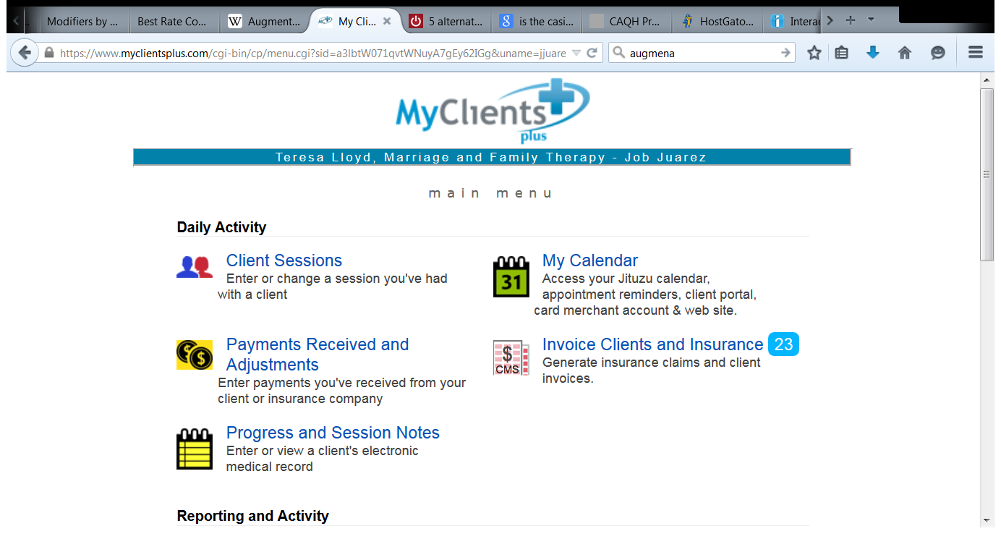
Start here

Slide 7
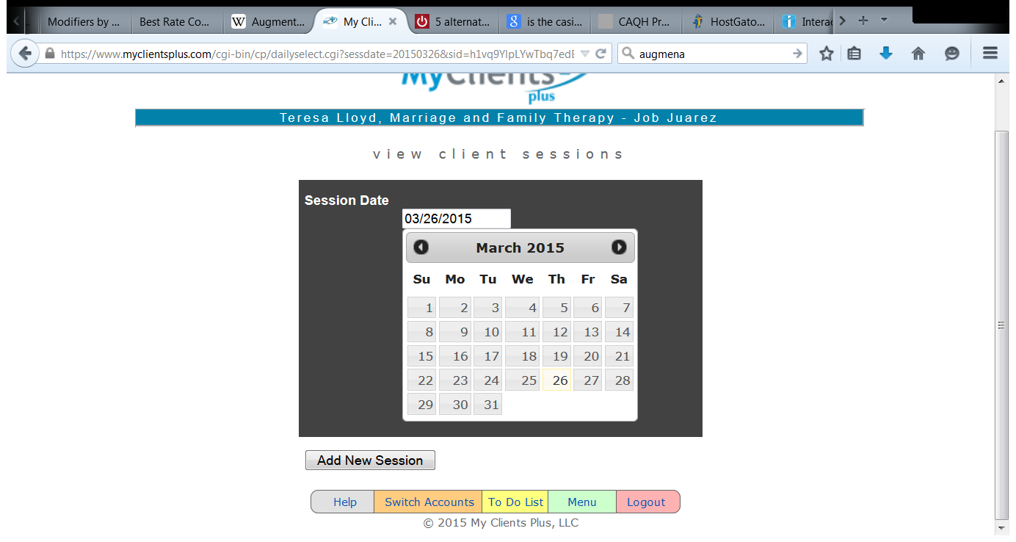
Pick your date and click on Add New Session

Slide 8
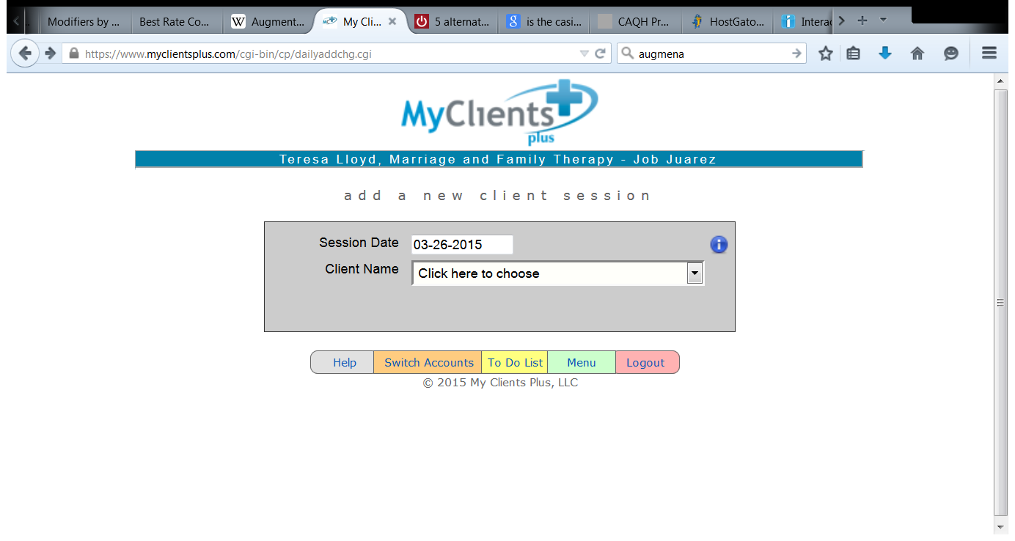
Now use the drop down box to find your client’s name

Slide 9
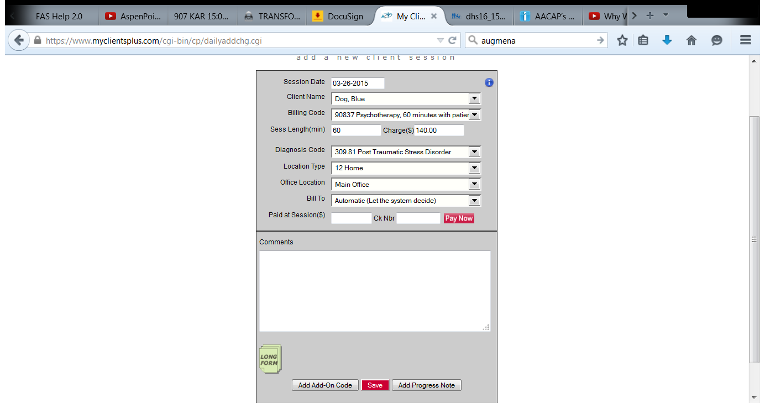
Verify the Session Date and Client Name. Don’t put your data in the wrong file.
Use the drop down box to open the Billing Code list and select the appropriate CPT Code.
Minutes are automatically added for one unit of the CPT code, if you are using more than one unit of this code you will need to edit the minute box.
Charge ($): The amount charged is automatically calculated for one unit of the CPT code. If you are using more than one minute, you must edit the charge amount to the correct dollar amount.

Slide 10
Use the drop down box to select the primary diagnosis.
Location type: Use 12-home for home and community based services. Select 11- office if you are providing services in your office. MHNet requires 99-other for all services.
Office Location: leave this set at Main Office.
Bill to: leave this at automatic, do not change the setting.
Paid at Sessions: Leave this blank. We do not collect copays.
Scroll to the bottom left and click on the icon that says Long Form.

Slide 11
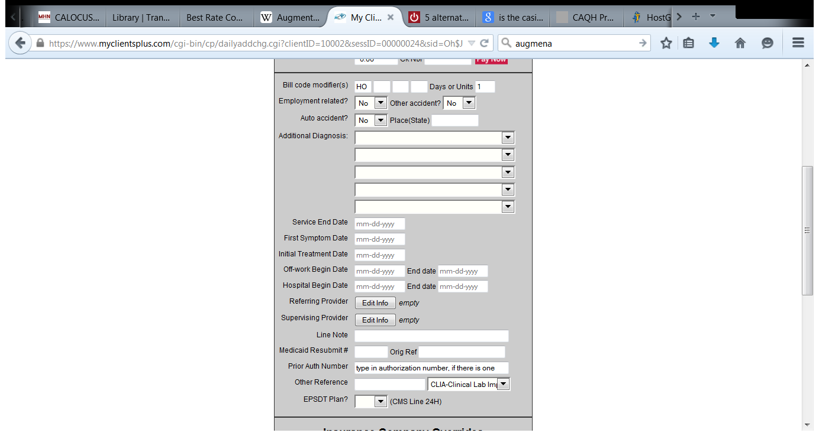
Once you have clicked on the Long Form icon, the form will expand.
Make the following edits:
Bill Code Modifiers is the first line of the Long Form. You will need to enter your modifier. Modifiers are specific to your provider type. Click here for a list of Modifiers. Be sure to enter the two letter modifier in the first block only.
Days or Units: Be sure to enter the number of units. It automatically sets to 1 unit. And remember, if you are using more than one unit, you must edit the Charges ($) amount as well.

Slide 12
Skip down to the Prior Authorization Number.
You must type in the authorization number. Leave it blank if you do not yet have a number. If you have previously entered the authorization in the tracking system, your authorization number will appear in red at the top of this form.
Copy and paste.
Click here to learn more about the tracking system.

Slide 13
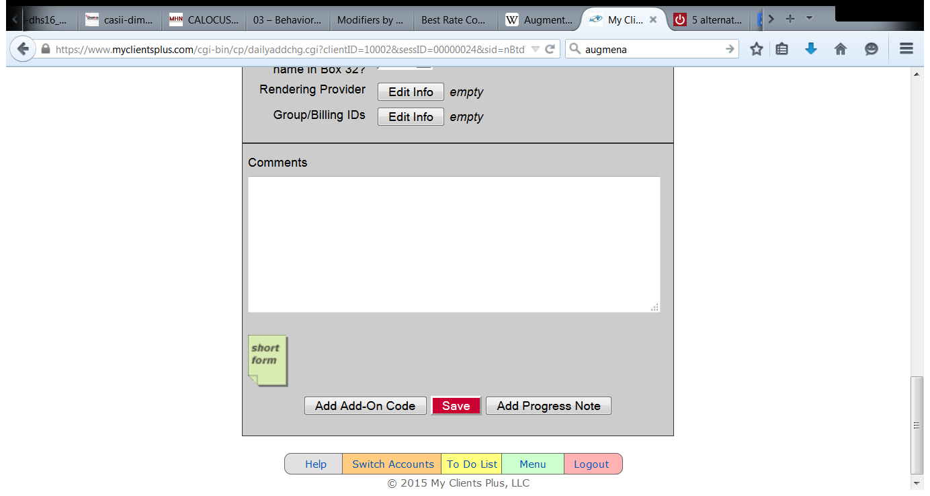
Skip down to the bottom of the form.
You have several options.
If you are utilizing an add-on code such as a 99354 for additional psychotherapy, click on Add Add-on Code. You will now do the form again with the add on-code information and charges.

Slide 14
Once you are finished entering the claim information you have two choices.
Click Save and write your note later.
Click Add Progress Note and write your note now. Recommended!!!!

Slide 15
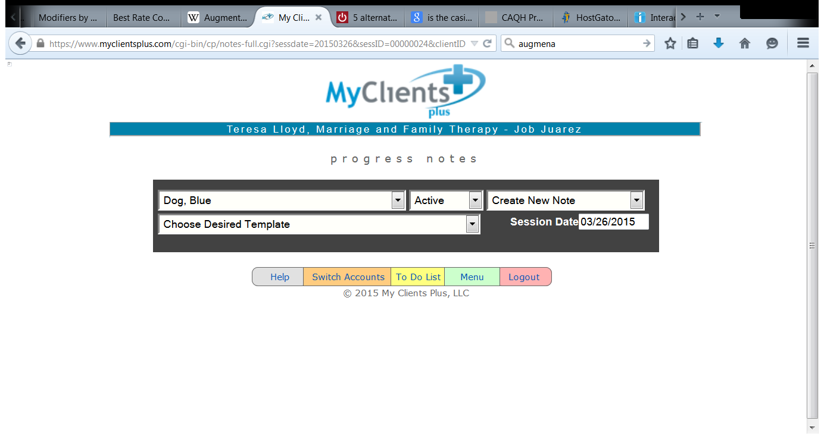
So you clicked Add Progress Note and came to this screen. It allows
you to select your client, the template you want to complete and
the date of the note you want to write.

Slide 16
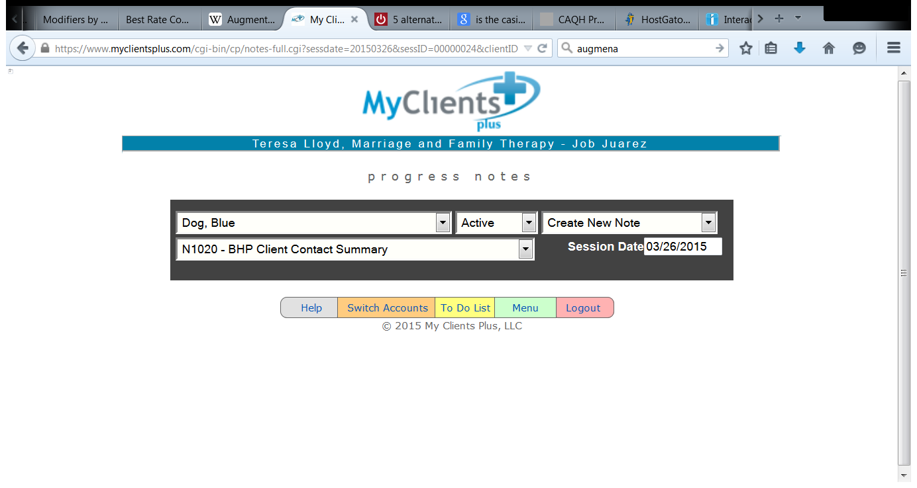
Here I have selected a BHP Client Contact Summary

Slide 17
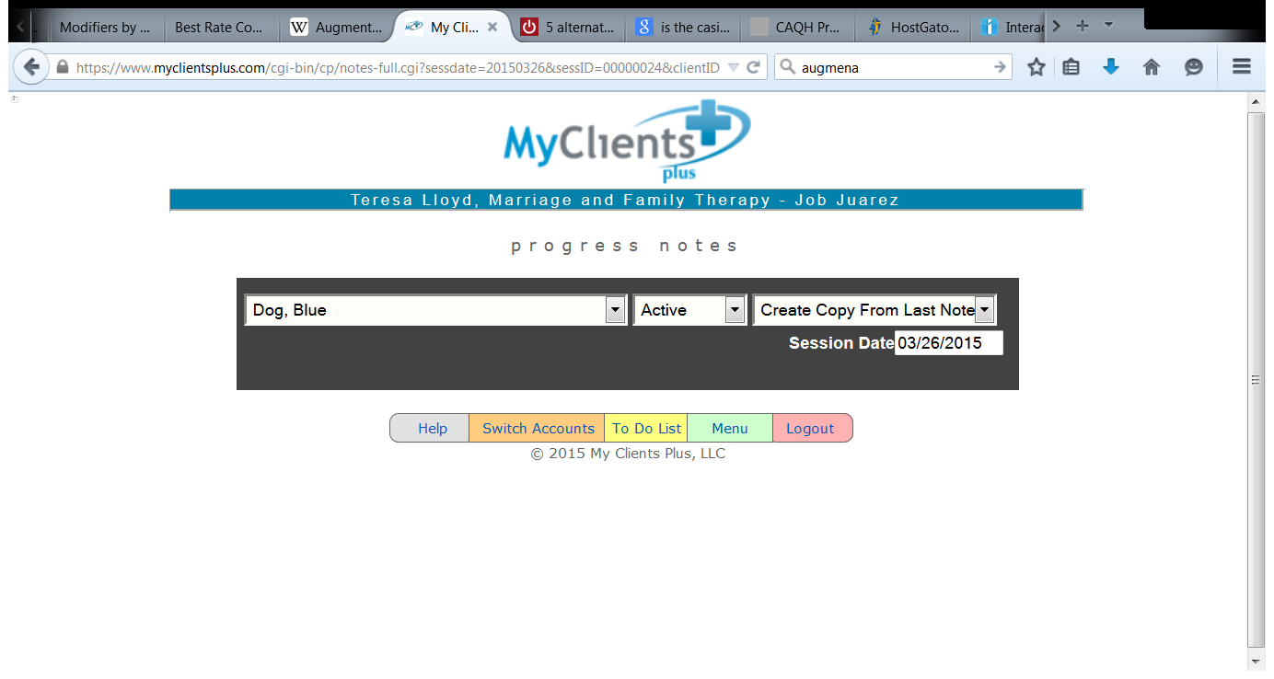
Here I selected to create a copy of my last note.

Slide 18
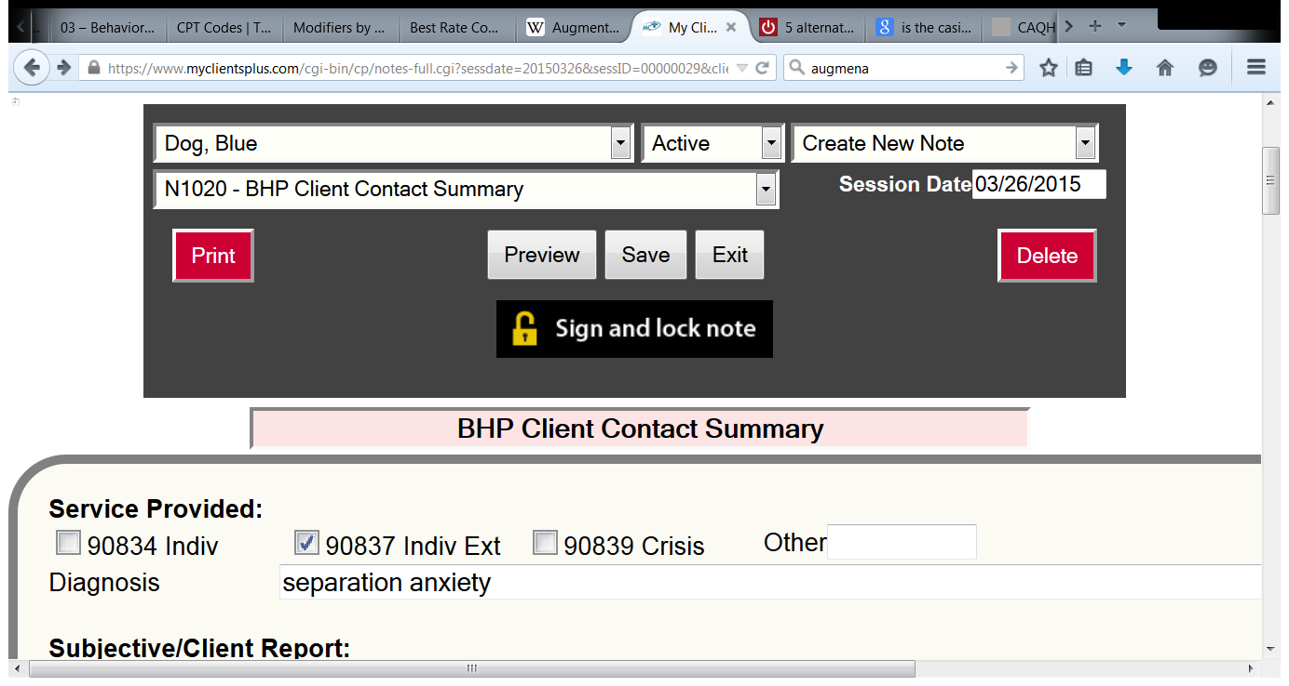
Once you have clicked on the session date in the calendar you can fill out your note.
Save it, Preview it, Sign it and lock it.

Slide 19
Save it
Preview it
Sign it and Lock
In that order

Slide 20
Save it
Don’t Loose it

Slide 21
Preview it
Because you are not going to be able to go back and change it.

Slide 22
Problems Previewing?
When you hit preview, a separate window should pop up.
If it doesn’t your internet browser needs to be set to allow pop-ups.
My Client’s Plus is designed to work with all web browsers.
Click here for information on web browsers, settings, and compatibility.

Slide 23
Sign it and Lock
This stamps the note with your electronic signature, and marks it with the date and time.
This proves you wrote the note with in 48 hours of the session.
This makes your documentation billable.

Slide 24
Click here
Once you have clicked on the session date in the calendar you can fill out your note.
Save it, Preview it, and Sign it and lock it.

Slide 25
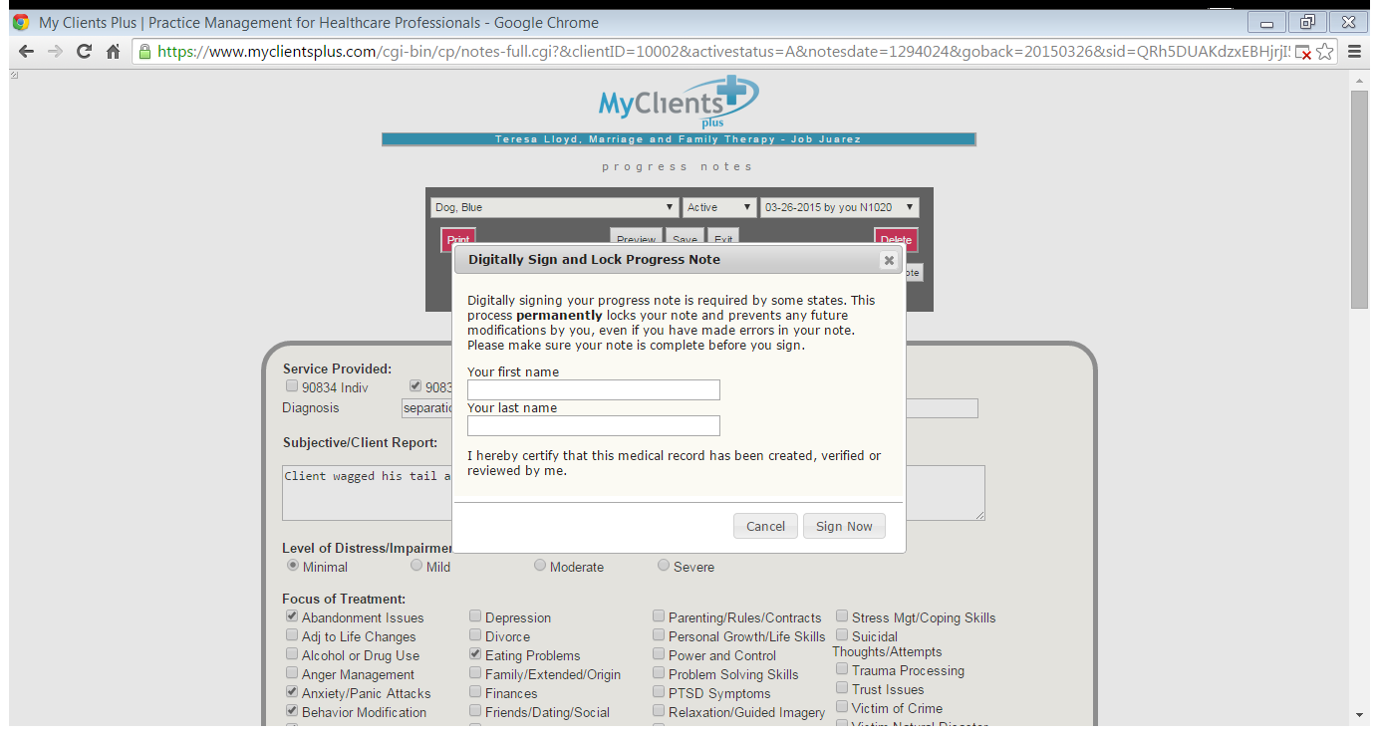
Sign now

Slide 26
But I made a mistake
Open the note back up again. Click on Add Note Addendum button at the bottom left of the screen. Select Note Correction in the drop down box and write your addendum to the session.

Slide 27
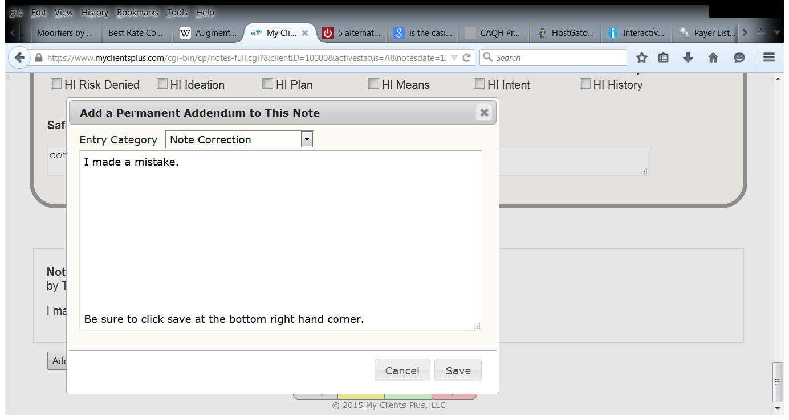

Slide 28
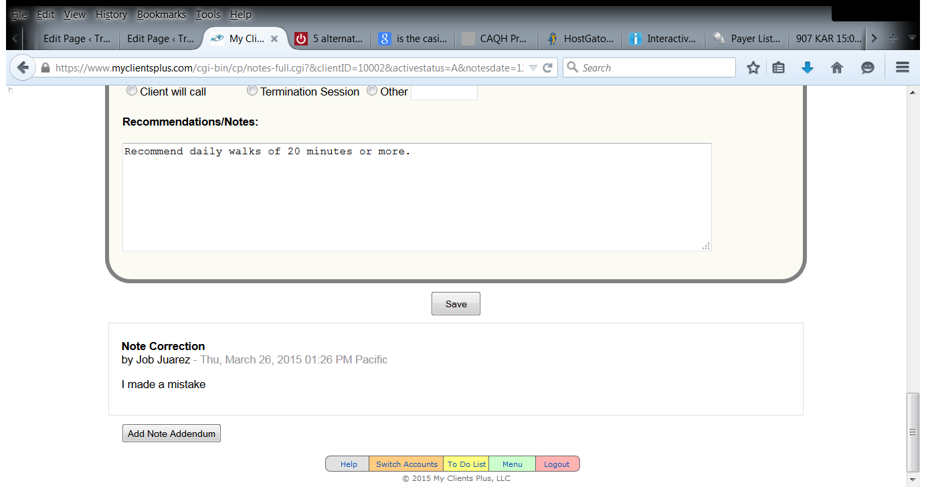

Slide 29
But I missed the 48 hour deadline
I put it in there but I forgot to save it.
I put it in there but I forgot to lock and sign it.
My internet went down.
My computer broke..
My cousin came in town.
I didn’t have time.
I screwed up.

Slide 30
907 KAR 15:010. Coverage provisions and requirements regarding behavioral health services provided by independent providers
(5)(a) A provider’s notes regarding a recipient shall:
1. Be made within forty-eight (48) hours of each service visit;
2. Describe the:
a. Recipient’s symptoms or behavior, reaction to treatment, and attitude;
b. Therapist’s intervention;
c. Changes in the treatment plan if changes are made; and
d. Need for continued treatment if continued treatment is needed.
(b)1. Any edit to notes shall:
a. Clearly display the changes;
b. Be initialed and dated.
2. Notes shall not be erased or illegibly marked out.
(c)1. Notes recorded by a practitioner working under supervision shall be co-signed and dated by the supervising professional.

Slide 31
bill
note
pay

Slide 32
Another way to write a note
Not all the notes you write will require a client session bill.
Targeted Case Managers are required to write four or five notes per month but only enter one bill for the month.
Clinical staff write non-billable notes for phone calls, missed appointments, discharge summaries, and change in service delivery patterns.
So there is another way to get to the note writing task.

Slide 33
Click here to write an unbillable note

Slide 34
And here you are again, ready to write a note.

Slide 35
How do I check my work
to be sure I correctly entered
the client session bill and
documented the session accurately?

Slide 36
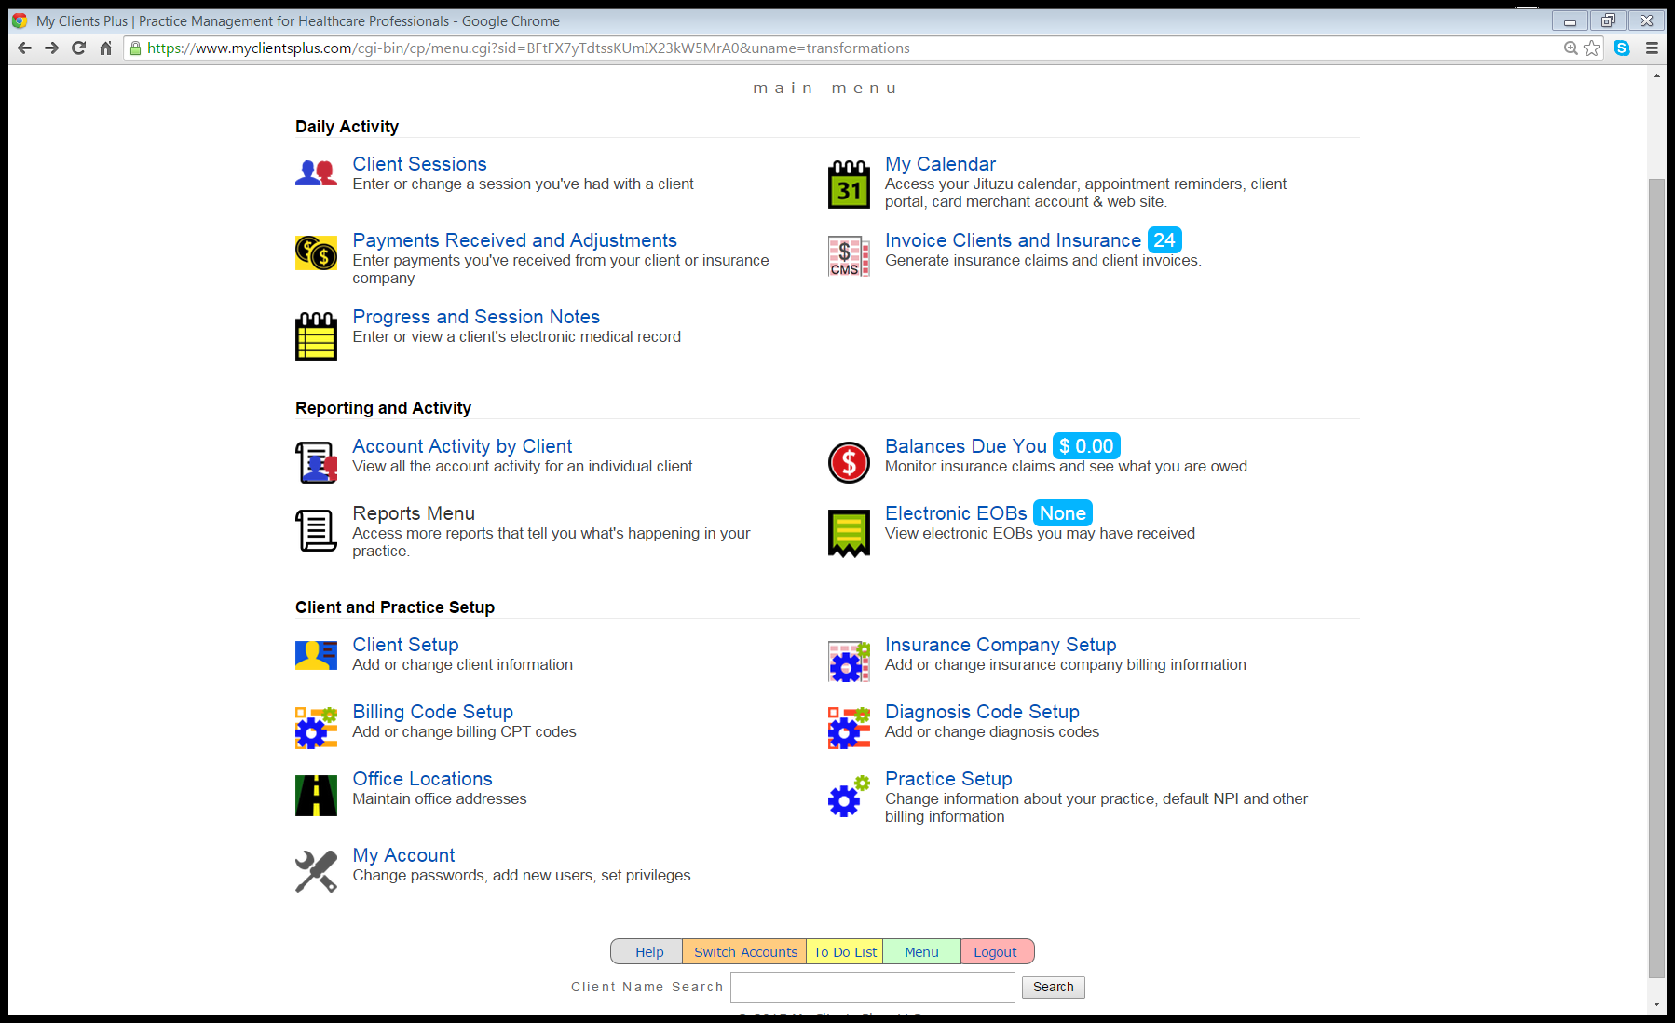
Click Here
Click on Reports Menu

Slide 37
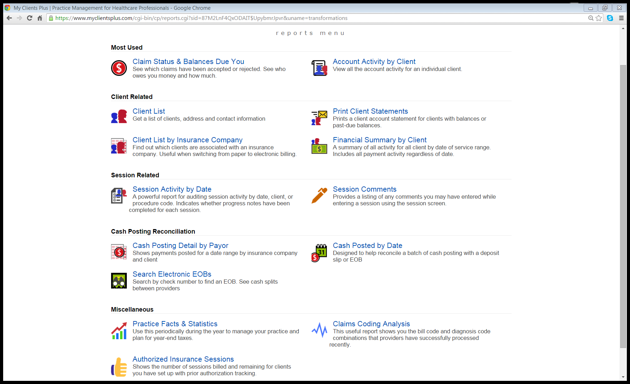
Click Here
Click on Session Activity by Date

Slide 38
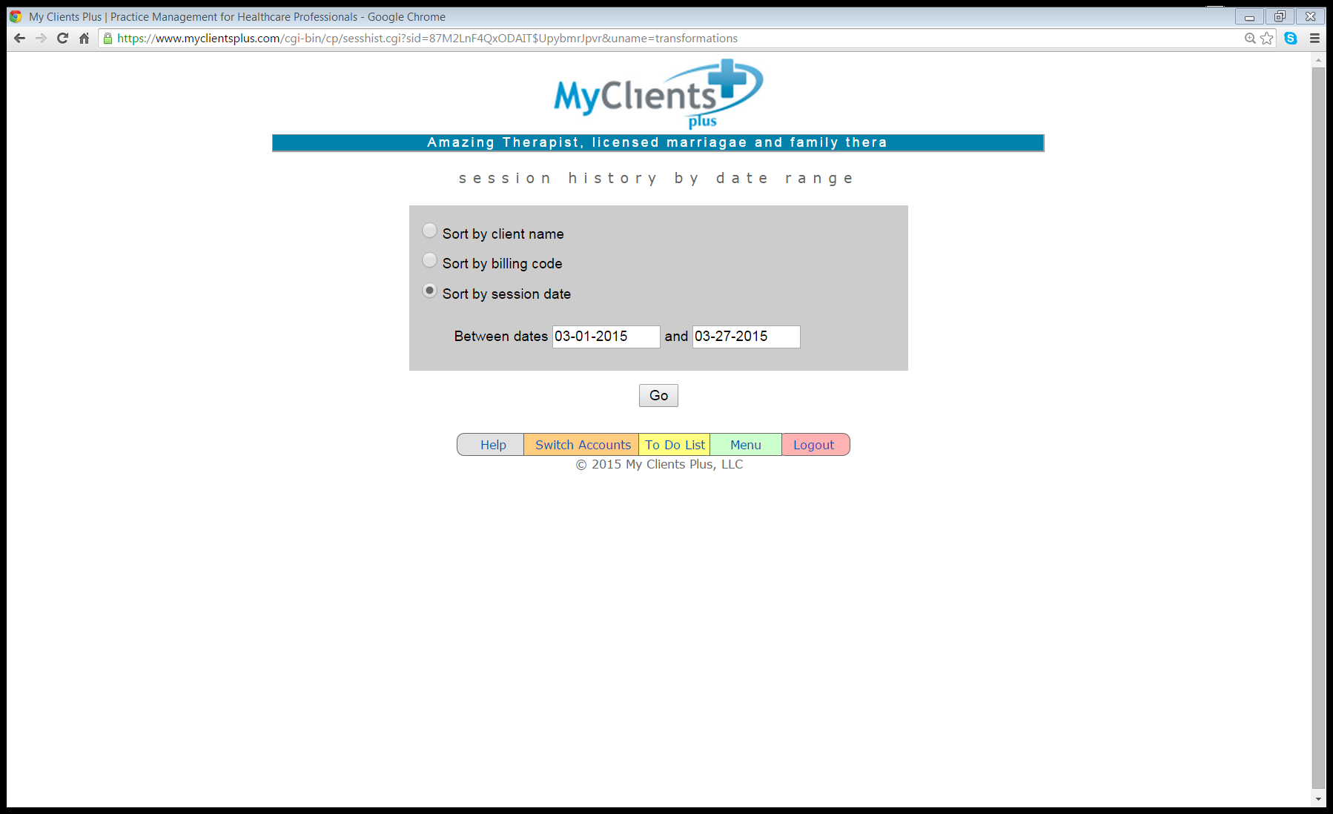
Sort and click go

Slide 39
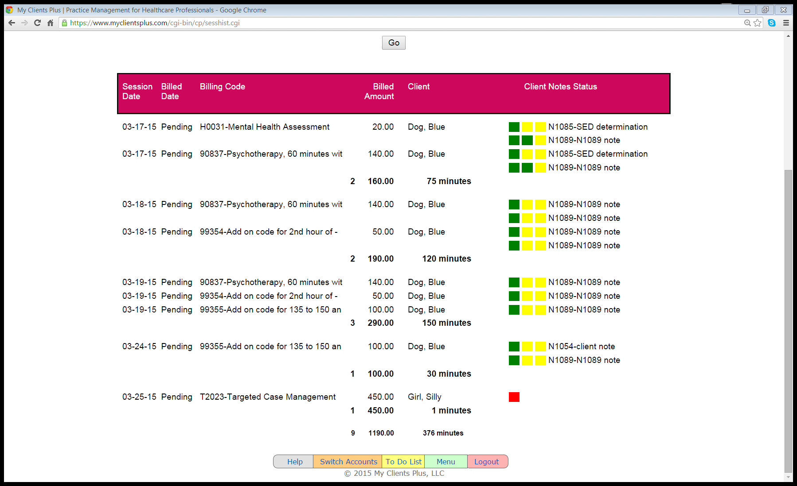
Hover your curser over the squares
This screen shows the client session bills and uses green, yellow and
red squares to indicate if the note has been written, locked and signed.

Slide 40
Start here
Another way to check your work is to click on client sessions.

Slide 41
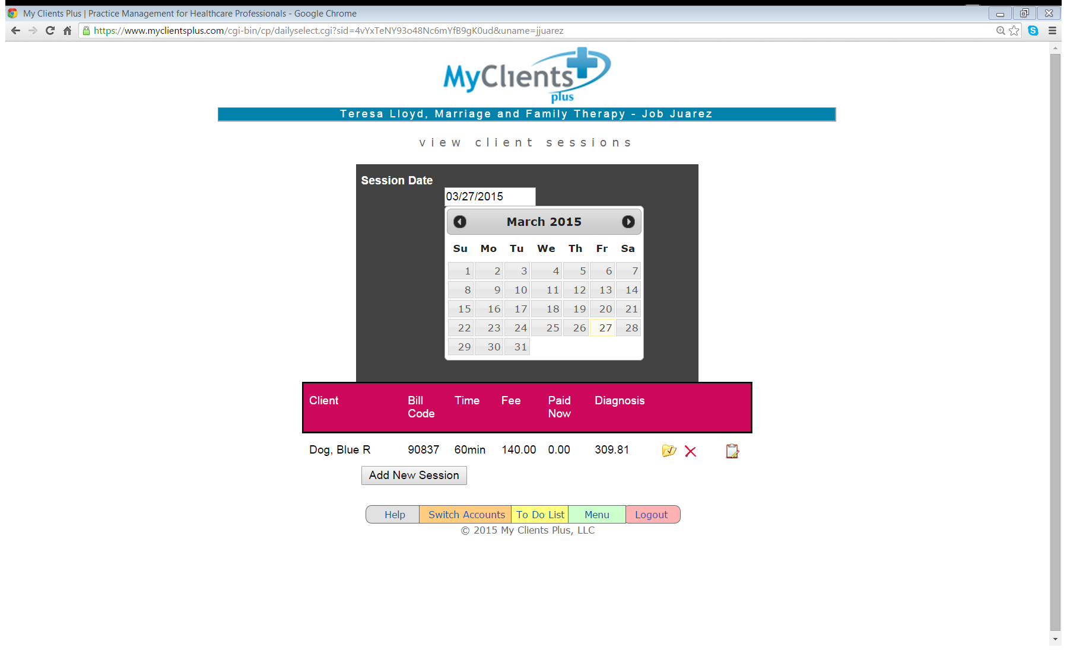
Click on the date and the client session bills will be displayed below the magenta bar. The file icon opens up the client session file. The clipboard shows whether or not
a note was entered on that date. You will need to click on print to view all the sessions recorded on the date indicated.

Slide 42
Start here
And another way to check your notes (but not the bill) is to click on client sessions.

Slide 43
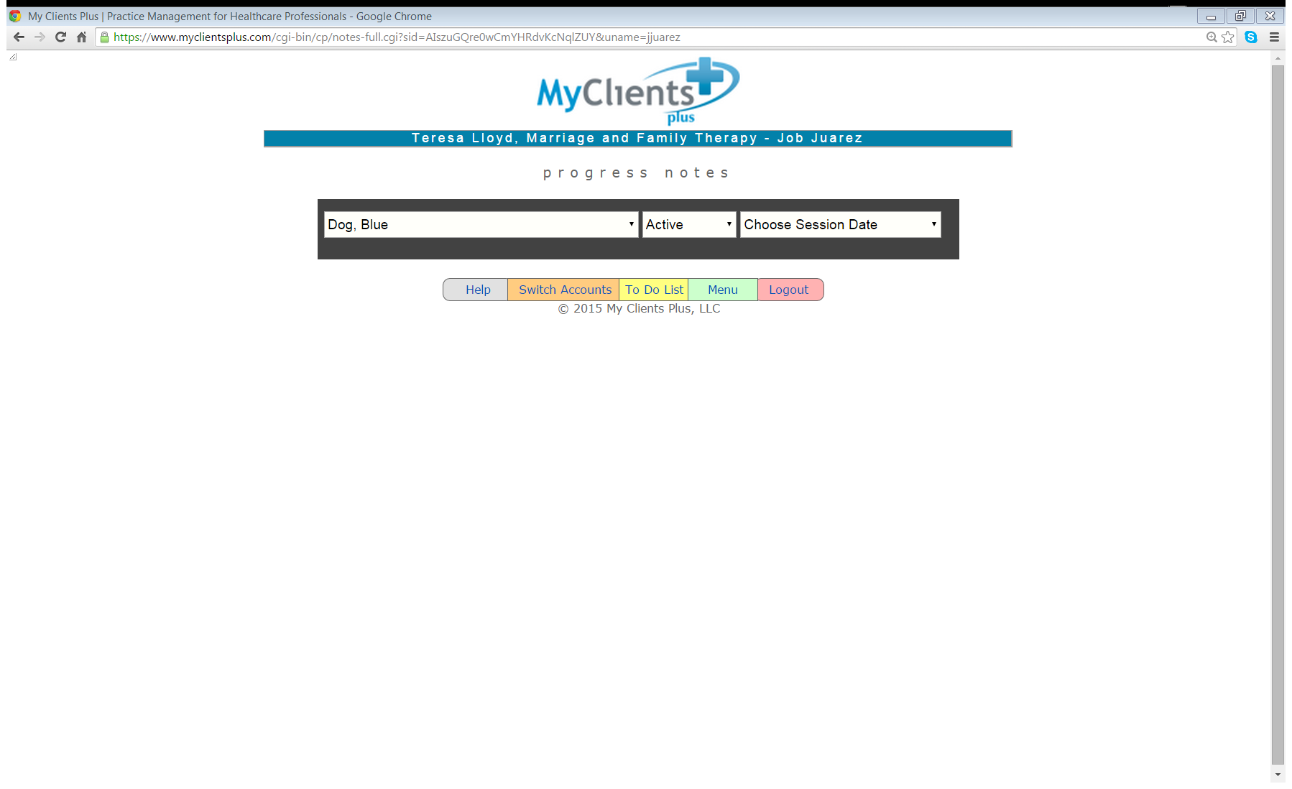
Click on the create new note drop down box. The dates of all of your notes are listed.

Slide 44
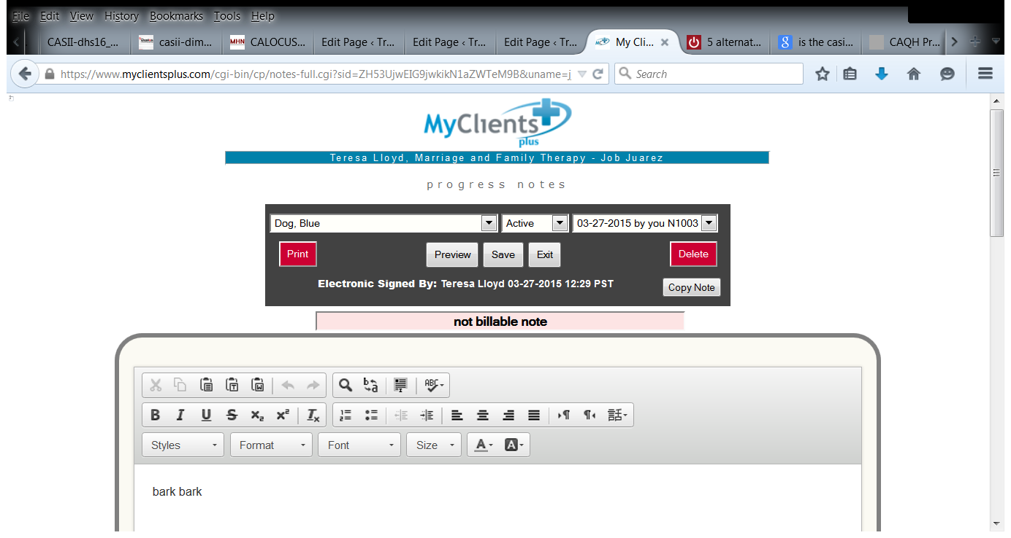
Click on the red print button and you can view all of
the client’s notes in a scroll down screen.

Slide 45
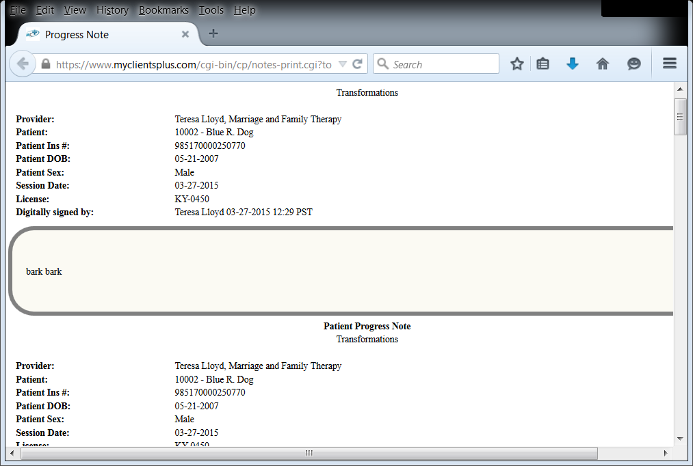

Slide 46
How do I track authorizations?

Slide 47
Click Here
Click on client Setup

Slide 48
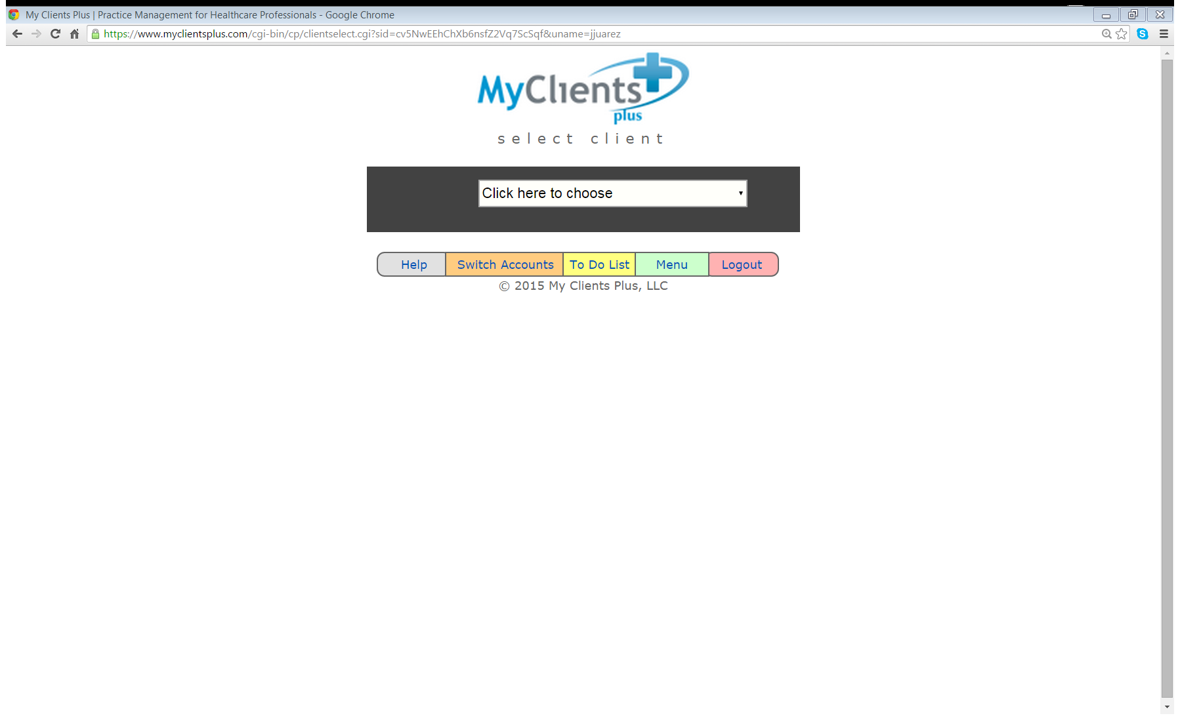
Click here to choose your client

Slide 49
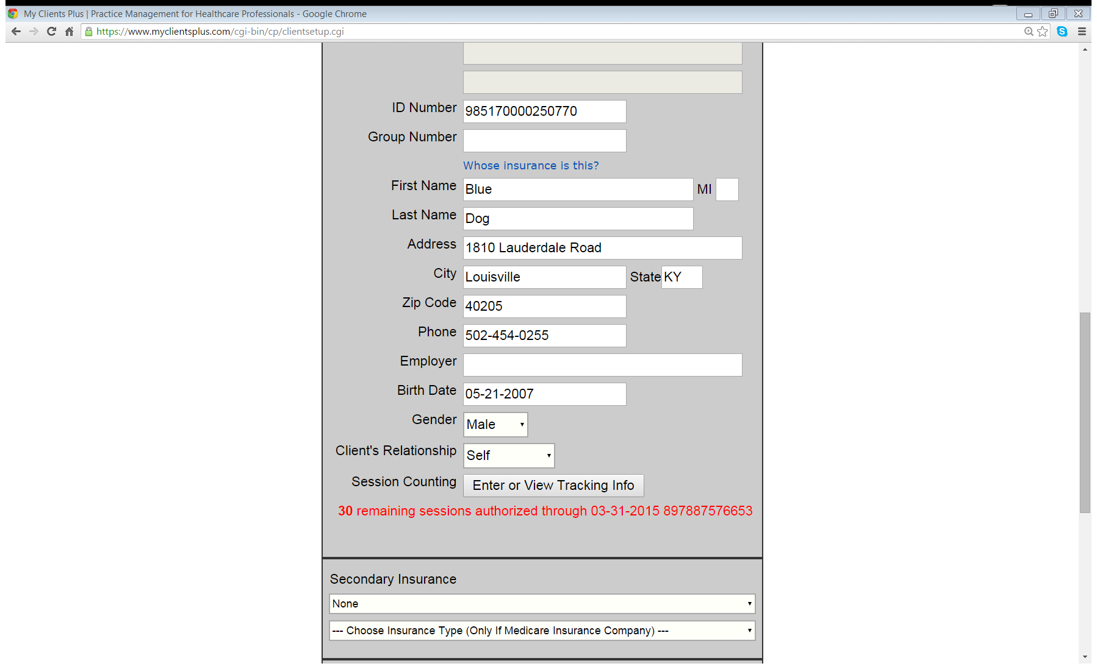
Scroll down to Session Counting

Slide 50
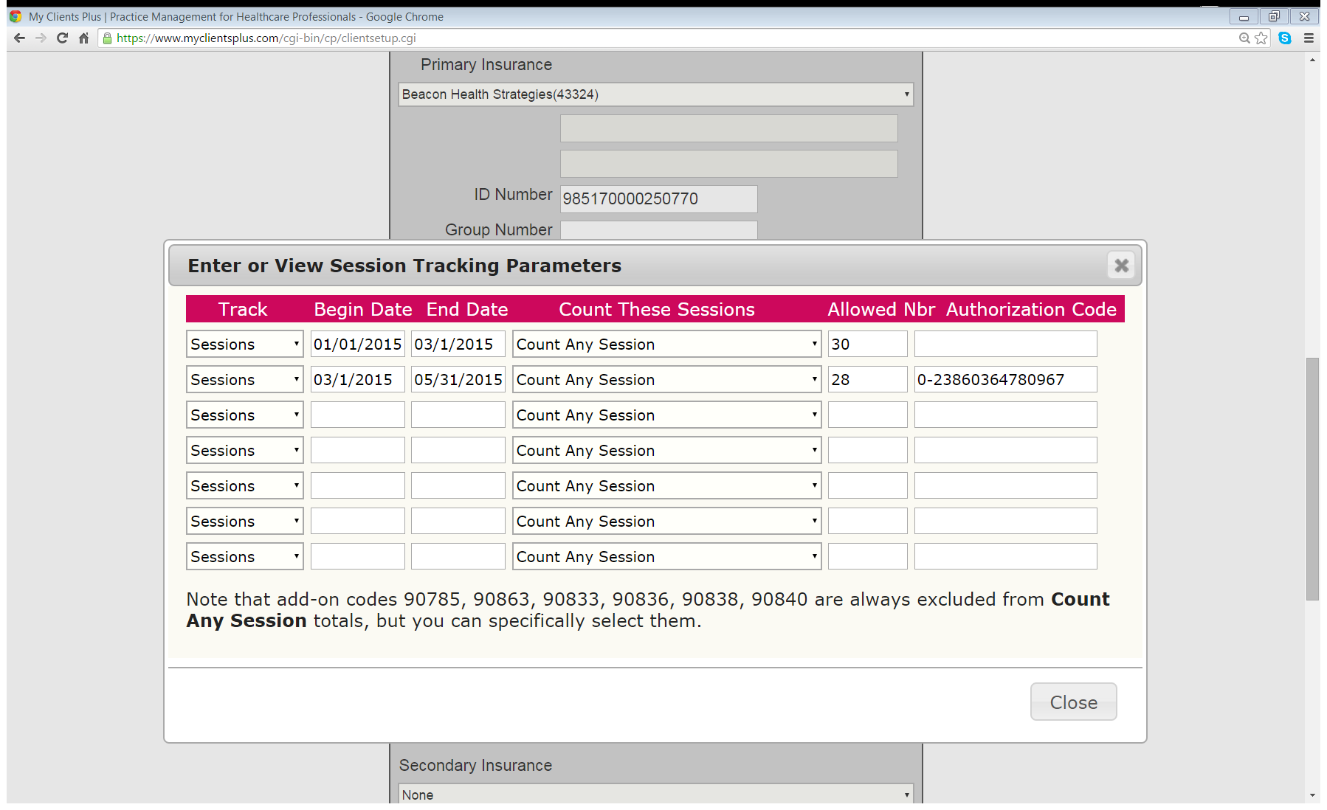
Remember to scroll down to the bottom of the page and click Save.

Slide 51
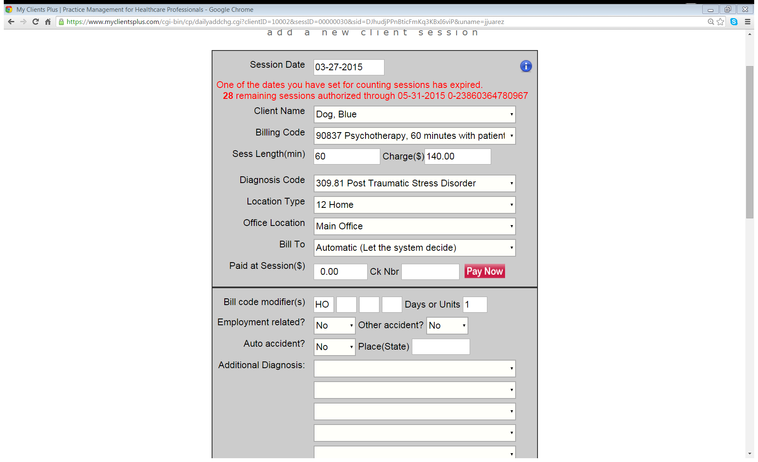
When you enter a client session bill, you will see the authorization number in red at the top of the page. Copy the number and then…..

Slide 52
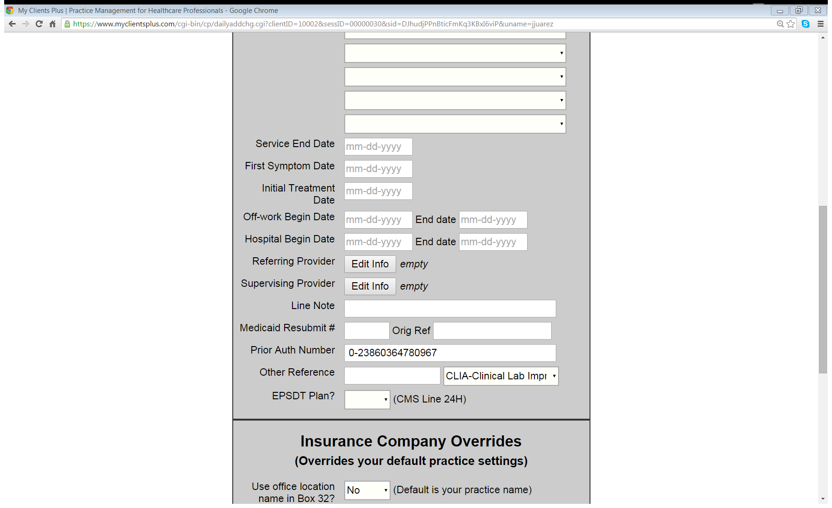
Paste the number in the Prior Authorization block

Slide 53
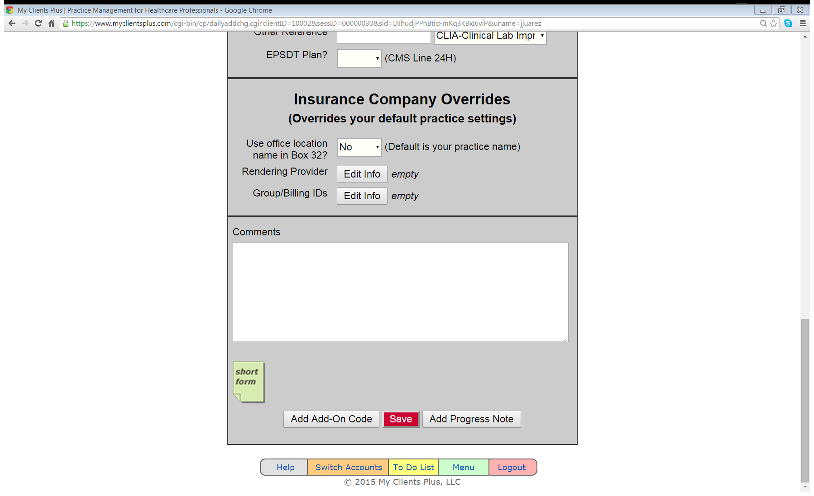
Scroll Down
And always remember to Save

