Slide 1

CASII
child adolescent service intensity instrument
Notes:
So I know you have a lot of questions? Do I have to do this? How long does it take to do it? Will it replace the CAFAS? Will it make my life easier? My goal is for Transformations to offer you a service that supports you in providing quality services and makes the professional both profitable and enjoyable. We developed an intake team that relieved you of doing the enrollment paperwork and the biopsychosocial. We moved to an EMR to provide efficiency in the billing process, to secure a speedier turn-around time on your payments and a better way to meet the new 48 hour regulation than driving into the office every other day. We adopted the CAFAS so that you could have a shared treatment plan and so that we could collect data to show the MCOs proof of your success. We currently have someone analyzing our CAFAS data and we will let you know the findings. If you are providing treatment to an adult or a child below the age of 5, we can not use the CAFAS Instead you are copying and pasting a treatment plan into MCP. And that has its benefits but it also means you have to be more intentional about sharing the plan with the treatment team. We are currently researching the Medicaid and mco requirements for treatment planning. How often do we really have to do the CAFAS? How often do we need to update the treatment plan? We are working on that.
But how is the CASII going to affect my goal?
First off lets clarify
On July 1, 2015 the Kentucky Department of Medicaid Services adopted four assessment tools. One is for drug and alcohol treatment (ASAM), the rest are for behavioral health. The CASII, for children and adolescents ages 5 to 19. The ECSII,for ages 0 to 5 and the LOCUS, for adults 19 and older. So we are actually looking at 3 tools. They were built off of each other and look and work the same with adjustments for the targeted age group. They are administered the same way the CAFAS is so you will be familiar with the process. So you will go through 5 or 6 categories and pick a column that describes the client’s behavior and it designates a score. Deb Holladay says the time to administer these assessments is less than 10 minutes. And I am counting on that today so that we get out of here on time.
Now let me reiterate that the Ky dept of Medicaid Services is requiring that these tools be used by the MCOs, not us. So that frees us up to look at if we want to use these tools, how we would want to use them. Will they help us meet my goal for Transformations to provide support for quality services and make your professional both profitable and enjoyable? So lets take a look.

Slide 2
Adopted by the Kentucky Department of Medicaid Services
For the purpose of standardizing level of care and service decisions
Notes:
The CASII is a tool that grades the level of need and then correlates it with the type and intensity and frequency of services. In days past the only level of care assessed with inpatient and out patient. The CASII recognizes the role of case management, CSA and community supports. Every medicaid managed care organization will be using this tool as they authorize services

Slide 3
The Child and Adolescent Service Intensity Instrument (CASII) is a standardized assessment tool that provides a determination of the appropriate level of services needed by a child or adolescent and his or her family. It is unique in its capacity to determine service intensity need, guide treatment planning, and monitor treatment outcome in all clinical settings.
Notes:
The Kentucky Department of Medicaid Services mandated all managed care organizations to utilize these tools for the purpose of determining medical necessity. What that means is, we now have a standard across all MCOs for determining level of care that will help us obtain authorization for services. I will elaborate some more on what this definition means.
So I know you have a lot of questions? Do I have to do this? How long does it take to do it? Will it replace the CAFAS? Will it make my life easier? Will it make it more complicated. My goal is for Transformations to offer you a service that supports you in providing quality services and makes the professional both profitable and enjoyable. We developed an intake team that relieved you of doing the enrollment paperwork and the biopsychosocial. We moved to an EMR to provide efficiency in the billing process, to secure a speedier turn-around time on your payments and a better way to meet the new 48 hour regulation than driving into the office every other day. We adopted the CAFAS so that you could have a shared treatment plan and so that we could collect data to show the MCOs proof of your success. We currently have someone analyzing our CAFAS data and we will let you know the findings. The CAFAS treatment plan does have its problems. If we can figure a way to do a shared treatment plan in MCP, I would gladly go to that. We could use the copy feature and edit the treatment plan rather than create a new one at every review. If you have done a treatment plan for an adult or a toddler in MCP you know it is pretty simple.

Slide 4
Which provider types may administer the CASII?
Notes:
Read screen

Slide 5

Holiday party picture of all providers goes here
Notes:
All provider types may administer the CASII

Slide 6
The CASII
Includes wraparound services, i.e. natural resources, case management, home based therapy, and CSA type services
Correlates the severity of a problem with greater frequency and intensity of services, rather than programs.
These services may be available at all levels of need.
Notes:
The CASII may be administered by you and it recommends the service types that you provide: Case management, CSA, Home based therapy. Ky is moving away from having programs like IMPACT Plus and focusing more on having services like the ones you provide. It is also more concerned with determining the frequency and intensity of your services than categorizing clients in to programs.

Slide 7
The CASII is an assessment tool and a service planning tool
Intensity of Problem
Intensity of Services
Notes:
The CASII tool gives a score to the intensity of the problem the client is experiencing and then correlates it with the type of services as well as the intensity and frequency of those services. I don’t think the CASII fits the state’s definition of a mental health assessment because it doesn’t result in a diagnosis. But I do think it fits into the treatment plan development service category.

Slide 8
Intensity of problem
1. Risk of Harm
2. Functional Status
3. Co-occurring Conditions
4. Recovery Environment
5. Resiliency and Response to Services
6. Involvement in Services
Notes:
The intensity of the problem is assessed in 6 different categories. Then each category is scored on a scale of 1 to 5 with 5 being the most severe.

Slide 9
Intensity of Problem
1. Risk of Harm: Child or adolescent’s risk of harm to self or other, assessment of potential for victimization, and accidental harm.
2. Functional Status: Assessment of the child’s ability to function in all age-appropriate roles, as well as basic activities of daily living
Notes:
Comment on the categories

Slide 10
3. Co-Occurrence: Co-existing disorders across four domains: Medical, Substance Abuse, Developmental Disability or Delay and Psychiatric
4. Recovery Environment: Two subscales: Environmental Stress and Environmental Support. Strengths/ weaknesses of the family, neighborhood and community -including services.
Notes:
3. Co-occurrence recognizes the children with multiple problems are at greater risk.
4. Stress and support

Slide 11
5. Resiliency and Response to Treatment: Child's emotional strength, capacity for successful adaptation, history of successful use of treatment
6. Involvement in Services: Assesses two things, the child’s active participation in treatment and the family or primary caregiver’s involvement in treatment.

Slide 12
Scoring the CASII
____I. Risk of Harm ______________________________________
___ II. Functional Status_________________________________
___ III. Co-Occurrence ___________________________________
IV. Recovery Environment
____ A. Stress _________________________________________
____ B. Support ________________________________________
____V. Resiliency and Response to Services __________________
___ VI. Involvement in Services: (record the higher of the two scores)
_____Child or Adolescent _________________________________
_____ Involvement in Services: Parent or Primary Caregiver _____
_____ Composite CASII Score
0 to 9 | 10 to 13 | 14 to 16 | 17 to 19 | 20 to 22 | 23 to 27 | 28 or more
Level 0 | Level 1 | Level 2 | Level 3 | Level 4 | Level 5 | Level 6
Notes:
The scores for each category is documented and added up for a composite CASII score.

Slide 13
Intensity of services
1. Basic services for prevention and maintenance (0 to 13)
2. Outpatient services (14 to 16)
3. Intensive outpatient services (17 to 19)
4. Intensive integrated services without
24 hour psychiatric monitoring (20 to 22)
5. Non-secure 24 hour services without
psychiatric monitoring (23 to 27)
6. Secure 24 hour services with psychiatric
monitoring (28 or more)
Notes:
We then take the composite score and use it to determine a level of service intensity.

Slide 14
Intensity of services
1. Basic services for prevention and maintenance
2. Outpatient services
3. Intensive outpatient services
4. Intensive integrated services without
24 hour psychiatric monitoring
5. Non-secure 24 hour services without
psychiatric monitoring
6. Secure 24 hour services with psychiatric
monitoring
Notes:
An aside to help you better understand the level of intensity. In the past these terms related to programs. Red is in-patient, Green is IMPACT Plus, Yellow is an IOP, 5 Cross Roads

Slide 15
Intensity of services
Meds in-home BHP TCM CSA
1. Basic services for prevention and maintenance
2. Outpatient services
3. Intensive outpatient services
4. Intensive integrated services without
24 hour psychiatric monitoring
5. Non-secure 24 hour services without
psychiatric monitoring
6. Secure 24 hour services with psychiatric
monitoring
Notes:
The CASII is designed to work more like this so that every service is available at every level of care. The difference would be the frequency and intensity.
Example: We were referred a client that was active in a therapeutic foster care program. These programs bill a bulk rate that includes therapy services. So traditionally we can not be reimbursed for therapy services to children in this program. Even a local partial hospitalization program was seeing this client for free because they could not get authorization. The client was referred to us and I used the documentation provided by the hospital and the therapeutic foster care program to request authorization. The services were denied. So I called up the client’s social worker at the therapeutic foster care program. We reviewed the CASII together over the phone and she gave the information to the MCO. The child was then approved for our therapy services.

Slide 16
Intensity of services
Level 1 Basic services for prevention and maintenance
Brief therapy, medication, and community resources
Level 2 Outpatient services
Traditional 1 x week outpatient therapy

Slide 17
Level 3 Intensive outpatient services
Therapy 2 to 3 times per week with up to three hours per visit. Includes multiple community services requiring coordination. Case management is an option
Level 4 Intensive Integrated Services without
24 hour psychiatric monitoring
Wraparound with formal supports such as CSA. May include partial, day treatment, case management is required.

Slide 18
Level 5 Non-secure 24 hour services without
psychiatric monitoring
Residential, group home, foster care and/or a tight knit wrap around team.
Level 6 Secure 24 hour services with psychiatric
monitoring
Inpatient, or highly structured residential, or wraparound if safety needs are met. Case management is essential

Slide 19
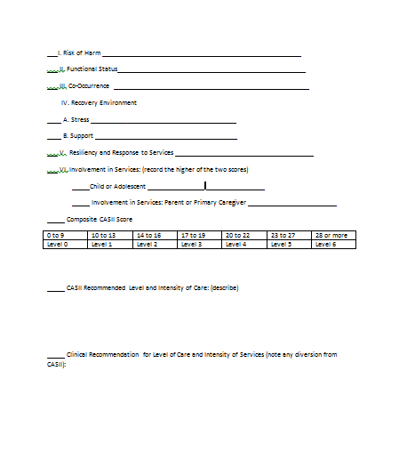
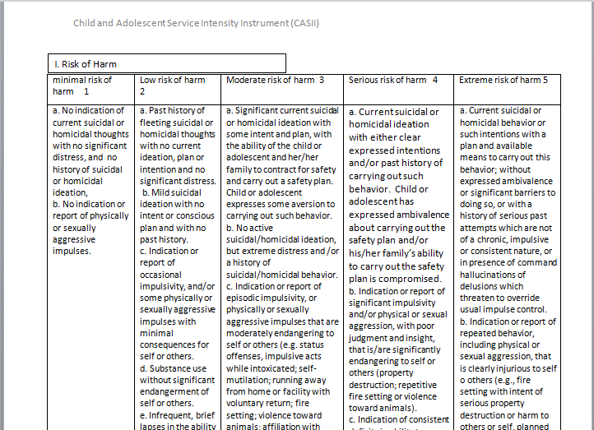
CASII Tools
Assessment Tool
Score Sheet
Notes:
Get these tools out. You will only need one copy of the Assessment tool. We do not need to fill this form out for each client.

Slide 20
Client: Harry Potter
Social worker-Hagrid
Placement: Residential care, Hogwarts
Harry is a teenage boy with a traumatic history. His parents were murdered and he sustained a head injury during the attack. He was an infant at the time. He was reared by his mother’s sister and husband. We suspect neglect and abuse. He was housed in a closet under the stairwell. They reported that Harry was an aggressive child and acted out aggressively on his younger cousin. He was removed from the home for out of control behaviors and placed in a residential setting. Attempts to reunite him with his family have been unsuccessful as the family does not participate in treatment or accept the need to make accommodating changes. Harry also claims he recently witnessed the murder of a peer.
Harry’s grades are excellent. However his social relationships with peers are conflictual and at times aggressive. He does tend to withdraw and is a target for bullying. His is often sneaky, dishonest, and defiant. His thought processes suggest a delusional disorder. He presents as paranoid and believes that he is being conspired against. His sense of self is distorted. He believes he has special powers and that his thoughts are invaded by the thoughts of others. He believes he can talk to snakes and reports auditory and visual hallucinations. On occasion he says his body is being invaded and his soul is being sucked out of him. Harry has two friends at the treatment center who evidence a shared psychotic disorder. They have adopted Harry’s delusions for themselves.
There is no known history of suicidal ideation or behavior. He is consumed with seeking revenge for the death of his parents but expresses some aversion to carrying out the threats. He has been violent toward some of the animals at his school. He has run away from the facility but voluntarily returned.. Harry has a positive history of drug use. He reports having tried some type of weed that distorted his experience of his body so that he thought he could breathe underwater and fly. He also reports drinking beer.
Despite his difficulties Harry manages to meet most expected levels of functioning. He recovers quickly from periods of deterioration. Generally his hygiene is no more disturbed than most young teens. As stated previously his grades and academic achievements are excellent. He excels in sports. There is no known disruption to his sleep cycle or eating habits. He is not sexually active and there are no known health issues.
Harry has developed a positive relationship with a few of the Hogwarts staff and they create a network that is partially able to compensate for Harry’s unmet needs. Unfortunately he does not have access to them during the summer break and decompensates when returned to his family. Harry cooperates with treatment and is bright enough to know that there is something wrong with him. He just doesn’t always agree with the staff’s interpretation of his difficulties.
The client’s social worker is considering placing Harry in foster care for the summer break and referring for in-home therapy with wrap around care. He has asked for your assessment on level of care and transition to lower intensity of services. Use the CASII assessment tool and your clinical judgement for your report.
Notes:
Here is our first client. Read this report and use the CASII to determine his score and services. Fill out the CASII work sheet and turn it in to your training supervisor. Be sure to write you name and the client’s name on the form.
Hints for Completing the assessment
Assess a problem not a diagnosis
Client will have behaviors in multiple columns but pick the column with the highest score.
If you can’t decide between two scores, go higher
Once you have completed the CASII score sheet, click to the next screen to compare your assessment with mine.

Slide 21
Hints for Completing the assessment
Assess a problem not a diagnosis
Client will have behaviors in multiple columns but pick the column with the highest score.
If you can’t decide between two scores, go higher

Slide 22
Harry Potter’s CASII Report
_3__I. Risk of Harm _ideation with aversion, substance use_________
_2__ II. Functional Status__episodes of defiance & dishonesty__
_3__ III. Co-Occurrence ___Substance use with adverse effect on disorder__
IV. Recovery Environment
_5___ A. Stress ___trauma: witnessed death of peer, lack of a home___
_3__ B. Support _Caregivers partially compensate for unmet need____
_3__V. Resiliency and Response to Services _maintained w/ strong support
_4__ VI. Involvement in Services: (record the higher of the two scores)
__2__Child or Adolescent _trusting relationships, problem def. _
__4___ Involvement in Services: Parent or Primary Caregiver _____
_23_ Composite CASII Score
0 to 9 | 10 to 13 | 14 to 16 | 17 to 19 | 20 to 22 | 23 to 27 | 28 or more
Level 0 | Level 1 | Level 2 | Level 3 | Level 4 | Level 5 X | Level 6
Notes:
review

Slide 23
When will we use the CASII?
At Intake with the Diagnostic Evaluation
At Treatment Planning time
When we request Authorization for services
Monthly Supervision logs for Associates and CSWs
Discharge Summary and Aftercare Planning
Notes:
When may we use the CASII? Whenever it is beneficial. Transformations uses the tool at intake for the diagnostic evaluation. This should help you when you accept a new case to know upfront the level of services required of you. Sara at passport told us she was going to start using the tool this January for authorizations. Wellcare and MHNet are already using it. I believe there is a place on beacon e services authorization form asking for the assessment score. I would like for Transformations to use the tool for supervision of associates and CSWs. It needs to go on our discharge summaries. This is a way to begin billing for the time you put into doing discharge summaries. By the way the time it takes to do this assessment

Slide 24
Where do we document this service?
On the Diagnostic Evaluation
On the Treatment Plan
On notes documenting the service planning
On the BHP/US Monthly Supervision Log
On the Discharge Summary

Slide 25
How do we bill for this service?
BHP and CSA may use the Treatment Plan Development code when the CASII is used for the writing of the treatment plan or if implemented with the CAFAS maybe billed as a Mental Health Assessment code.
TCM will bill all services as T2023

Slide 26
LOCUS
Level of care utilization services

Slide 27
The CASII was developed from the LOCUS so you will find that these two assessment tools are very similar
The LOCUS also assesses intensity of need in six dimensions and utilizes a 5 point scale to quantify severity
The LOCUS correlates the severity of the behavior with the intensity of services

Slide 28
Intensity of Need
CASII
LOCUS
1. Risk of Harm
2. Functional Status
3. Co-occurring Conditions
4. Recovery Environment
5. Resiliency and Response to Services
6. Involvement in Services
1. Risk of Harm
2. Functional Status
3. Medical, Addictive, and Psychiatric Co-Morbidity
4. Recovery Environment
5. Treatment and Recovery History
6. Engagement and Recovery Status

Slide 29
INTENSITY OF SERVICES
CASII
LOCUS
1.. Basic services for prevention and maintenance
2. Outpatient services
3. Intensive outpatient services
4. Intensive integrated services without
24 hour psychiatric monitoring
5. Non-secure 24 hour services without
psychiatric monitoring
6. Secure 24 hour services with psychiatric
monitoring
Recovery maintenance and health management
2. low intensity community based services
3. high intensity community based services
4. Medically monitored non-residential services
5. Medically monitored residential services
6. Medically managed residential services

Slide 30
The LOCUS manual is posted on our website
As well as a power point presentation by Mary Thornton, a Medicaid trainer

Slide 31
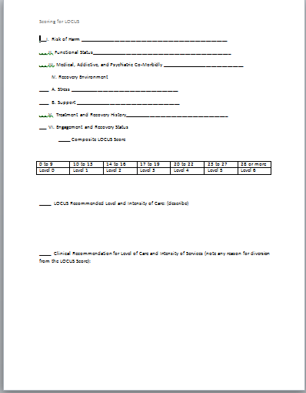
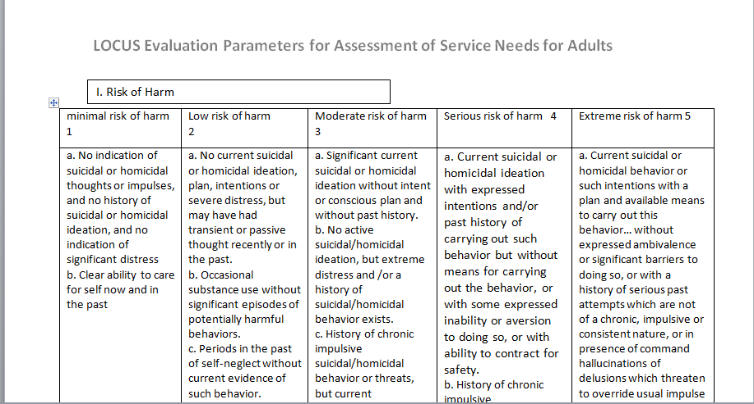
LOCUS TOOls
Assessment tool
Score sheet

Slide 32
Lars and the real girl
A delightful movie

Slide 33
Lars
Lars is a 20 something single male who lives alone, but near the home of his only brother and sister- in-law in a small town. His parents are both deceased. His mother died during his childbirth. His father’s death is much more recent. His sister-in-law is pregnant and approaching the due date. There is no current or known history of suicidal or aggressive behavior. He has been significantly withdrawn and avoidant of almost all social interaction. Lars may have a sensory disorder. He does not tolerate human touch. He has no known history of substance use or abuse, no known medical conditions or any other psychiatric disorders apart from the presenting symptom: Lars has a fixed delusion. He has ordered a life-size sex doll and has the delusion that she is a real woman and his girlfriend. His brother is highly disturbed by the behavior and wonders if he should be institutionalized. His sister-in-law is actively seeking psychiatric help and assists in engaging the small town community to interacting with Lars and his delusion. The community is responsive and highly supportive. He works, shops, attends church and has begun to interact with others from the delusion. Lars has no prior treatment experience. He has no insight into his bizarre behavior. He does not see a need for help or treatment for himself. He is distrustful and avoidant.
What is his LOCUS score and level of service intensity?

Slide 34
Scoring of LOCUS
___I. Risk of Harm ________________________________
___ II. Functional Status______________________________
___ III. Medical, Addictive, and Psychiatric Co-Morbidly ________
IV. Recovery Environment
____ A. Stress _________________________________________
____ B. Support ________________________________________
___ V. Treatment and Recovery History___________________
___ VI. Engagement and Recovery Status__________________
_____ Composite LOCUS Score
Level of Service Intensity:
Clinical judgement and diversion from LOCUS recommendations:
0 to 9 | 10 to 13 | 14 to 16 | 17 to 19 | 20 to 22 | 23 to 27 | 28 or more
Level 0 | Level 1 | Level 2 | Level 3 | Level 4 | Level 5 | Level 6

Slide 35
Scoring of LOCUS
_1__I. Risk of Harm _no current or history of___
_4_ II. Functional Status _withdrawn and avoidant of almost all__
_1__ III. Medical, Addictive, and Psychiatric Co-Morbidly _______
IV. Recovery Environment
__4__ A. Stress __Death of father and new baby coming_______
__1__ B. Support ____plenty of support and resources___
_1__ V. Treatment and Recovery History __ no prior experience _
_5__ VI. Engagement and Recovery Status __ denial and avoidant __17___ Composite LOCUS Score
Level of Service Intensity: Level 3 High Intensity Community Based Services.
Clinical judgement and diversion from LOCUS recommendations: CSA and Case Management may not be necessary due to role of sister-in-law in facilitating community resources.
0 to 9 | 10 to 13 | 14 to 16 | 17 to 19 | 20 to 22 | 23 to 27 | 28 or more
Level 0 | Level 1 | Level 2 | Level 3 | Level 4 | Level 5 | Level 6

Slide 36
ESCII
Early Childhood Service Intensity Instrument

Slide 37
The Early Childhood Service Intensity Instrument (ESCII) was developed to determine intensity for services for children age 0 to 5

Slide 38
Assessment Domains for the ESCII
1. Degree of Safety
2. Child-Caregiver Relationship
3. Caregiving Environment
4. Functional Developmental Status
5. Impact of Medical, Developmental, or Emotional/Behavioral Problems
6. Service Profile
Notes:
Each category is scored on a scale of 1 to 5 and then added up for a total score

Slide 39
Service Intensity Level for the ESCII
1. Basic health services
2. Minimal service intensity (beginning care)
3. Low service intensity
4. Moderate service intensity
5. High service intensity
6. Maximal service intensity

Slide 40
7 Service Categories
Evaluation
Medical
Developmental/Educational
Mental Health
Social service/child welfare
Care Coordination/ Child and Family Teams
Community and Natural Supports

Slide 41
Service Intensity: Evaluation
0 Primary care check-up; Health screening in pre-school settings
1 Evaluation in a single service area
2 Evaluations from one or more service areas
3 Evaluations from multiple service areas, with repeated visits
4 Complex, integrated, multidisciplinary evaluation
5 Evaluation in inpatient or other 24-hour setting

Slide 42
Service Intensity: Medical
0 Well child care/ primary health care
1 Primary care management of acute common childhood illness,
e.g. occasional otitis media, gastroenteritis
2 Chronic medical problems manageable by primary care provider,
e.g. asthma or recurrent otitis media
3 Chronic medical problems managed by primary care provider
with occasional specialist consultation
4 Chronic medical problems requiring management by specialist or
multiple specialist consultation, e.g. poorly controlled diabetes,
chronic failure to thrive
5 Frequent hospital admissions, secure nursing facility or chronic
care facility; medical foster

Slide 43
Service Intensity: Developmental/Educational
0 Head Start; Regular preschool; Child care
1 Single developmental therapy (e.g. speech or occupational
therapy)
2 Early Intervention service provided in home; Added
supports in classroom without IEP eligibility
3 Center-based Early Intervention or Early Special Education
(1 day/wk); Multiple developmental therapies
4 Center-based Early Intervention or Early Special Education
(multiple days per week)
5 Self-contained special education placement with full-time 1-
to-1 aide

Slide 44
Service Intensity: Mental Health
0 Mental health screening in school or primary care setting
1 Parent guidance and support, e.g. parent education/ training; Mental
health consultation to Head Start or child care
2 Entry mental health services (1x per week or <) by a behavioral specialist
(e.g. individual, dyadic, family, or parental therapy); Psychiatric diagnosis
and psychotropic medication by a primary care practitioner
3 Intensive outpatient (i.e. more than one session per week) of individual,
dyadic, family, or parental therapy; More than one modality concurrently
4 Psychiatric day treatment; Very intensity individual, dyadic or family
therapy (multiple sessions per week, some which may be home-based);
Multiple modalities concurrently, generally requiring multiple agency
involvement
5 Therapeutic out-of-home placement (e.g. treatment foster care);
Psychiatric hospital (for children > 2 ½); Residential treatment

Slide 45
Service Intensity: Social Services/Child Welfare
0 Public health education; basic financial assistance; home visits for first time
mothers
1 Public assistance (TANF); periodic home monitoring for identified area of
concern
2 Parenting education classes for area of concern; regular home monitoring or
intervention for area of concern; low level referrals to child welfare
3 Beginning home-based family support services (e.g. one day a week of
respite); voluntary child welfare involvement; Foster care for non protective
reasons (e.g. parent is killed)
4 Intensive home-based services (e.g. family preservation services); open child
protective services case due to substantiated
5 Open child protective service case due to substantiated child maltreatment
that may require removal from the home; treatment foster care

Slide 46
Service Intensity: Care Coordination/
Child And Family Teams
0 Caregiver (s) (e.g. parents) coordinates services as needed
1 Caregiver(s) (e.g. parents) coordinates services as needed in collaboration
with primary service provider (e.g. primary care physician, therapist)
2 Primary service provider (e.g. therapist) performs care coordination as
needed in collaboration with caregiver(s) (e.g. parents)
3 Separate care coordinator (i.e. not primary service provider) if multiple
providers are involved. Development of child and family team (CFT) with
active family involvement. CFT may meet on as-needed basis or be timelimited
4 Formal care coordination with a child and family team (CFT) that meets
regularly
5 Formal care coordination with a child and family team (CFT)

Slide 47
Service Intensity: Community and Natural Supports
0 Support from family, kin, community; child care, faith-based community
1 Parents support group or parenting education class; increased involvement
of extended family
2 Specialized parent education program to address need; increased
community supports
3Trained parent mentor; trained parent advocate; family support services
4 Intensive home-based support to help with daily functioning; home-based
parent coaching
5 Intensive in-home support for a greater number of hours and supporting
safety in the home

Slide 48
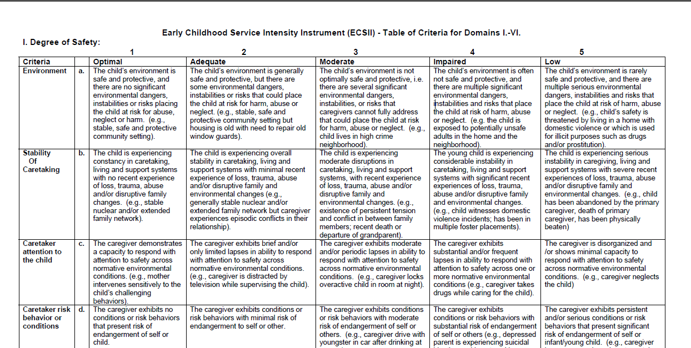
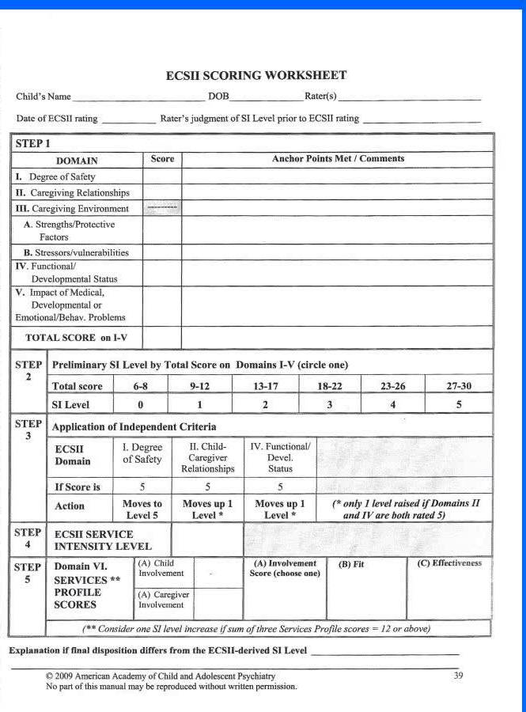
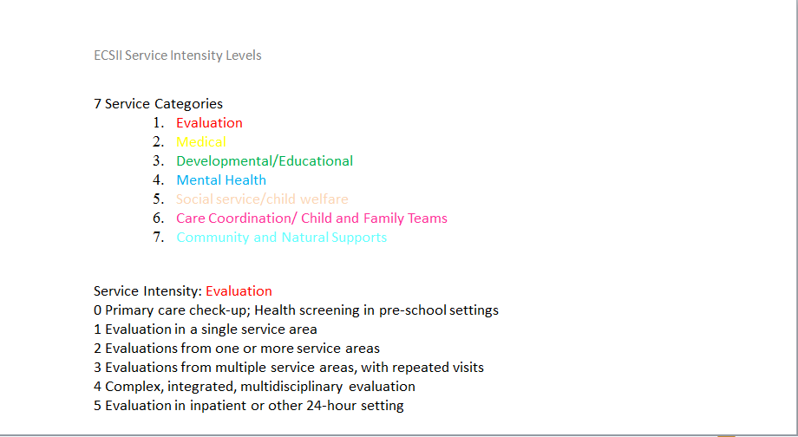
ECSII Tools
Assessment tool
Score sheet
Service Intensity Tool

Slide 49
Jack is a 5 year old boy whose unmarried parents separated eight months ago. He and his mother live in a two bedroom apartment. They receive public assistance and is mother is in a job training program part-time. Jack’s speech and motor skills are age appropriate and he was toilet trained successfully. His general health has been fine. Over the past six months Jack has developed steadily worsening escalating behavior problems. He has been overactive, distractible, and won’t follow directions. He seems to be irritable most of the time, loses his temper frequently and often breaks things. He bites himself an hits his mother when frustrated . He has trouble getting to sleep at night most nights. Earlier this week he threatened to kill himself when his mother reprimanded him. He recently found a lighter at a neighborhood park and set a fire in the house, which fortunately was extinguished before much damage was done.
Jack had been attending Head Start on week days until recently. Despite the involvement of a mental health consultant to Head Start and medication trials by his pediatrician for hyperactivity and aggression, they were unable to contain his behavior at Head Start and are not allowing him to return until his behavior is stabilized. Several appointment have been scheduled at the local mental health center abut these have not been kept allegedly because of transportation problems. The parents broke up because the father would hit jack and his mother when he was drinking. Jack saw the father hitting the mother, once resulting in noticeable facial bruising. She has custody but the father takes Jack at times for visitation. The head Start teacher contacted child protective services because of concerns about jack’s safety during these visits., but their evaluation is pending and no action has yet been taken. Jack’s mother has struggled with depression in the past and made a non-serious suicide attempt by a pill overdose tow years ago. She was hospitalized briefly by elected not to pursue ongoing mental health treatment after discharge. She denies any history of substance abuse.

Slide 50
Jack’s ESCII Score Sheet
STEP 1
DOMAIN |  |  |  |  | Score |  |  | Anchor Points Met/Comments
I. Degree of Safety |  |  |  |  | 5 |  |  | Low Degree of Safety. Fire setting, witness and victim of violence, still with perpetrator, suicidal threat
II. Caregiving Relationships |  |  |  |  | 4 |  |  | Moderate Impairment. Worsening behavior, irritable, hitting, temper tantrums, sleep difficulties
III. Caregiving Environment |  |  |  |  | -------------
Strengths/protective Factors |  |  |  |  | 4 |  |  | Minimal. Housing is secure but childcare is disrupted due to his behavior. Missed appointments, father violent with child, mother depressed, and suicide attempt, hospitalized and no follow up.
Stressors/vulnerabilities |  |  |  |  | 4 |  |  | Serious. Intermittent aggression in family. Depressed suicidal mother with no treatment
IV. Functional/Developmental Status |  |  |  |  | 4 |  |  | Moderate impairment. Trouble falling asleep. Expelled from school, overactive, defiant, irritable, bites self
V. Impact of Medical, Developmental or Emotional/Behavior Problems |  |  |  |  | 4 |  |  | Moderate impairment. Behavior is disrupting daily functioning, can’t go to school due to behavior
TOTAL SCORE ON I-V |  |  |  |  | 25 |  |  | Level 4
STEP 2 | Preliminary SI Level by Total Score on Domains I-V (select one)
 | Total Score |  |  | 6-8 |  | 9-12 |  |  | 13-17 |  |  | 18-22 |  |  | 23-26 |  | 27-30
 | SI Level |  |  | 0 |  | 1 |  |  | 2 |  |  | 3 |  |  | 4 |  | 5
STEP 3 | Application of Independent Criteria
 | ECSII Domain | I. Degree of Safety |  |  |  |  | II. Child-Caregiver Relationships |  |  |  | IV Functional/ Devel. Status
 | If Score is | 5 |  |  |  |  | 5 |  |  |  | 5
 | Action | Moves to Level 5 |  |  |  |  | Moves up 1 Level* |  |  |  | Moves up 1 Level * |  |  | (* only 1 level raised if Domains II and IV are both rated 5)
STEP 4 | ESCII SERVICE INTENSITY LEVEL |  |  |  |  |  | Level 5
STEP 5 | Domain VI. SERVICES ** PROFILE SCORES |  | (A)Child Involvement |  |  |  | Minimal 4 |  |  | (A) Involvement Score (choose one) 4 minimal |  |  | (B) Fit Minimal 4 |  |  | (C) Effectiveness None 5
 |  |  | (B) Caregiver Involvement |  |  |  | Minimal 4
 | (**) Consider one SI level increase if sum of three Services Profile scores _ 12 or above

Slide 51
STEP 2 | Preliminary SI Level by Total Score on Domains I-V (select one)
 | Total Score |  |  | 6-8 | 9-12 |  | 13-17 |  |  | 18-22 |  |  | 23-26 |  | 27-30
 | SI Level |  |  | 0 | 1 |  | 2 |  |  | 3 |  |  | 4 |  | 5
STEP 3 | Application of Independent Criteria
 | ECSII Domain | I. Degree of Safety |  |  |  | II. Child-Caregiver Relationships |  |  | IV Functional/ Devel. Status
 | If Score is | 5 |  |  |  | 5 |  |  | 5
 | Action | Moves to level 5 |  |  |  | Moves up 1 Level* |  |  | Moves up 1 Level * |  |  | (* only 1 level raised if Domains II and IV are both rated 5)
STEP 4 | ESCII SERVICE INTENSITY LEVEL |  |  |  |  | Level 5 |  |  | Maximal service intensity
STEP 5 | Domain VI. SERVICES ** PROFILE SCORES |  | (A)Child Involvement |  |  | Minimal 4 |  | (A) Involvement Score (choose one) 4 minimal |  |  | (B) Fit Minimal 4 |  |  | (C) Effectiveness None 5
 |  |  | (B) Caregiver Involvement |  |  | Minimal 4
 | (**) Consider one SI level increase if sum of three Services Profile scores _ 12 or above

Slide 52
Take a look at the Assessment tool and lets run through 6 dimensions of the Assessment

