Slide 1
Successful Implementation of Nurturing Parenting Programs®
Stephen Bavolek, Ph.D.
Family Nurturing Center
Carol Lapin, MSSW
National Trainer/Consultant
Nurturing Parenting Programs®

Slide 2
Communicating and Connecting
  My name is ….
  My agency is ….
  The families I serve are….
  My experience in facilitating Nurturing Parenting Program curricula is ….
  My favorite childhood memory is ….

Slide 3
Hopes and Fears
Hopes for the families you serve.
Fears for the families you serve.

Slide 4
What is Abuse or Neglect?
Group activity

Slide 5
Tragic Results of Child Abuse and Neglect
It is estimated that five children die each day from abuse and/or neglect.
Do the math: 5 children x 365 = 1,825 dead each year x 81 years (average lifespan of American female) = 147,825 children will die.
The negative health effects reach well beyond these fatalities.
P. 9

Slide 6
The ACE Study
Adverse Childhood Experiences
and the development of
Protective Factors
ACE Survey (see p. 94)
P. 56

Slide 7
Adverse Childhood Experiences Study
The ACE Study
Goal
From 1995 to 1997, approximately 17,500 adult patients of Kaiser Permanente Health Clinic completed a questionnaire regarding their exposure to 10 adverse childhood experiences.
To examine the link between
childhood stressors and
adult health.
P. 56

Slide 8
ACE Study
Ten exposures of adverse experiences were studied:
Physical, emotional and sexual abuse
Physical and emotional neglect
Household substance abuse
Mental illness
Incarceration
Mother treated violently
Separation/divorce
P. 56

Slide 9
Findings of ACE Study
More than half of the 17,500 adults completing the questionnaire reported at least one exposure
25% reported two or more childhood exposures
Patients who experienced four or more childhood exposures compared to patients who experienced none had a 4 to 12 fold increase for health risks.
P. 56

Slide 10
Findings of the ACE Study
Health risks included:
Alcoholism
Drug Abuse
Depression
Attempted Suicide
Smoking
Poor self-rated health
Physical Inactivity
Severe Obesity
Sexually transmitted diseases
P. 56

Slide 11
Findings Related to Child Maltreatment
28% of the respondents indicated they were physically abused
21% sexually abused
15% emotionally neglected
11% emotionally abused
10% physically neglected
P. 56

Slide 12
Findings of ACE Study
The higher the score on the survey, the greater risk of dying up to 20 years early.

Slide 13
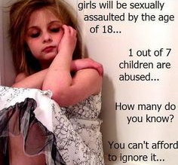
Why does child maltreatment flourish
in the
21st century?

Slide 14
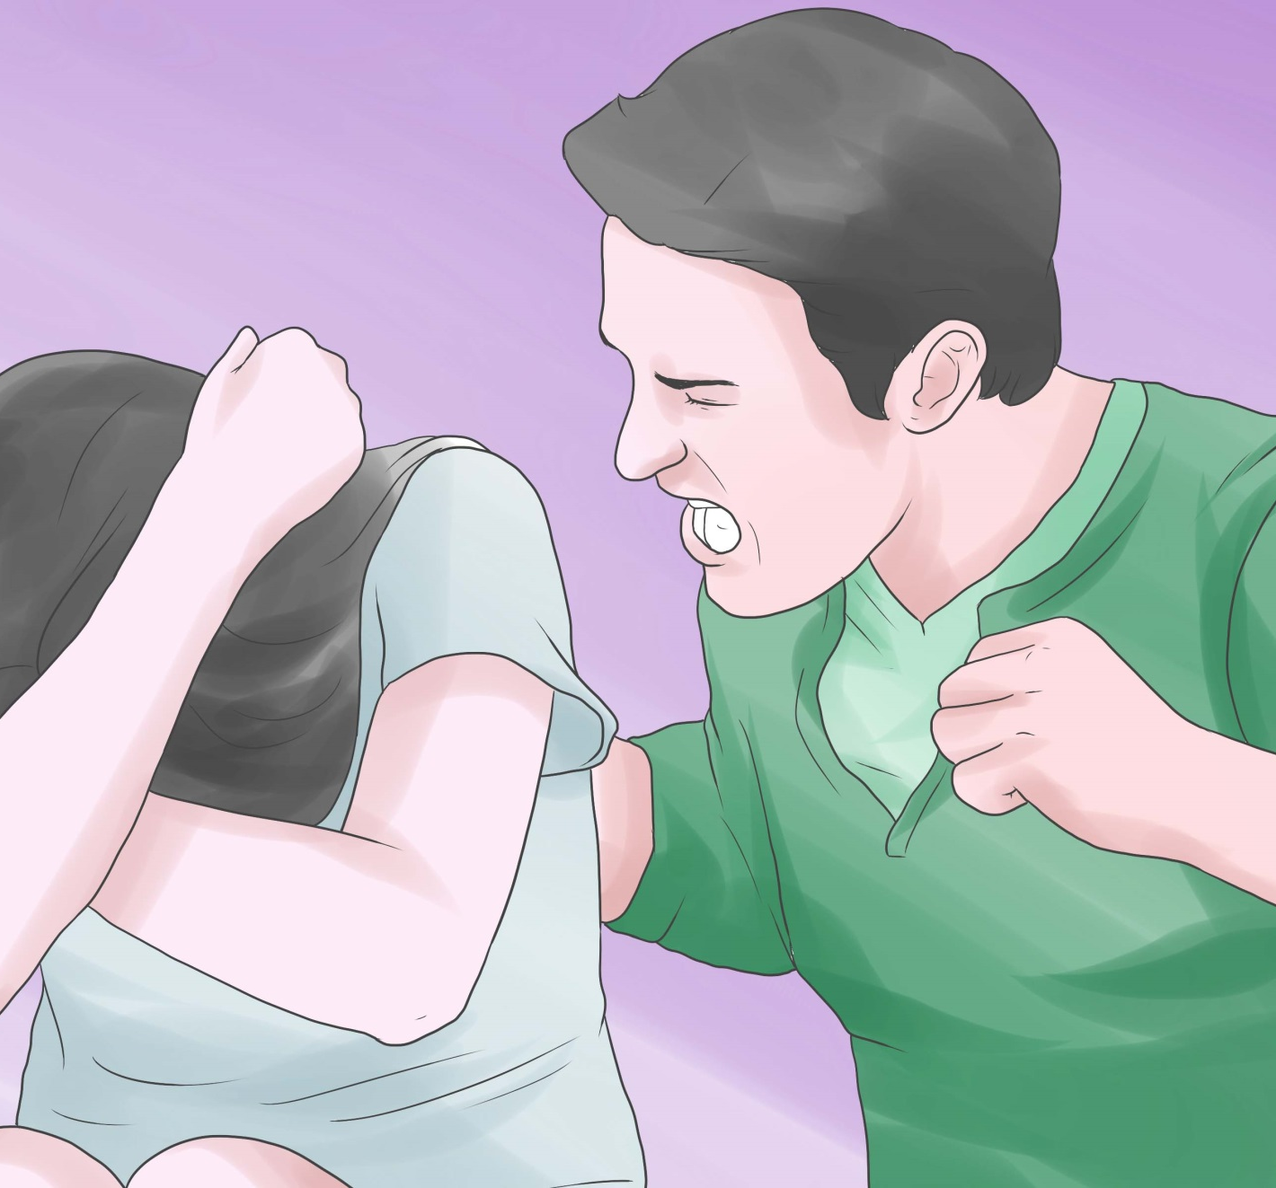
Are humans genetically violent by nature?

Slide 15

Is human behavior determined more by their nature or nurture?

Slide 16
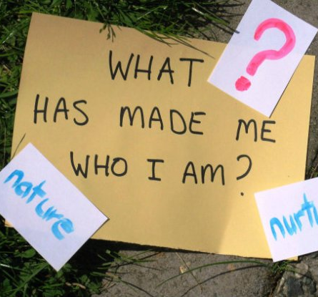
Is child maltreatment the result of human nature or nurture?

Slide 17
Nature’s Heritable Traits
Physical traits and behaviors passed on through DNA:
Eye color
Tongue roller
Patterned baldness
Height
Intelligence
Blood type
    P. 10

Slide 18
Nature vs. Nurture
20% personality comes from nature (primarily physical and mental health)
80% of personality comes by way of how we were treated during the process of growing up.
P. 10

Slide 19

Nurturing Parenting Programs®
Evidence-Based Programs for the Prevention and Treatment of Child Abuse and Neglect

Slide 20
Dr. Bavolek’s Research
Understanding Abusive and Neglecting
Parenting Beliefs

Slide 21
Critical Practices of Child Maltreatment
Construct A: Inappropriate parental expectations of their children.
Construct B: Parental lack of empathy in meeting the needs of their children.
Construct C: Strong belief in the use of corporal punishment.
Construct D: Reversing parent-child family roles and responsibilities.
Construct E: Oppressing children’s power and independence.
P. 13

Slide 22

Process and Product
Understanding Children’s Behavior

Slide 23
Inappropriate Expectations
Construct A of the AAPI
Process:
Beginning very early in the infant’s life, abusive and neglecting parents tend to inaccurately perceive the physical, emotional, and intellectual skills and abilities of their children.
Parental expectations exceed the capabilities of each of their children.
Despite individual differences, children are expected to perform within the same standards parents have set.
P. 13

Slide 24
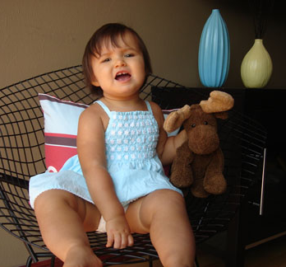
Inappropriate Expectation
Children should be aware of ways to comfort their parents after a hard day’s work.

Slide 25
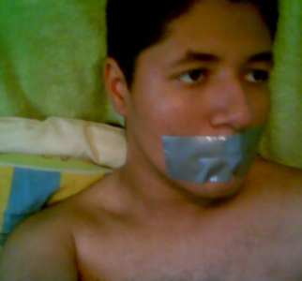
Inappropriate Expectation
Children should be seen and not heard.

Slide 26
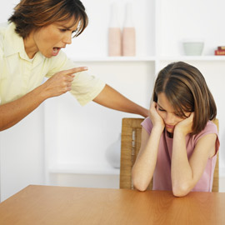
Inappropriate Expectation
Children should do what they’re told to do, when they’re told to do it. It’s that simple.

Slide 27
Common Effects of Inappropriate Expectations on Children
Low regard for self (concept, esteem, worth)
Feelings of failure
Cannot please others
Angry and anxious attachments
Lack of trust in their skills and abilities
Constantly striving to achieve higher goals because they are seldom satisfied with accomplishments.
Develop a role based/performance-based identity
Difficulty in accepting positive recognition
P. 15

Slide 28
Consistent Lack of Parental Empathy
Construct B of the AAPI
Process:
Abusive and neglecting parents are:
Insensitive to their children’s needs as well as their own needs
Fail to create a caring environment that is conducive to promoting children’s emotional, social, intellectual, physical, spiritual, and creative growth.
Fail to bond and form early attachments.
P. 15

Slide 29
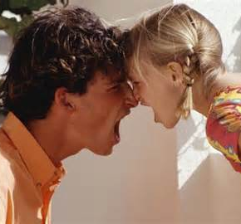
Lack of Parental Empathy
Children should be obedient to authority figures.

Slide 30
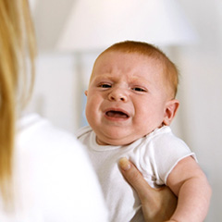
Lack of Parental Empathy
Parents spoil babies by picking them up when they cry.

Slide 31
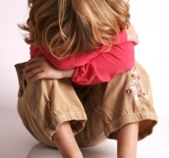
Lack of Parental Empathy
The less children know the better off they are.

Slide 32
Common Effects of Low Parental Empathy
Children develop:
Diminished ability to trust with fears of abandonment
Difficulty in taking care of one’s self
Develop clingy relationships
Focus is on self and easily led by others.
Possessive and smothering relationships
Inability to communicate feelings in healthy ways
Inability to bond with others and to form positive attachments
P. 15

Slide 33
Attachment Research
Infants will adopt 1 of the 3 ways of relating to their parent

Slide 34

Secure
Attachment
Child sees mother/father as supportive and feels free to explore the world.
p. 16

Slide 35

Anxious
Attachment
Child sees mother/father as an unpredictable caregiver and commits his or her life to earning mother/father’s love.
p. 16

Slide 36
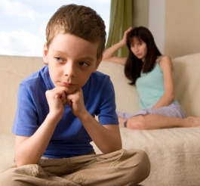
Avoidant
Attachment
Child sees mother as rejecting and consequently discounts his or her own needs.
p. 16

Slide 37
Learning Emotional Regulation
Children need to feel confident that their feelings will be heard.
Name and honor the feeling the child may be expressing.
All feelings have energy. Children need to learn proper ways to express the energy.
Babies need to be comforted when they are crying and not be told to stop crying.
Parents are the primary source for teaching emotional regulation through modeling.
P. 15

Slide 38
Strong Belief in Physical Punishment
Construct C of the AAPI
Process:
Physical punishment is generally the preferred
means of discipline used by abusive parents.
Spanking, hitting, whooping, beating, popping are all variations of the same theme: physical pain caused by hitting.
Corporal punishment has been documented as a practice during the ancient times when infanticide was allowed.
P. 16

Slide 39
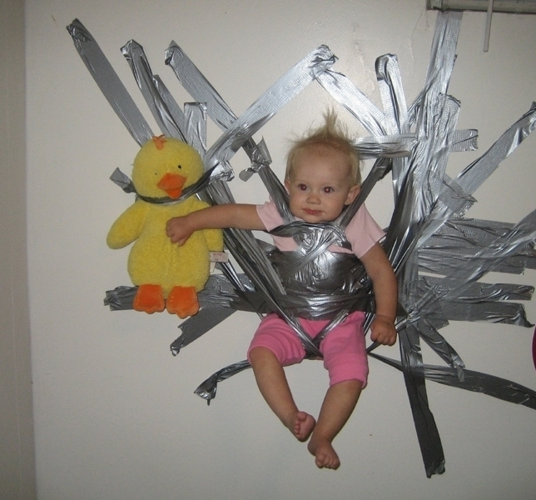
Strong Belief in Corporal Punishment
The problem with kids today is that parents give them too much freedom.

Slide 40
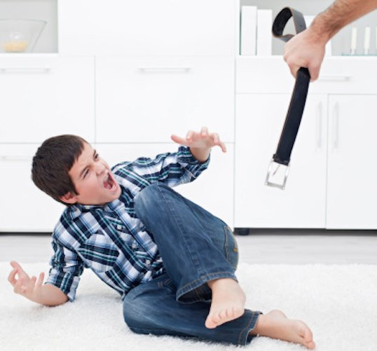
Strong Belief in Corporal Punishment
Children learn respect through strict discipline.

Slide 41
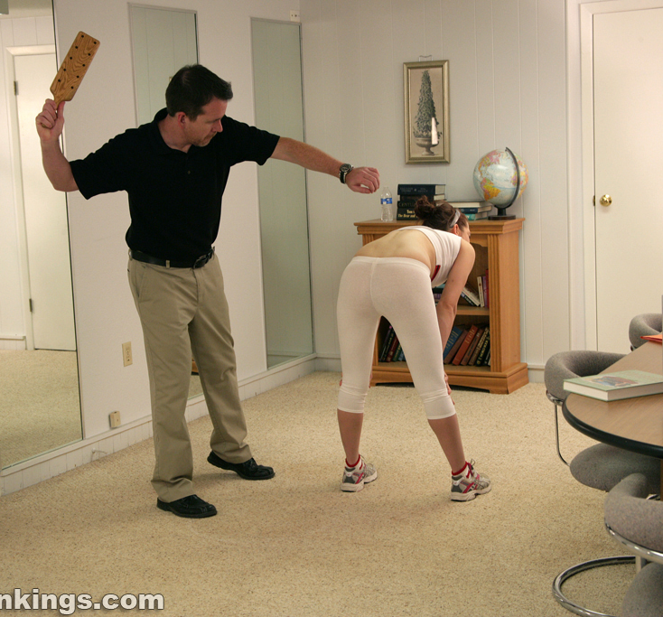
Strong Belief in Corporal Punishment
If you love your children, you will spank them when they misbehave.

Slide 42
Why Parents Hit their Children
Process:
Parents hit children to teach them right from wrong.
Parents hit children as a form of punishment.
Parents hit children based on religious writings.
Parents hit children as an “act of love.”
Parents hit children because it’s a cultural practice.
Parents hit children to prepare them for the real world.
P. 16

Slide 43
Common Effects of using Physical Punishment on Children:
Children identify with the act of spanking as an act caring.
Children hold repressed anger towards the one doing the hitting.
Children develop anxious and angry attachments.
Children use violence as a way of solving problems and replicate the CP as parent.
Children learn CP is normative and pass the act on to another generation.
                P. 16

Slide 44
Parent-Child Role Reversal
Construct D of the AAPI
Process:
Parent-child role reversal is an interchanging of traditional role behaviors between a parent and child.
Child adopts some of the behaviors traditionally associated with parents;
Common occurrence when parents lack the support of a partner;
Common among single parents;
Common parents who are very needy themselves.
P. 17

Slide 45

Parent/Child Role Reversal
In father’s absence, the son needs to become the man of the house.

Slide 46

Parent/Child Role Reversal
Parents should be able to confide in their children.

Slide 47
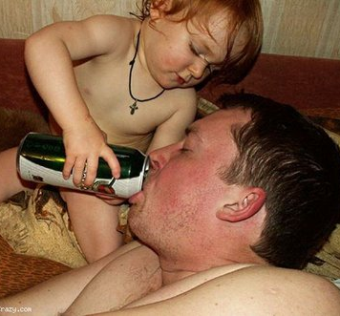
Parent/Child Role Reversal
Children should be the main source of comfort for their parents.

Slide 48
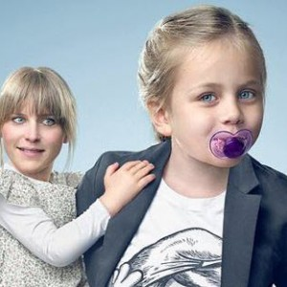
Parentified Child
What are the effects?

Slide 49
Common effects of role reversal on children:
Children fail to negotiate the developmental tasks of childhood.
Develop feelings of inadequacy.
Lag behind in social and emotional development.
Often view themselves as existing to meet the needs of others.
Develop a “role-based” identity.
Have a limited sense of self.
Have difficulty relating to children; play is acting foolish.
P. 17

Slide 50
Oppressing Power & Independence
Construct E of the AAPI
Process:
Children are not allowed to challenge, to voice opinions, or to have choices.
Children are told to “do what they are told to do” without question; “are better seen and not heard”; “are too smart for their own good”; “are too big for their britches.”
Children have little to no voice in family activities.
Are consistently told “no” without the obligatory “yes”
Fail to learn the art and science of negotiating, compromise;
Are told “don’t make waves; and do what the others are doing”
P. 17

Slide 51
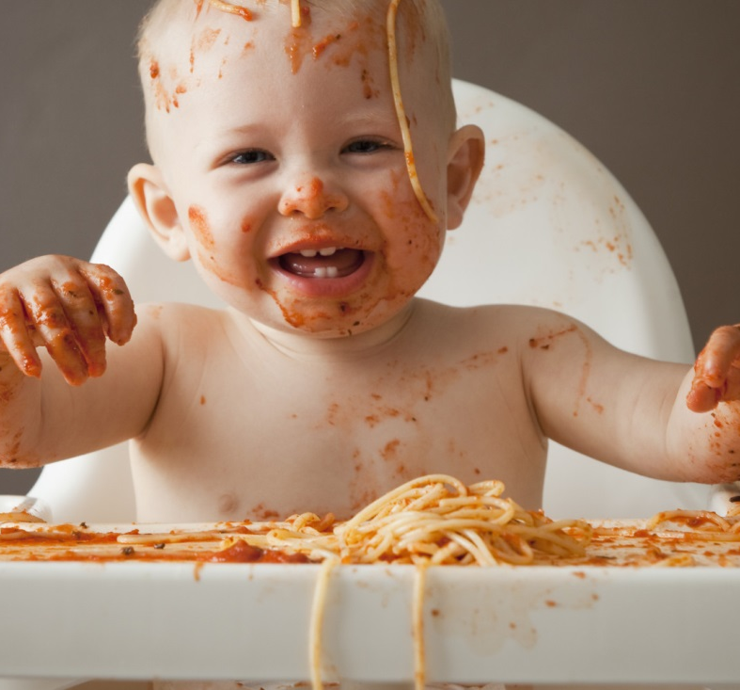
Oppressing Power and Independence
Two year old children make a terrible mess of everything.

Slide 52
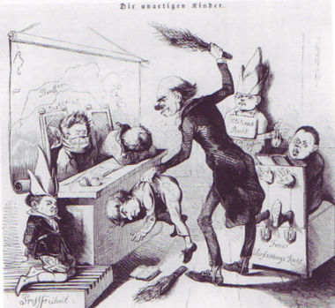
Oppressing Power and Independence
Strong willed children must be taught to mind their parents.

Slide 53
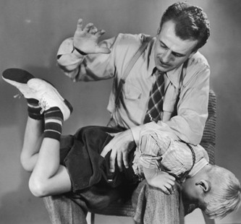
Oppressing Power and Independence
If a child is old enough to defy a parent, then he or she is old enough to be spanked.

Slide 54
Common effects of oppressing children’s power and independence
This demand for compliance to parental authority has many limitations:
Obedience breeds powerlessness.
Obedience breeds inadequacy.
Obedience also breeds rebelliousness.
Obedience breeds compliance — to all.
Obedience breeds followers, not leaders.
Are very vulnerable to peer group pressure.
P. 17

Slide 55
Build A Tower

Slide 56

What makes Nurturing Parenting tick?

Slide 57

Nurturing Parenting Programs are designed to involve the entire family.

Slide 58

Current research indicates family based programs provide the most robust results and have the greatest impact on changing family dynamics.

Slide 59
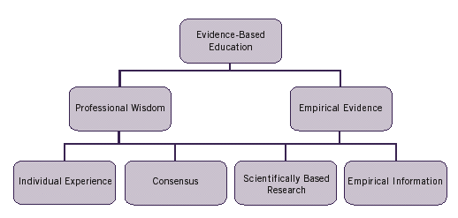
Nurturing Parenting Programs are proven, evidence-based programs recognized by the National Registry for Evidence-based Programs and Practices (NREPP).

Slide 60
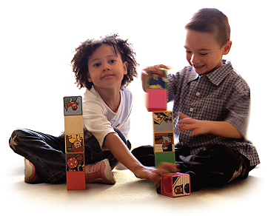
Skill-focused, competency-based programs designed to correspond to the developmental age level of children.

Slide 61
Principles of Nurturing Principles
Therapy
Therapeutic
A systematic procedure of empowering the client to examine how previous unconscious life experiences have shaped current behavior patterns.
Lessons, activities, information and role plays designed to stimulate self-discovery of the relationship between early childhood experiences and present day parenting beliefs and behaviors.
p. 22

Slide 62
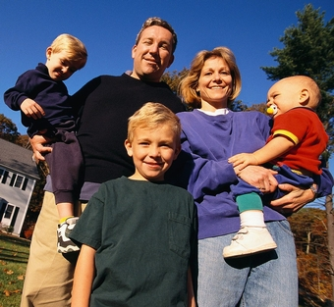
Nurturing Parenting embraces the theory of
“re-parenting.”
NP replaces old, destructive behavior and incorporates new knowledge, values and skills for daily life.

Slide 63

Nurturing Oneself

Slide 64


Nurturing oneself as a man or woman is an important practice in nurturing children and others.

Slide 65

In humans, there is an essential difference between our Being, which constitutes the core elements of our identity …

Slide 66

…and our Doing, which constitutes our behavior.

Slide 67
Principles of Nurturing Parenting
Behavior does not define a person, rather describes a person’s actions and state of consciousness at that moment.

Slide 68
Principles of Nurturing Parenting
There are three primary
categories of roles

Slide 69

Family

Slide 70

Work/Career

Slide 71
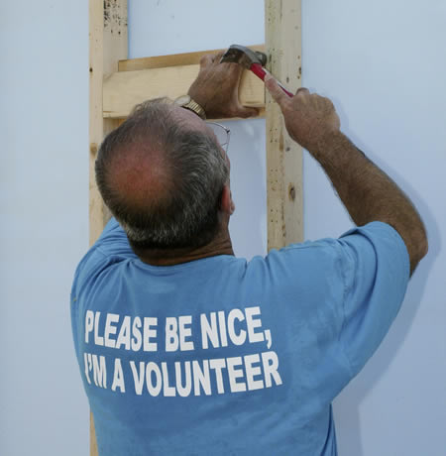
Community Service

Slide 72
Principles of Nurturing Parenting
How many of you
are parenting
right now?

Slide 73

Parenting is a role. A role is generally defined as a set of behaviors that are time and situation specific.

Slide 74
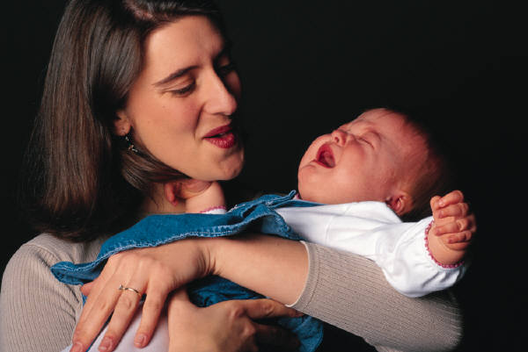
Principles of Nurturing Parenting
Women are “mothers” in the presence or acting on behalf of their “children”.

Slide 75
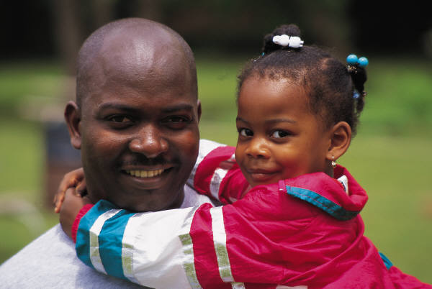
Principles of Nurturing Parenting
Same is true for men and their role as fathers.

Slide 76

A self-identity formed from role-identity places the burden of ones self-worth on others or on one’s performance.

Slide 77

Principles of Nurturing Parenting
When parenting is perceived as 24/7, 365 days/year, stress which usually leads to burnout, increases the feelings of parental resentment and risk of maltreatment to children.

Slide 78
Principles of Nurturing Parenting
When humans find value in nurturing themselves as men and women, they will perform at a more nurturing level in any role they choose.

Slide 79

Philosophy of Nurturing Parenting
So what is Nurturing Parenting?

Slide 80
Nurturing: The Energy of Life
The word nurturing comes from the Latin word
nu tri tura:
to Promote,
to Nurse,
to Nourish Life.
Nurturing is the single most critical PROCESS for creating and sustaining life.
P. 11

Slide 81


Philosophy of Nurturing Parenting
The energy of nurturing is both
positive and negative.

Slide 82
Nurturing Creates and Influences the Quality of Life
Positive Nurturing is nourishing the aspects of life we want.
Negative Nurturing is nourishing the aspects of life we don’t want, but get anyway.
P. 11

Slide 83
Positive Nurturing
Positive nurturing is called EMPATHY which
Comes from the Greek word
empatheia
Empathy is the most important characteristic
of a nurturing parent
P. 11

Slide 84
Empathy
The ability to imagine yourself in someone else’s position and to intuit what that person is feeling.
to project into or identify with another.
to enter fully through understanding another’s feelings or motives.
To stand in someone’s shoes, to see what they see, to hear what they hear, and to feel with your heart.
P. 11

Slide 85
Negative Nurturing
Negative nurturing is called
abuse and neglect.
The word abuse comes from the Latin word
abusus
to mistreat; cruel and harsh punishment.
P. 11

Slide 86
Negative Nurturing
Neglect comes from the Latin word
neg le gere
neg means “not” and
legere means “pick up.”
Neglectful parenting means not holding or
touching children
P. 11

Slide 87
Research on the effects of Positive and Negative Nurturing
Positive, healthy nurturing in childhood is related to subsequent healthy lifestyles
Negative, unhealthy nurturing in childhood is related to subsequent unhealthy lifestyles.
P. 11

Slide 88
Who’s in control?
Brain or Mind?

Slide 89
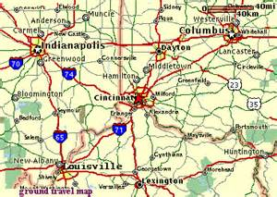
Neuroplasticity

Slide 90
Recent discoveries in brain functioning:
that brain cells carry an emotional memory in addition to a cognitive memory.
the more negative or positive images of your self, the more those thoughts become “normalized”
images form neural pathways, and become the story of that person.

Slide 91
For Pete’s Sake!
Who’s Pete?

Slide 92
Nurturing and Abuse/Neglect are two parenting patterns that exist on a continuum of frequency and intensity of zero to 10.
Nurturing Parenting
Frequency Always Frequent Sometimes Infrequent Never
Intensity Very High High Average Low Not Present
10 9 8 7 6 5 4 3 2 1 0
Abusive and Neglectful Parenting
Frequency Never Infrequent Sometimes Frequent Always
Intensity Not Present Low Average High Very High
0 1 2 3 4 5 6 7 8 9 10
p. 18

Slide 93
Impossible or Unbelievable?
Alice laughed, “There’s no use in trying,” she said. “One can’t believe in impossible things.”
“I daresay you haven’t had much practice,” said the queen. “When I was your age I always did it for half an hour a day. Why sometimes I’ve believed as many as six impossible things … before breakfast.”
- Lewis Carroll

Slide 94
Childhood Hours
The neurological networks and pathways that are created in childhood and influence behavior are the result of the frequency and intensity of the quality of life.
There are approximately
157,776 hours
in the first 18 years of life.
The following chart displays how personalities and behavior patterns are influenced early in life based on the quality of life in childhood portrayed in hours.
p. 18

Slide 95
Positive and Negative nurturing
Positive % Negative % Pos Hours Neg Hours
20% 80% 31,555 126,220
30% 70% 47,333 110,443
50% 50% 78,888 78,888
70% 30% 110,443 47,333
80% 20% 126,221 31,555
90% 10% 141,998 15,778
95% 5% 149,887 7,889
99% 1% 156,198 1,578
100% 0% 157,776 0 p.18

Slide 96
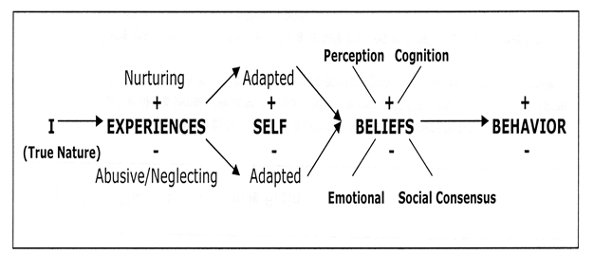
Understanding our Self
P. 19

Slide 97
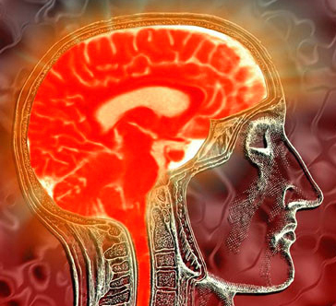
Philosophy of Nurturing Parenting
Abusive and neglecting parenting practices create diseased networks of anger, stress, etc.
p. 11-12

Slide 98
Negative Nurturing Experiences
Stress caused by negative nurturing experiences produce stress hormones cortisol and adrenaline
Brain is normalizing dysfunction
Diseased neurological networks and pathways are developed

Slide 99
Monkey see
Monkey Do
https://www.youtube.com/watch?v=6doYhDD8kqs

Slide 100
Children see children do
https://www.youtube.com/watch?v=KHi2dxSf9hw

Slide 101
The Two Wolves
Native American Wisdom
Family Development Resources, Inc.
Publishers of the Nurturing Parenting Programs®
Visit our Website at www.nurturingparenting.com

Slide 102
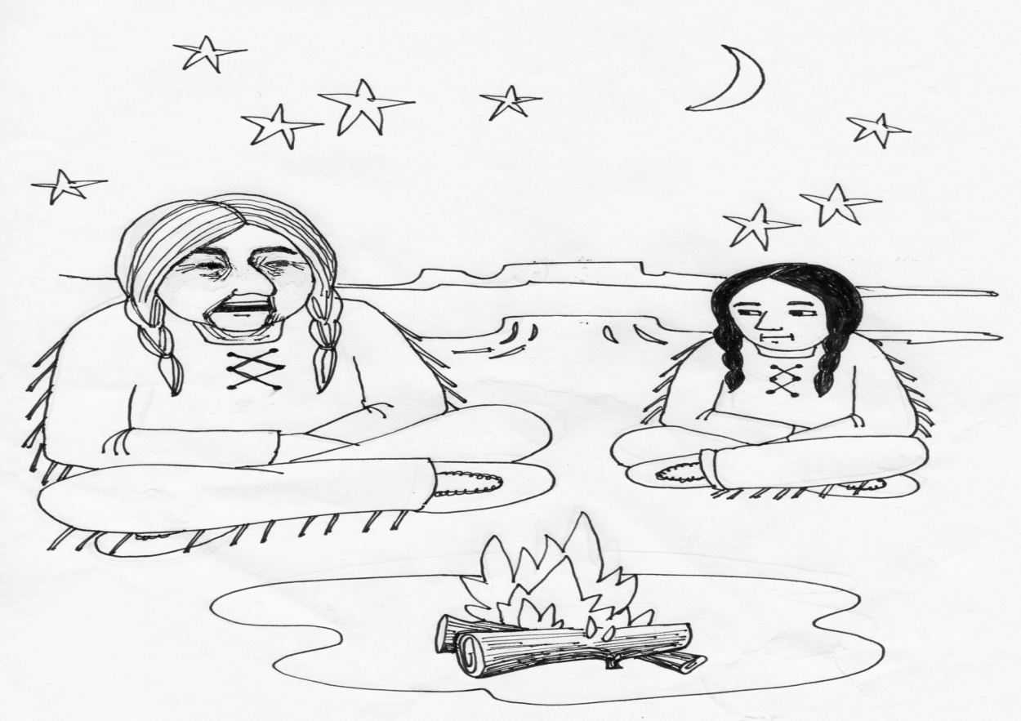
An elder Cherokee Native American was teaching his grandchild about life. He said to his grandchild …

Slide 103
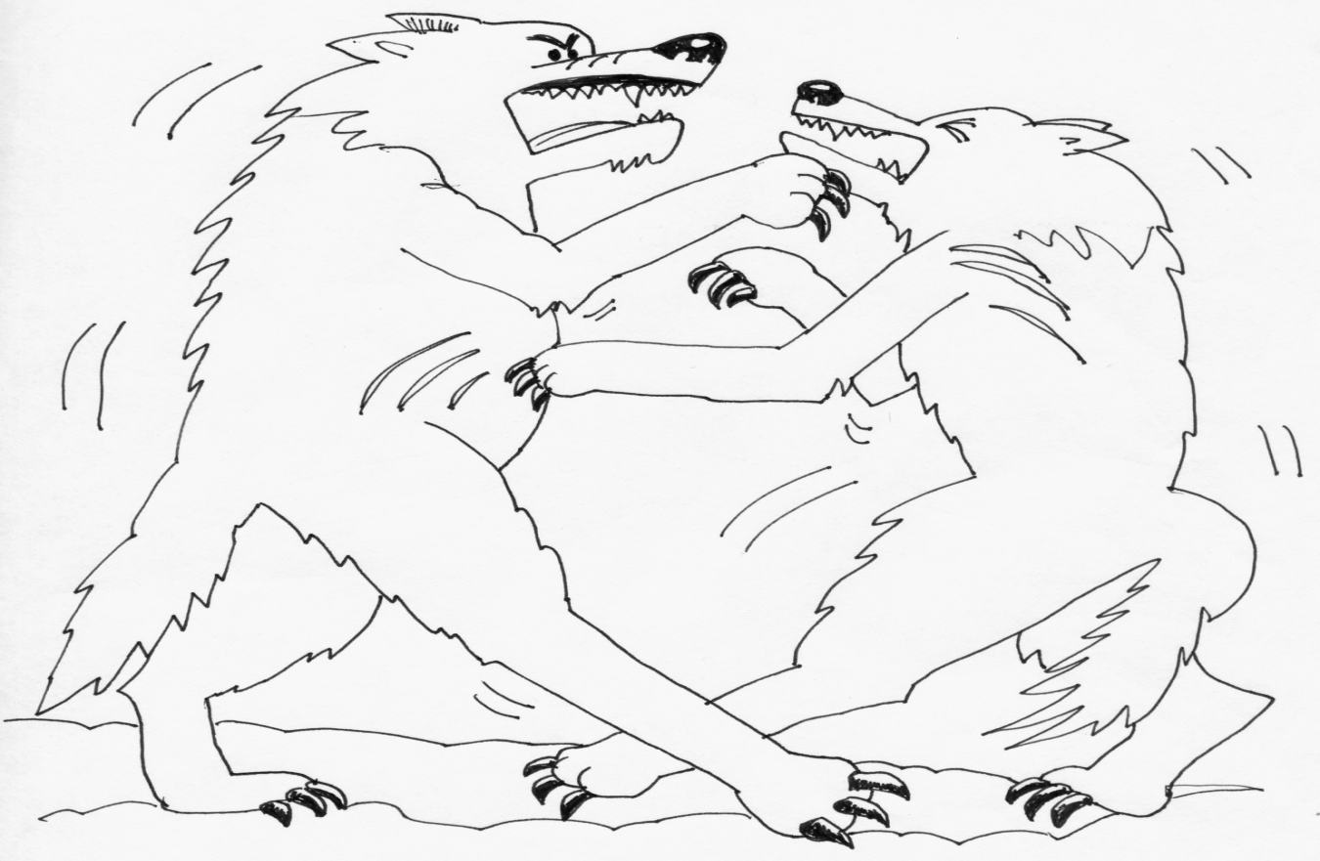
“A fight is going on inside of me … and it is a terrible fight and it is between two wolves.

Slide 104
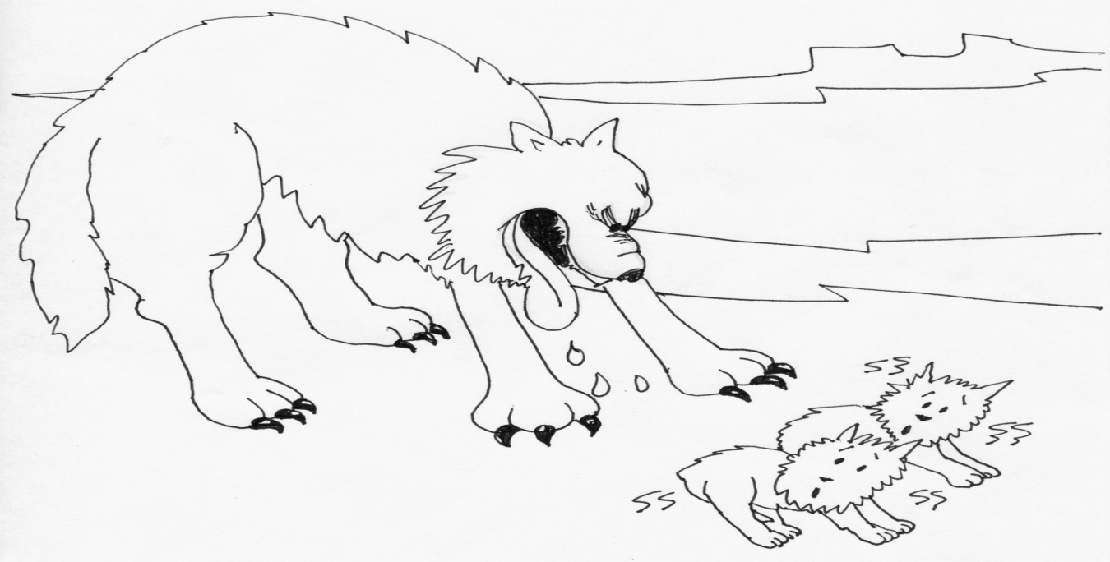
One wolf represents fear, anger, envy, sorrow, regret, greed, arrogance, self-pity, guilt, resentment, inferiority, lies, false pride, superiority and ego.

Slide 105
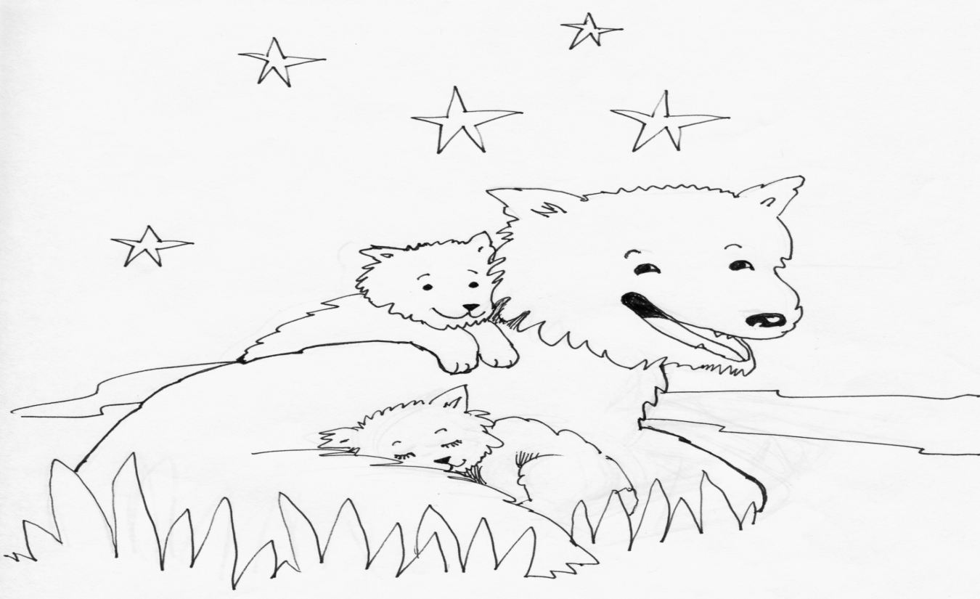
The other wolf stands for honor, joy, peace, love, hope, sharing, serenity, humility, kindness, benevolence, friendship, empathy, generosity, truth, compassion, and faith.

Slide 106
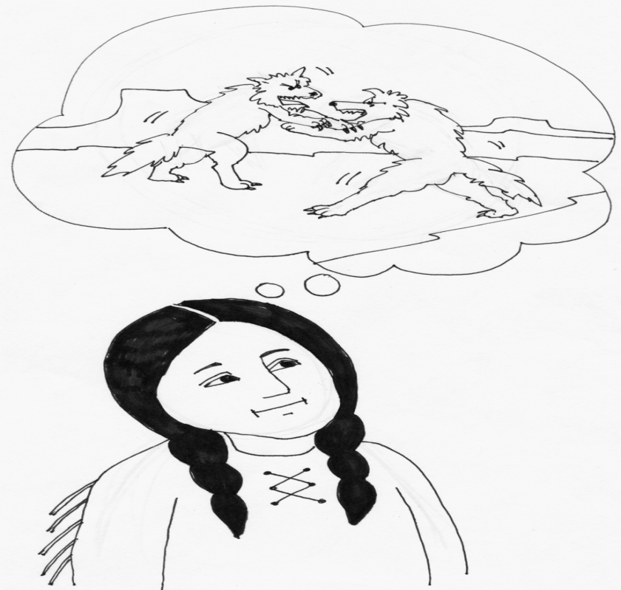
The same fight is going on inside of you and inside of every other human being too.”

Slide 107
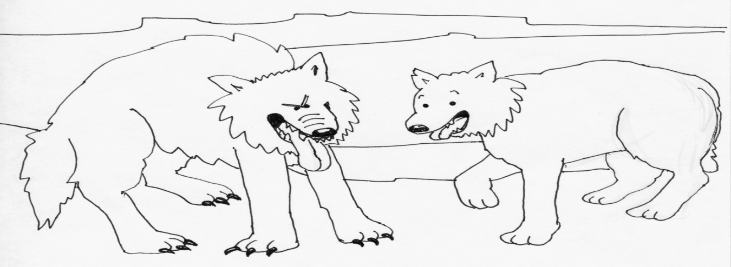
After thinking about it for a minute or two, the grandchild asked her grandfather, “Which wolf will win”?

Slide 108
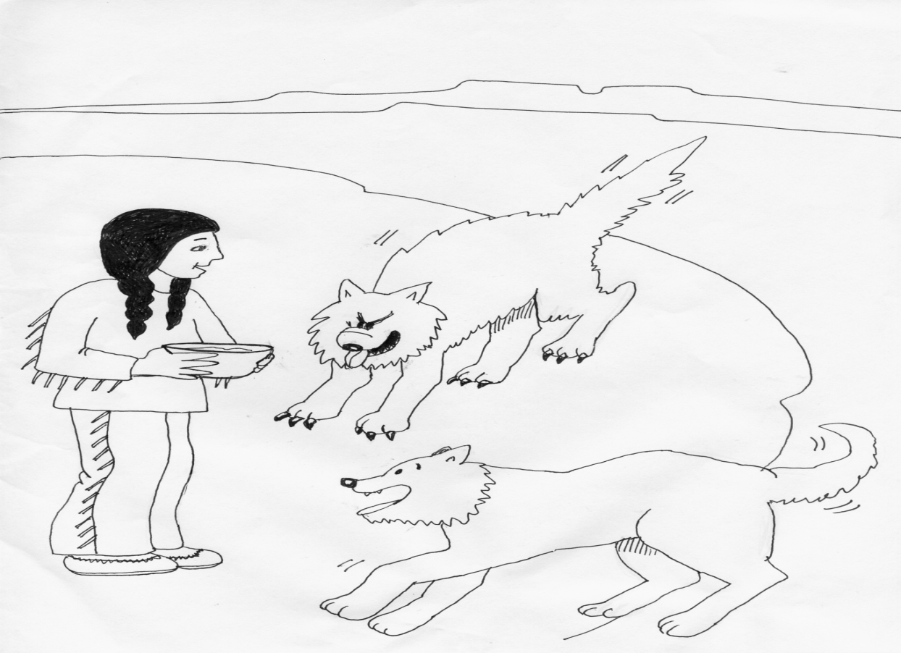
The old man leaned toward his grandchild and whispered …
“The one you feed.”

Slide 109
The Story of Me
1. The more negative or positive images of your self that are thought, the more those thoughts become “normalized”.
2. The more you experience positive or negative nurturing experiences, the more the brain normalizes repeated behavior.
3. Images and experiences form neural pathways, and become the story of that person.
P. 20

Slide 110
Welcome to Day 2
Nurturing as a Lifestyle

Slide 111
Secure
Attachment
The Parent I Choose To Be.

Slide 112
Rate Your Nurturing Skills

Slide 113
Behaviors in children that drive parents crazy

Slide 114
Discipline
Morals, Values, Rules and
Consequences

Slide 115
Four Personality Poster

Slide 116
Personality Traits
Caring for Someone
Receiving Care
Hurting Someone
Being Hurt

Slide 117
Personality Traits
Hurting Someone
Caring for Someone
What do you notice?
How do you feel looking at this trait?
List the times your Bully comes out?
Notice any patterns?
What do you notice?
How do you feel looking at this trait?
List the times your Bully comes out?
Notice any patterns?
Compare both personalities
Do the same with Victim and Nurtured

Slide 118
Positive Personality Traits
Nurturer
The part of our personality that:
Is capable of giving care, empathy and compassion
Takes care of one’s self as well as the selves of others
Builds strong attachments with children, family, friends and pets
P. 20

Slide 119
Positive Personality Traits
Nurtured
The part of our personality that is capable of:
receiving care
seeking closeness
accepting attachments
accepts praise and positive touch.
P. 20

Slide 120
Negative Personality Traits
Perpetrator-Bully
The part of our personality that is abusive, hurts
others:
  physically
  emotionally
  spiritually
  sexually
Generally disregards the overall goodness of other
living creatures.
P. 20

Slide 121
Negative Personality Traits
Victim
The part of our personality that believes:
hurt and pain given by others is justified and valid
hurt received from others is for their own good
people who love you can hurt you
victims are taught to feel grateful for their
victimization
P. 21

Slide 122
Commitment to 10-Zero
Make time to take care for your self.
Know the difference between “being” and “doing”
Know the difference between your “self” and your “roles”
Stay in control of your thoughts and feelings: the Pinocchio Effect
Respect your kids and they will respect you.

Slide 123
Taking Care of My Self
Self Concept: What do I think about my self?
Self Esteem: How do I feel about my self?
Self Worth: Do I value my self?
“I should take care of my self!”

Slide 124
Exposure to Child Abuse
DVD

Slide 125
Life Experiences Causing
Physical Changes to the Brain
Marble Exercise

Slide 126
Successful Implementation Criteria
P. 46

Slide 127
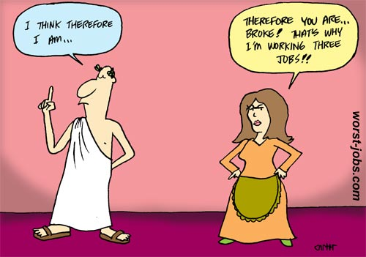
Philosopher
Knowing my parenting beliefs and practices
Pg. 47

Slide 128
Nurturing Program
Facilitator is a Philosopher
Philosophy is a well thought out set of beliefs allows individuals to make conscious, congruent choices.
Parenting entails a set of unconscious beliefs and practices that have been past down and recycled to another generation of children without understanding or challenge.
The best parents make conscious, informed choices in raising their children.
P. 46

Slide 129
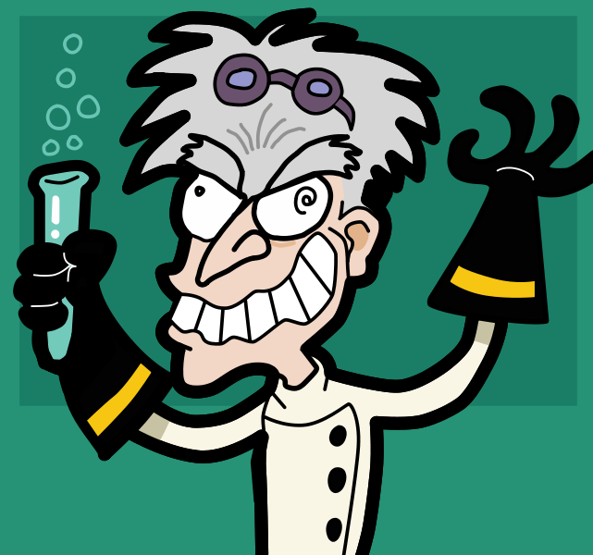
Scientist
Understanding the differences between personal truths, beliefs, opinions, and facts.
P. 47

Slide 130
Facilitator is a Scientist
Nurturing embraces the power of science and research in the prevention and treatment of child abuse and neglect.
Understanding the ACE Study and the ramifications of Child Abuse and Neglect on long term health

Slide 131
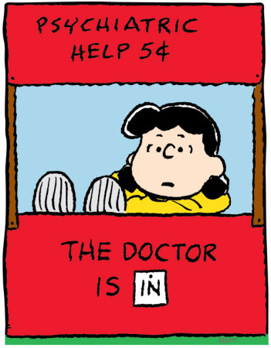
Clinician
Having insight into the origins and value of my parenting beliefs.
p. 47

Slide 132
Clinician: Having insight into the origins and value of my parenting beliefs.
Understanding the motivations and reinforcements of behavior.
Aware of the impact the quality of childhood has on the life styles and parenting styles of adults.
Understanding how the brain normalizes repeated experiences and develops neurological pathways.
Understanding and accepting one’s own personal history and influence as a facilitator.

Slide 133
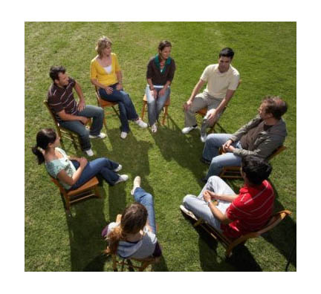
Practitioner
Do I practice and teach healthy, proven parenting strategies and techniques?
Facilitator is a Practitioner

Slide 134
Facilitator as a practitioner
Skills in facilitating groups.
Skill in working with children and teens in groups or one to one.
Creating a comfortable, positive learning environment.
Understanding difference between primary, secondary and tertiary prevention levels.

Slide 135
Nurturing vs.
Abusive World

Slide 136
The quality of life experiences we have shape our perceptions about ourselves which are often referred to as our …
Self Concept
Thoughts we have of our self.
Self Esteem
Feelings we have about our self.
Self Worth
The overall value we have for our self.

Slide 137
Labels
When I think of myself, two words come to mind are ________ and _________.

Slide 138
Brainstorm the following:
Self-Esteem
Self-Concept

Slide 139
Self-Worth
An overall self worth is developed by the way we are treated by others during the process of growing up.
Analogy: quality of building

Slide 140
Self-Worth Activity
Positive Life Experiences
Negative Life Experiences

Slide 141
Diagram of Self -Worth
Experiences develop + or – self concept and self esteem
+ or – self concept and self esteem is reflected in the child’s + or – behavior.
There’s a reason behind all behavior.
The same holds true for negative feelings.
Children learn to be nurturing and caring by being treated as such.
Children learn to be mean and uncaring by being treated in the same manner.

Slide 142
Labels
Were your words positive or negative?

Slide 143
Survivor

Slide 144
Labels for Self and Others
Labels are a type of “unspoken” communication. The way we perceive a person or the way we think about a person will determine our type or style of communication.

Slide 145
Decoding Problem Behavior
Obnoxious
Rude, arrogant
Lazy, un-invested
Manipulative
Just looking for attention
Closed-mouthed
Different, odd
Stubborn and defiant
Tantrum, fit, outburst

Slide 146
Positive, Hope-Based Reframe
Obnoxious ---Good at pushing people away
Rude, arrogant---Good at affecting people
Resistant---Cautious
Lazy, un-invested---Good at preventing further hurts, failures
Manipulative---Good at getting needs met
Just looking for attention---Good at caring about and loving yourself
Closed-mouthed---Loyal to family or friends
Different, odd---under-appreciated
Stubborn and defiant---Good at standing up for yourself
Tantrum, fit, outburst---Big message

Slide 147
Negative Labels
List examples of negative labels given to children/youth

Slide 148
Small Group Activity
Changing negative labels to positive labels.

Slide 149
Negative Labels
Understanding the message
Reframing message

Slide 150
Small Group Activity
List 10 ways to improve a child’s self-worth.

Slide 151
Praising Children and Ourselves
Match the praise with the correct praising technique:
        Praise for Being
        Praise for Doing

Slide 152
Praise for Being and Doing
Form pairs
Identify Person A
Identify Person B
Person B will praise Person A for one minute
Person A will only “ thank you”
Change roles
Process
Importance of praising children

Slide 153
Self-Praise
Praise Plates Activity

Slide 154
Empathy
Understanding Needs and Behavior

Slide 155
NEEDS
Spices of Life

Slide 156
Needs drive behavior
Everything we do gets a “payoff”
Break into small groups to complete needs activity.

Slide 157
Welcome to Day 3
Nurturing as a Lifestyle

Slide 158
Morals and Values of nurturing parenting programs
Preventing and Treating Child Abuse and Neglect in parenting practices

Slide 159
Appropriate Expectations
Value One:
Information and Techniques for Building Positive Self-Worth in Parents and Children
Construct A: Appropriate Developmental Expectations;
Appropriate Expectations
Developmental Stages and Self-Worth
P. 28

Slide 160
Appropriate Expectations
Children’s Brain Development
How Children’s Brains Develop
Teen’s Brain Development
Difference between Male and Female Brains
Ten Ways to Improve Self-Worth
Praise for Being and Doing
Special Motivations
Labels for Self and Others
Positive Self-Talk and Affirmations
Self-Expression
P. 28

Slide 161
Empathy
Value Two:
Techniques and Strategies for Developing a Sense of Caring and Compassion
Construct B: Empathy:
Defining Empathy
Attunement
Bonding and Attachment
Needs and Behavior
Spoiling Children
P. 28

Slide 162
Empathy
Establishing Nurturing Routines
Personal Touch History
Body Map
Recognizing, Understanding and Communicating Feelings
Typical Feelings of Discomfort
Recognizing and Handling Anger
Recognizing and Handling Stress
Strategies to Reduce Children’s Stress
P. 28

Slide 163
Dignified Discipline
Value Three:
Techniques and Strategies for Providing Children and Teens with Dignified Discipline
Construct C: Alternatives to Corporal Punishment:
Discipline, Punishments and Rewards
Managing, modifying and encouraging behavior
Danger proof the house
P. 28

Slide 164
Dignified Discipline
Establish Clear Family Rules
Choices and Consequences
Verbal and Physical Redirection
Ignoring
Negotiation and Compromise
Praise for Being and Doing
Nurturing Touch
Privileges as Rewards
Objects as Rewards
Allowance as a Positive Consequence
P. 28

Slide 165
Dignified Discipline
Loss of Privilege
Being Grounded
Parental Disappointment
Restitution
Time Out
Reasons Why Parents Hit Children
P. 28

Slide 166
Self-Awareness & Family Roles
Value Four:
Techniques and Strategies for Increasing Self-Awareness and Proper Family Roles
Construct D: Appropriate Family Roles
Anger, Alcohol and Abuse
Families and Alcohol
Violent and Possessive Relationships
P. 28

Slide 167
Self Awareness & Family Roles
Self Expression
Draw Yourself
Draw your Family
Draw Your Parents
Draw Your Children
Examining My Touch History
My Cultural Parenting Traditions
Spirituality
Dating, Love and Rejection
P. 28

Slide 168
Empowerment
Value Five
Techniques and Strategies for Developing a Healthy Sense of Empowerment
Construct E: Autonomy and Independence
Personal Power and Control
Understanding Power Struggles
Empowerment and the Strong Willed Child
Obedience, Responsibility and Cooperation
P. 28-29

Slide 169
Empowerment
Activities to Empower Children:
  Giving Children Choices
  Choices and Consequences
  Transition Time
  Bed Time Power Stories
  Situational Stories
  Body Part Awareness
  Scary Touch
  Saying No
  Owning Your Body and Personal Space
  P. 28-29

Slide 170
Empowerment
Taking Responsibility
No Blaming Messages
Criticism
Confrontation
Brainstorming
Problem Solving
Decision Making
Negotiating and Compromising
Positive, Negative and Neutral Styles of Communication
P. 28-29

Slide 171
Empowerment
Smoking and the Dangers of Second Hand Smoke
Date Rape Drugs
P. 28-29

Slide 172
Humor and Laughter
Value Six: Humor, Laughter and Fun
All Nurturing Parenting Constructs
Talking Objects
Reverse Psychology
Role Play
Art, Music and Sports
And other fun family activities
P. 29

Slide 173
Assessment and outcome measures
Adult Adolescent Parenting Inventory 2.1 (AAPI-2.1)
Nurturing Skills Competency Scale 3.0 (NSCS 3.0)

Slide 174
SPANKING IN OUR SOCIETY

Slide 175
Personal Power
One area of my life I have power is ________________.
One are of my life I would like more power is _____________.

Slide 176
Small Group Activity
Brainstorm how you feel when you have power and how you feel when you don’t have power.

Slide 177
Small Group Activity
Brainstorm areas in which children have power and areas in which they don’t have power.

Slide 178
Do children feel differently than adults?
What “power” have abused and neglected children lost?

Slide 179
Recognizing, Understanding and Communicating Feelings
nfp

Slide 180
Recognizing and Handling Stress

Slide 181
Morals and Values of Nurturing
Value One: Developing a Positive Self-Worth
Construct A: Appropriate Expectations
Value Two: Developing a Sense of Caring and Compassion
Construct B: Building Empathy in Children and Parents
Value Three: Providing Children with Dignified Discipline
Construct C: Alternatives to Physical Punishment
P. 28

Slide 182
Morals and Values of Nurturing
Value Four: Increasing Self-Awareness and Acceptance of Family Roles
Construct D: Appropriate Family Roles
Value Five: Developing a Healthy Sense of Empowerment
Construct E: Empowering Power and Independence in Children and Adults
Value Six: Humor, Laughter and Fun
All Nurturing Parenting Constructs
P. 28

