Slide 1
Children’s Alliance Quality Measures 2023
©2022 Aetna Inc.
August 2022

Slide 2
Value Based Programs
Reward health care providers with incentive payments for the quality of care provided. ₁
Focused on the quality of the service that was provided.
Essential part of value-based programs is quality measurement.
An example of a quality measure is a follow-up appointment within 7 days of a behavioral health hospitalization
Benefits of Value Based Programs
Patient centered care
Focus moves from quantity of care to quality of care
Improves health outcomes

Slide 3
Agenda
Review proposed HEDIS Measures for 2023
Review proposed Custom Measures
Review proposed SKY specific Measures
Review Children’s Alliance Baseline data for proposed measures
Roundtable
Schedule follow up meeting to finalize agreed measures

Slide 4
Proposed HEDIS Measures for 2023 with Baseline Data

Slide 5
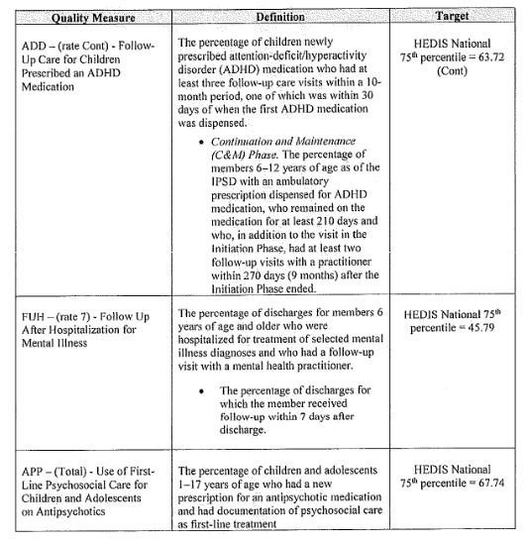
Current 2022 HEDIS Measures in Contract:
Notes:
Initial Barrier to Current 2022 Measures: Methodology behind attribution and timeframes with APP & ADD
Logic for use of FUH, FUM, and APM – still need to tweak attribution, but anticipate that these will be more streamlined to manage and receive supplemental data.
Process that has been put in place this month – JP to explain re: addressing attribution

Slide 6
Proposed Measures for 2023-HEDIS
Quality Measures | Definition | Denominator | Numerator | Target/Goal - TBD
HEDIS FUH-Follow-Up After Hospitalization for Mental Illness | Percentage of adults and children 6 years of age or older with a diagnosis of a mental illness or intentional self-harm that resulted in an inpatient stay who had a follow-up visit within 7 days post discharge. Follow-up appointment does not include any appointment on the day of discharge. Measurement year is Jan 1 to Dec 1. Follow-up appointment cannot be the same day as the hospital discharge. | Total members who had an inpatient visit | Members who had a follow-up appointment within 7 days after the inpatient discharge | Increase by percentage the amount of follow-up appointments after an inpatient discharge
HEDIS APM-Metabolic Monitoring for Children and Adolescents on Antipsychotics | The percentage of children and adolescents 1–17 years of age who had two or more antipsychotic medication dispensed within the measurement year and had both Cholesterol and Glucose metabolic testing; at least one test for blood glucose and one test for LDL-C. | Members who are on two or more antipsychotic mediation | Members who had both cholesterol and glucose testing | Increase by percentage the frequency of cholesterol and glucose testing within a measurement year.
HEDIS FUM-Follow-Up After Emergency Department Visit for Mental Illness * No supplemental data can be accepted for FUM measure per NCQA requirements. Claims data only. | Percentage of adults and children 6 years of age and older with a diagnosis of mental illness or intentional self-harm and emergency department (ED) visits who received a follow-up visit 7 days post ED discharge . The follow-up appointment can be the same day as the ED discharge (8 days total). Excludes the ED visits that result in an inpatient admission. Measurement year is Jan 1-Dec | Total members who had an ED visit | Members who had a follow-up appointment within 7 days after the ED discharge | Increase by percentage the amount of follow-up appointments after an ED stay
Notes:
Initial Barrier to Current 2022 Measures: Methodology behind attribution and timeframes with APP & ADD
Logic for use of FUH, FUM, and APM – still need to tweak attribution, but anticipate that these will be more streamlined to manage and receive supplemental data.

Slide 7
Proposed Custom Measures for 2023 with Baseline Data
©2022 Aetna Inc.

Slide 8
Proposed Measures for 2023-Custom
Quality Measures | Definition | Denominator | Numerator | Target/Goal - TBD
Utilization of Inpatient Behavioral Health Services while receiving Targeted Case Management | The percentage of members receiving targeted case management that also had an inpatient behavioral health admission within the reporting period. (TCM/IP) | Total members receiving Targeted Case Management | Members who had an inpatient behavioral health admission while receiving Targeted Case Management | Reduce number of admissions by frequency
Emergency Department Visit for Behavioral Health while receiving outpatient | The percentage of total members who had an emergency room visit for behavioral health with a primary diagnosis related to mental illness or intentional self-harm, while receiving outpatient services | Total members receiving outpatient services | Members who had an Emergency Department visit while receiving outpatient services | Decrease the percent of emergency department by frequency
Notes:
Time frame: rolling 12 month time frame, claims based
OR quarterly report (report Q1 at end of Q2)
Mechanism of reporting –
Payment –

Slide 9
Proposed Measures for 2023-Custom SKY Specific Population Attributed to CA Only
Quality Measures | Definition | Denominator (SKY members only) | Numerator | Target/Goal - TBD
High Level Psychotropic Polypharmacy (HLPP) | Annual percentage (based on monthly average) of total members, 1-17 years of age, who meet criteria for high level psychotropic polypharmacy as defined as the concurrent use of at least four classes of psychotropic medication for at least 30 days during the calendar year | Number of unique members seen by Children’s Alliance | Members on four or more classes of psychotropic medications | Reduce by ___ percent of members who meet criteria for High Level Psychotropic Polypharmacy, compared to baseline

Slide 10
Children’s Alliance Baselines
MEASURE | NUMERATOR | DENOMINATOR | CHILDREN'S ALLIANCE BASELINE
The percentage of members receiving targeted case management that also had an inpatient behavioral health admission within the reporting period. (TCM/IP) | 153 | 1295 | 11.81%
The percentage of total members who had an emergency room visit for behavioral health with a primary diagnosis related to mental illness or intentional self-harm, while receiving outpatient services (ED/OP) | 791 | 9104 | 8.68%
MEASURE – SKY Population Specific | NUMERATOR | DENOMINATOR | CHILDREN'S ALLIANCE BASELINE
Annual percentage (based on monthly average) of total members, 1-17 years of age, who meet criteria for high level psychotropic polypharmacy as defined as the concurrent use of at least four classes of psychotropic medication for at least 30 days during the calendar year | 225 | 985 | 22.84%
Time Frame: 1/1/2021-3/31/2022 Claim based data
Notes:
1/1/2021-3/31/2022 Claim based data
Unique members
Ther percentage of members receiving targeted case management that also had an inpatient behavioral health admission within the reporting period.

Slide 11
Baseline Data 1/1/2021 – 3/31/2002
Utilization of Inpatient Behavioral Health Services while receiving Targeted Case Management (TCM/IP)

Slide 13
Baseline Data 1/1/2021 – 3/31/2002 High Level Psychotropic Polypharmacy (HLPP)

Slide 14
Final Measures
©2022 Aetna Inc.

Slide 15
Next Steps – Confirm Final Measures
Quality Measures | Definition
HEDIS FUH-Follow-Up After Hospitalization for Mental Illness | Percentage of adults and children 6 years of age or older with a diagnosis of a mental illness or intentional self-harm that resulted in an inpatient stay who had a follow-up visit within 7 days post discharge. Follow-up appointment does not include any appointment on the day of discharge. Measurement year is Jan 1 to Dec 1. Follow-up appointment cannot be the same day as the hospital discharge.
HEDIS APM-Metabolic Monitoring for Children and Adolescents on Antipsychotics | The percentage of children and adolescents 1–17 years of age who had two or more antipsychotic medication dispensed within the measurement year and had both Cholesterol and Glucose metabolic testing; at least one test for blood glucose and one test for LDL-C.
Utilization of Inpatient Behavioral Health Services while receiving Targeted Case Management | The percentage of members receiving targeted case management that also had an inpatient behavioral health admission within the reporting period. (TCM/IP)
Emergency Department Visit for Behavioral Health while receiving outpatient | The percentage of total members who had an emergency room visit for behavioral health with a primary diagnosis related to mental illness or intentional self-harm, while receiving outpatient services
High Level Psychotropic Polypharmacy (HLPP) | Annual percentage (based on monthly average) of total members, 1-17 years of age, who meet criteria for high level psychotropic polypharmacy as defined as the concurrent use of at least four classes of psychotropic medication for at least 30 days during the calendar year
Notes:
Here are 3 custom measures with the two HEDIS measures that we are suggesting that we include.

Slide 16
Thank you for your collaboration!

